Slide 1
Introduction to the VICH Outreach Forum
Steven D. Vaughn, DVM
VICH Workshop
Dar Es Salaam, Tanzania – June 24, 2015

Slide 2


VICH Outreach Forum
Purpose, membership, processes
Criteria for membership
Recognition for a wider harmonization
Expectations from Outreach members

Slide 3
VICH Outreach Forum
The VICH Outreach Forum is a VICH initiative with the main objectives of:
providing a basis for wider international harmonization of technical requirements,
improving information exchange and
raising awareness of VICH and VICH guidelines with non-VICH countries/regions.

Slide 4
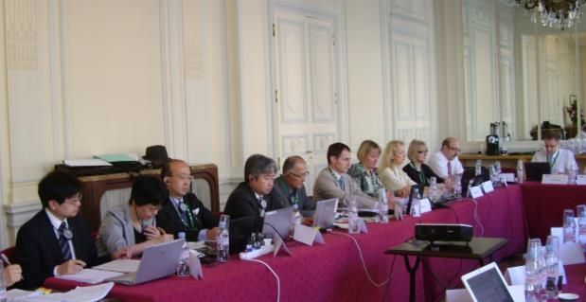
VICH Outreach Forum
The over-reaching aim is to avoid the duplication of tests and encourage a minimum standard of product ‘quality’ (includes quality, safety and efficacy),
while also promoting the good governance of veterinary medicinal products worldwide.

Slide 5


VICH Outreach Forum
The Outreach Forum is composed of countries and regional organizations that have expressed an interest in the work of VICH and are motivated to participate in the activities of the VICH Outreach Forum.
Currently approximately 14 countries and 4 regional organizations are participating (or have been invited).
  Argentina (SENASA, CAPROVE)
  ASEAN
  Brazil
  CAMEVET
  China
  India
  Korea
  Malaysia
  Mexico
  Morocco
  Russia
  SINDAN
  Taipei
  Taiwan
  Thailand
  UEMOA
  Ukraine

Slide 6

VICH Outreach Forum (VOF)
Chaired by VICH/OIE for;
  Wider international harmonisation
  Raising awareness of VICH
  Good governance of VMPs worldwide
Matters to be addressed;
  How to participate in VICH work
  Practical issues for accepting and using VICH guidelines
  Sharing of translations of guidelines
  Collating comments from the initial stage of guideline creation, etc….

Slide 7

All the members can participate!
OIE members can send comments to draft guidelines during the public consultation
Encouraged to use VICH guidelines as national or regional guidelines
Free of charge
If you wish to go one step forward
  Deeper understanding of VICH-GLs
  Learning how to implement and use VICH-GLs
  Proposing new topics of interest
  Involved in drafting GLs as an EWG member
VOF may be your choice

Slide 8
How to be a VICH Outreach Forum member
The criteria for participation in VOF:
Regulation for marketing authorization in place
Willingness to work towards accepting VICH guidelines
Regular participation to VOF meetings (every 9 months)
Paying for participation (travel costs, accommodation)
Interested in participating in VOF activity?
  Write to the VICH secretariat: sec@vichsec.org
  for more information

Slide 9
VICH Outreach Forum (VOF)
The VOF will meet in the margins of VICH Steering Committee meetings (approximately every 9 months) in one of the VICH member countries/regions. Matters addressed at the VOF will be:
  Information exchange on how to participate in VICH work, such as proposing topics and commenting on concept papers and draft guidelines.
  Discussing feedback to VICH concept papers and draft guidelines
  Providing feedback on implementation and acceptance of existing guidelines
  Discussing practical issues related to VICH guidelines arising in the participants’ countries/regions and providing feedback to the Forum.
  Collaborating and sharing of translations of guidelines.
(Concept papers and draft guidelines for consultation will continue to be distributed to non-VICH countries and regions through OIE and the VICH website.)

Slide 10


The VICH public website
10
Notes:
10

