Slide 1
How Can I Get More Information on VICH?
Bettye Walters, DVM US Food and Drug Administration Center for Veterinary Medicine
VICH Workshop: Dar Es Salaam, Tanzania – 24 June 2015

Slide 2
What will I find on the VICH website?
“the reference point for all past/current activities”
7 Major Headings
HOME
STRUCTURE
PROCESS
GUIDELINES
CONSULTATIONS
ACTIVITIES
MEMBERS AREA

Slide 3
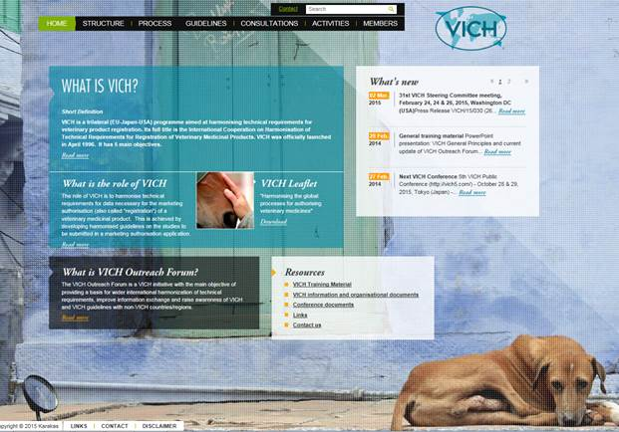
HOME

Slide 4
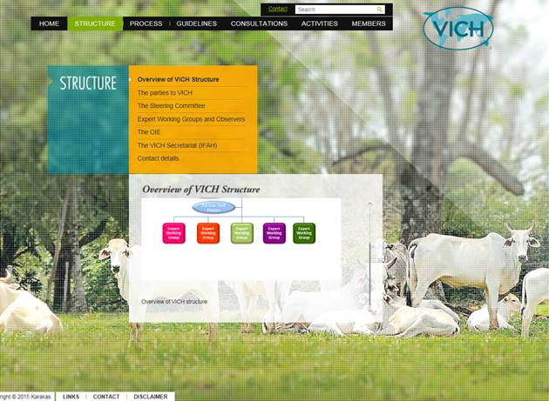
STRUCTURE

Slide 5
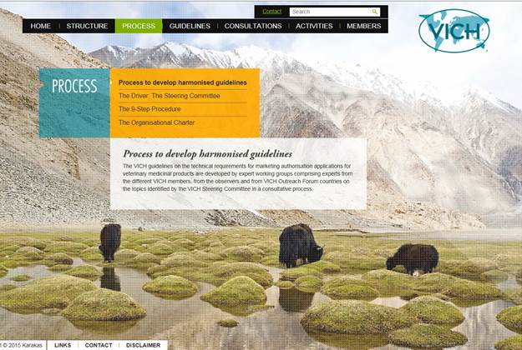
PROCESS

Slide 6
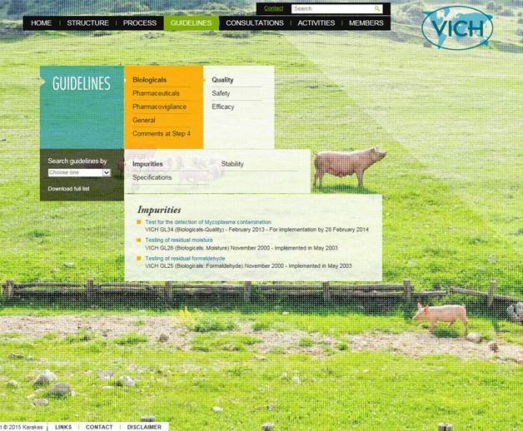
GUIDELINES

Slide 7
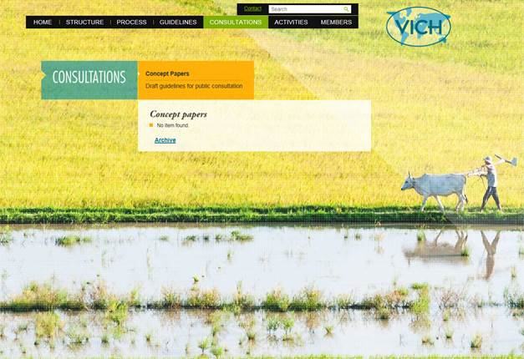
CONSULTATIONS

Slide 8
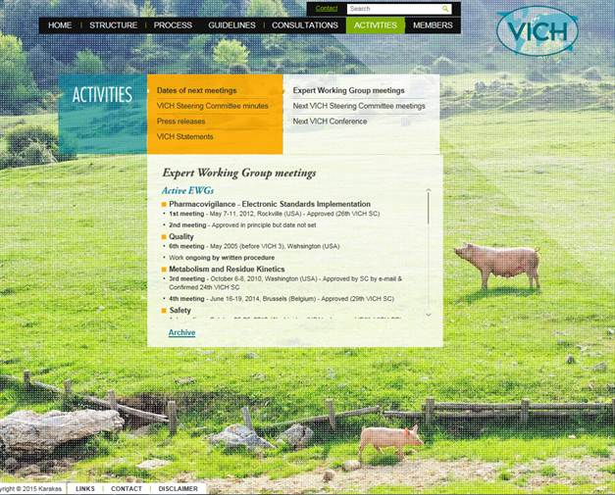
ACTIVITIES

Slide 9
5th VICH Public Conference
October 27 – 29, 2015 Tokyo

Slide 10
5th VICH Public Conference, Tokyo
Contribution of VICH to One Health
Benefits of VICH to emerging economies
Legal framework of VMP regulations and GLs
Contribution of VICH to animal welfare
Voices of industries
Vision for the future

Slide 11
CONFERENCE DETAILS

