Slide 1
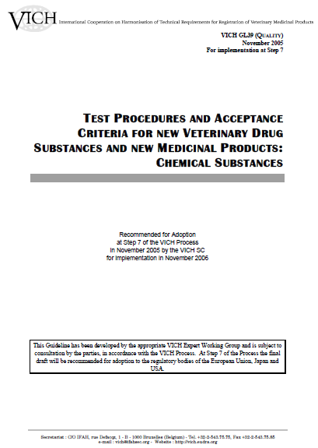
GL39 – Test Procedures and Acceptance Criteria for New Veterinary Drug Substances and New Medicinal Products: Chemical Substances

Slide 2
Disclaimer
These slides have been provided for training purposes only. The presenter has made every attempt to ensure that they are consistent with relevant VICH guideline(s).
As always, the original Guideline(s) should be used as the primary source of information for working with regulators.

Slide 3
Table of contents
Setting the scene:
General introduction; GL Lifecycle
Chapter 1. Introduction
Objectives of the GL; background; scope of the GL
Chapter 2. General concepts
Definition of each concept and indication of the circumstances of their applicability
Chapter 3. Guidelines
Specifications: definition and justification; Universal tests / Criteria; Specific tests / Criteria
Chapter 4. Glossary: not included in this presentation, please refer to the guideline
Chapter 5. References: not included in this presentation, please refer to the guideline
Chapter 6. Decision trees 1 to 8: not included in this presentation, please refer to the attachment to GL39

Slide 4
Quality Guidelines on specifications – General introduction
GL39 is part of the specifications group of guidelines:
GL39 – Test Procedures and Acceptance Criteria for New Veterinary Drug Substances and New Medicinal Products: Chemical substances
Attachment to GL39 – Decision trees 1 to 8
GL40 - Test Procedures and Acceptance Criteria for New Biotechnological/Biological Veterinary Medicinal Products

Slide 5
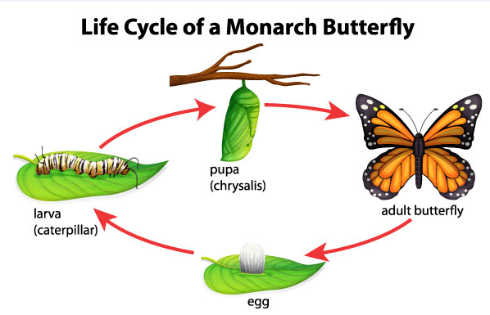
How to set the specifications? – GL Lifecycle
When you read this GL, imagine your specification as the life cycle of a butterfly: starting with an egg…
Specifications for registration
Fix the final set of tests for registration
Periodic/skip testing proposal
In-process controls fixed
Release potentially ≠ as End of Shelf Life
Stick to guidelines or scientifically justify
Specifications « Chrysalis stage »
Consider GL39; regional Pharmacopoeia, regional GL
Define in-process control
Decide if parametric testing is possible
Propose provisory specification, perhaps release = End of Shelf Life
Specifications « Larva stage »
Validation
Scale-up
Specifications « Adult butterfly stage »
Add specific tests to DS/DP
Define the acceptance criteria
Think about alternative analytical procedure
Consider evolving technology
Accepted by Authorities but potentially with differences between regions
Routine
Formulation development
Life cycle
Change control
In case of changes GL/Pharmacopeia, or from the applicant -> study of impact on DS and DP
Start of project
Specifications « Egg stage »
Drug substance (DS): universal tests (including pharmacopeia if it exists)
Drug product (DP): universal test according to pharma forms (+ impact of DS or DP for related substances)

Slide 6
Chapter I: Introduction
Objective
Establish a single set of global [USA, Europe and Japan] specifications for new veterinary drug substances and new medicinal products.
The specifications are designed to ensure product quality and consistency
Background
Specifications
= List of tests + references to analytical procedures + appropriate acceptance criteria (numerical limits, ranges or other criteria for the test described)
= Critical quality standards proposed and justified by the manufacturer and approved by regulatory authorities
= The chosen characteristics should focus on quality attributes found to be useful to ensure safety and efficacy of the drug substance and medicinal product
To be justified by the applicant and approved by Authorities

Slide 7
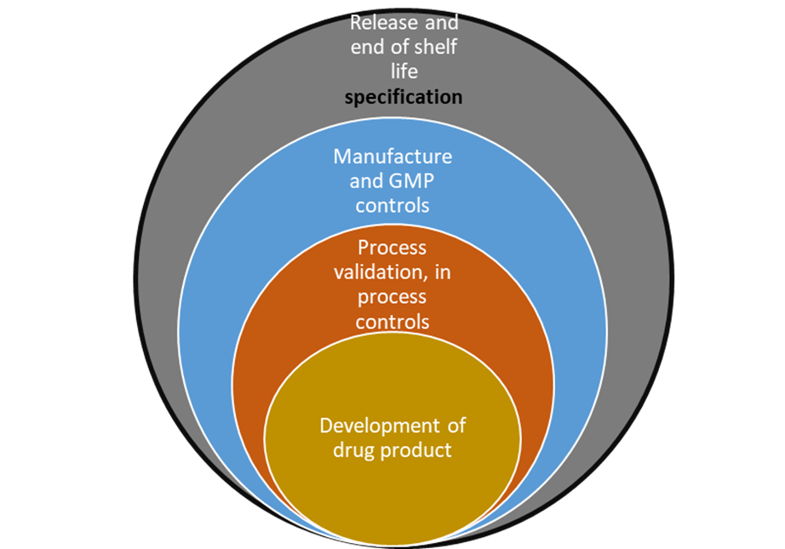
Chapter I: Scope – What is quality?

Slide 8
Chapter I: Scope
In scope:
> This guideline addresses specifications, chosen to confirm the quality of the new drug product (DP) (including combination product) and where applicable new drug substances (DS)
[“New” means not previously registered in the region or Member State]
> This guideline may be applicable to synthetic and semi-synthetic antibiotics and synthetic peptides of low molecular weight
> Dosage forms addressed in this guideline include solid oral dosage forms, powders, liquid oral dosage forms, and parenterals (small and large volume) however this is not meant to be an exhaustive list, or to limit the number of dosage forms
Not in scope:
This guideline does not apply to DPs during clinical research or development
Higher molecular weight peptides and polypeptides
Biotechnological/biological products
Radiopharmaceuticals, products of fermentation, oligonucleotides, herbal products and crude products of animal or plant origin

Slide 9
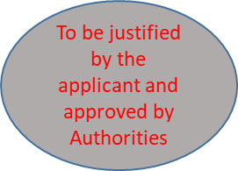
Chapter II: General concepts (1/4)
The following concepts should be considered to set specifications:
Periodic or skip testing: limited possibility not to perform a specified test on every batch. Justification based on data and an associated low risk of out of specifications. E.g. Residual solvents, microbiological testing for solid oral forms.
Release vs. Shelf-life acceptance criteria (medicinal products only):
Release criteria more restrictive than shelf-life criteria.
E.g. assay and impurity (degradation product) levels
In-process tests: tests performed during manufacture: to guide manufacturing, e.g. machine adjustment, or to follow the process, e.g. pH measurement
Design and development consideration: experience gained during development should form the basis for the setting of specifications, and can also provide the rational to exclude or replace certain tests. Examples are given in the GL.
Limited data available at filing: it is understandable that initially approved tests and acceptance criteria shoud be reviewed as more information is collected. E.g. total impurities: after industrial scale-up and stability study results, the limits could be tightened or widened.
The guideline refers to the authorities

Slide 10
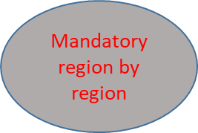
Chapter II: General concepts (2/4)
The following concepts should be considered to set specifications:
Parametric release: Parametric release can be used as an operational alternative to routine release testing for the medicinal product in certain cases when approved by the regulatory authority. When parametric release is performed, the attribute (e.g., sterility) is indirectly controlled by monitoring specific parameters (e.g., temperature, pressure, and time during the terminal sterilization phase(s)).
Check regional requirements: e.g. EMA guideline CVMP/QWP/339588/2005 on parametric release.
Alternative procedures: may be used if comparable or superior to the official procedure (subject to validation).
Pharmacopoeial tests and acceptance criteria: some harmonised (or considered as equivalent) tests are agreed between USA, Europe and Japan. The list of harmonised tests is on the EDQM website.
E.g. the Ph. Eur sterility test can be used and is accepted in USA and Japan.
For non-harmonised tests, the regional Pharmacopoeia should be followed, unless the equivalence of using an alternative Pharmacopoeia can be justified and agreed with the competent authority.

Slide 11
Chapter II: General concepts (3/4)
The following concepts should be considered to set specifications:
Evolving technologies: when offering additional assurance of quality, new technologies have to be taken into consideration.
Impact of drug substance on Medicinal Products Specifications: it is normally not considered necessary to test the medicinal product for process related impurities which are controlled in the drug substance and are not degradation products. However those process related impurities that are also degradation products have to be controlled.
Reference standard: A reference standard, or reference material, is a substance prepared for use as the standard in an assay, identification, or purity test. It should have a quality appropriate to its use.
Impurities from drug substances | Drug substance | Drug product
Imp K (synthesis by-product) Imp G (synthesis and degradation) | ≤ 0,5 % ≤ 0,5 %* | Not to be followed ≤ 1,0 % *(followed because degradation product) * VICH limits

Slide 12
Chapter II: General concepts (4/4)
Example to illustrate the general concepts:
List of tests | Reference to analytical procedures | Acceptance criteria | Comments
Microbiological quality* | Ph. Eur. 2.6.12 Harmonised text with USP <61>, Japan Ph. | Ph. Eur. 5.1.4 USP <1111> | * Periodic-Skip testing: One batch every 10 batches based on development results and because the dosage form is tablets.
Related substances - Specified known impurity | HPLC method in-house xxxx | R : 1.2 % EoSL: 1.8 % | Different limits Release vs end of SL: limit above qualification threshold based on toxicological qualification report (up to 2 %).
Hardness (IPC results) Resistance to crushing | Ph. Eur. 2.9.8 | 50 N to 90 N | In process control result reported in the specifications. Limits determined based on development considerations.
Example for a drug substance | Ph. Eur. Monograph: thin layer chromatography. HPLC proposed by the applicant. | Imp. x ≤ 0,5 % | Alternative procedure, and evolving technologies. Conditions: HPLC better and validated.

Slide 13
Chapter III: Guidelines (1/7)
Universal tests / criteria
Some tests and acceptance criteria are considered generally applicable to all new drug substances
and finished products.
Note: do not forget to consider the mandatory Regional Pharmacopoeia
E.g. Ph. Eur: Substances for pharmaceutical use (2034), Ph Eur: for pharmaceutical forms (e.g. tablets)
VICH Guidelines to consider: “validation of analytical procedures: definition and terminology” and
“validation of analytical procedures: methodology”.
Specific tests / criteria
For drug substance and/or for drug product, some tests and acceptance criteria may be added to the
universal ones, this is case by case, when the tests have an impact on the quality for batch control.
Note: do not forget to consider the mandatory Regional Pharmacopoeia, as well as specific
guidelines (e.g. in EU: EMA/CVMP specific GL).

Slide 14
Chapter III: Guidelines (2/7)
Universal tests / criteria
Tests | New Drug substances | New Drug Products | Comments
Description (qualitative) | For state: solid/liquid state, colour. | Example: Size, shape, colour. | Evolution of colour over time => investigation/action; propose quantitative testing.
Identification | Specific: IR; in case of LC (not considered specific), the use of 2 chromatographic methods e.g. LC retention time + LC-UV spectrum is generally accepted. Salt has to be identified. Chirality has to be considered. | Specific: IR; In case of LC (not considered specific), the use of 2 chromatographic methods e.g. LC retention time + LC-UV spectrum is generally accepted. | Identification is not necessary during stability studies (unless stability indicating). Identity should however remain part of the shelf life specification.
Assay | Specific and stability-indicating. If not specific (titration), add a specific test for impurities. | Specific and stability-indicating. If not specific (titration), add a specific test for impurities. | The same method is possible for substance/product, in particular for impurities.
Impurities | Organic, inorganic and residual solvents. Refer to decision tree #1. | Residual solvents should be discussed. Degradation products (organic impurities) should be monitored. See VICH guidelines Refer to decision tree #2. | If limited data available do not establish acceptance criteria which tightly encompass the batch data at the time of filing.

Slide 15
Chapter III: Guidelines (3/7)
GL 39 Decision trees are proposed for specified impurity, particle size distribution, polymorphism, chirality and microbiological quality attributes given a clear way of proceeding.
Tests | New Drug substances | Comments
Physicochemical properties | Melting point, refractive index. Example: pH (in solution). | Tip: The use of the drug substance and the type of drug product should be considered.
Particle size | Potentially affects bioavailability. Refer to decision tree #3. When drug product is solid or suspension. | Tip: The use of the drug substance and the type of drug product should be considered.
Polymorphic forms | Potentially affects bioavailability. Refer to decision trees #4. | Tip: The use of the drug substance and the type of drug product should be considered.
Water content | When water is impacting the quality of the substance. Prefer Karl Fischer titration (KF). | Do not forget to validate the KF method (Ph.Eur).
Elemental impurities | Catalysts, sulfated ash/residue on ignition. | According to development data and manufacturing process. Discuss with the drug substance manufacturer.
Microbial limits | Necessary if not sterile substance. Decision tree #6. | Refer to Ph.Eur procedures and limits.

Slide 16
Chapter III: Guidelines (4/7)
Specific tests / criteria for drug product
GL39 Decision trees are proposed for degradation product, polymorphism, chirality, dissolution and microbiological quality attributes given a clear way of proceeding.
The specific tests are listed hereafter for specific dosage forms: solid oral, liquid oral, parenterals.
☞ application of the concepts contained in this guideline to other dosage forms is encouraged.

Slide 17
Chapter III: Guidelines (5/7)
Specific tests / criteria for drug product
Tests | New Drug product : solid oral (coated and uncoated tablets; hard capsules) | Comments
Dissolution | Please refer to the decision trees 7(1), 7(2) and 7(3). | Pay attention to this test because if there is a link between dissolution and bioavailability, this should be considered a critical attribute. Pharmacopoeial methods should be considered. Partially harmonised (US/JP/EU).
Disintegration | Could replace dissolution (see decision tree 7(1)). | Refer to Pharmacopoeia for limits. It is listed in harmonised test (US/JP/EU).
Hardness/friability | In-process controls. | Normally not necessary to include them in the specification but should be included if critical impact on quality. Check impact of hardness evolution on dissolution rate.
Uniformity of dosage units | Means uniformity of mass of the drug product or of content of the drug substance in the drug product depending on the active content. | Uniformity of dosage unit is listed in harmonised test (US/JP/EU).
Water content | Prefer KF but Loss on drying may be an alternative. | Appropriate if negative impact of hydration or hydroscopic product.
Microbial limits | Refer to decison tree 8. | Harmonised test (US/JP/EU).

Slide 18
Chapter III: Guidelines (6/7)
Tests | New Drug Product: oral liquid and powder intended for reconstitution as oral liquid | Comments
Uniformity of dosage units | Means uniformity of mass of the drug product or of content of the drug substance in the drug product depending on the active content | In case of multidose with measuring device, unif. of mass of delivered dose is applied.
pH | Range has to be proposed and justified. | Appropriate when ionic medium.
Microbial limits | Follow decision tree 8. | Harmonised test (US/JP/EU).
Antimicrobial preservative content | Limits for assay should be included in the specifications for shelf life (SL). | Effectiveness of the preservative should be demonstrated during development at the lower limit for the duration of SL and in-use SL
Antioxidant preservative content | Normally performed at release but omission can be justified. When an in-process test, the acceptance criteria to remain part of the release specification | If changes in manufacturing or packaging occur, levels throughout SL should be re-evaluated.
Extractables | Please refer to regional GL on extractables. | Commonly not in routine testing.
Dissolution | Should be considered for oral suspensions and dry powder products for resuspension. | Particle size distribution should also be considered when evaluating the need for dissolution testing
Particle size distribution | Should be considered for oral suspensions. | Dissolution should also be considered when evaluating the need for particle size distribution testing
Redispersibility | May be appropriate and time required to achieve resuspension should be specified | A simple test such as shaking may be sufficient
Rheological properties | Viscosity/specific gravity for viscous solution/suspension. | -
Reconstitution time | Acceptance criteria should be provided for dry powder products which require reconstitution. | Skip lot testing or elimination of this attribute from the specification possible if justified.
Water content | For oral products requiring reconstitution, a test and acceptance criterion should be proposed if appropr. | -

Slide 19
Chapter III: Guidelines (7/7)
Tests | New Drug product: Parenterals | Comments
Uniformity of dosage units | Same definition as previous slides | Refer to solid oral.
pH | Range has to be proposed and justified. | Appropriate when ionic medium.
Sterility | Test procedure and acceptance criteria necessary. | Parametric release possible. Harmonised text (US/JP/EU).
Endotoxins/pyrogens | Endotoxins should be included in accordance with regional requirements (Pharmacopoeia). | Pyrogenicity may be an alternative.
Particulate matter | Includes clarity, visible and sub-visible particulates. | In accordance with regional Pharmacopoeia.
Water content | For non-aqueous or for product for reconstitution. | -
Antimicrobial preservative content | limits for assay should be included | Effectiveness of the preservative should be demonstrated during development at the lower limit for the duration of shelf life and in-use shelf life
Antioxidant preservative content | Normally performed at release but omission can be justified. If an in-process test, the acceptance criteria to remain part of the release specification | If changes in manufacturing or packaging occur, levels throughout shelf life should be re-evaluated
Extractables | Please refer to regional GL on extractables. | Significantly critical.
Functionality testing of delivery systems | Test to verify if prefilled syringe, autoinjector cartridges are functioning correctly. | Skip testing or absence may be justified based on stability data
Osmolarity | Appropriate when tonicity is declared on labelling. | Commonly absent on label.
Particle size distribution | Should be considered for oral suspensions. | Dissolution should also be considered when evaluating the need for particle size distribution test
Redispersibility | Appropriate for suspension and time required to achieve resuspension should be specified | A simple test such as shaking may be sufficient
Reconstitution time | Acceptance criteria to be provided for all parenteral products which require reconstitution. | For rapidly dissolving products: Skip lot testing or elimination of this attribute possible if justified

