Slide 1
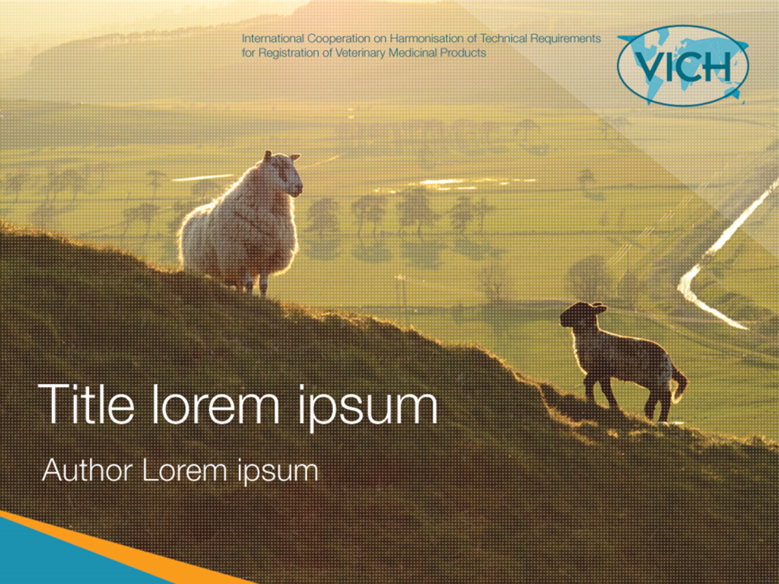

VICH General Principles and
current update of VICH Outreach Forum activity

Slide 2
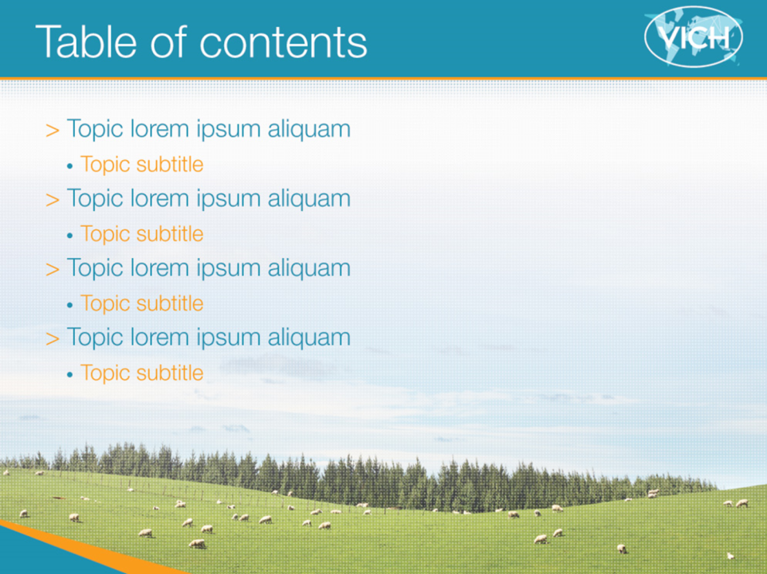
WHAT Is VICH?
WHY Participate in?
HOW to Participate in?

Slide 3

What Is VICH?

Slide 4


VICH =
International Cooperation
on Harmonisation of Technical Requirements
for Registration of Veterinary Medicinal Products (VMPs)
Full Members
Russia
Canada
EU
Ukraine
Korea
Japan
USA
China
Morocco
Saudi Arabia
ASEAN
Taiwan
India
Thailand
Outreach
Forum
Mexico
UEMOA
Uganda
Malaysia
Brazil
Australia
CAMEVET
South
Africa
New Zealand
Argentina
Observers
OIE : Associate Member, HealthforAnimals : Secretariat

Slide 5
What is the role of VICH?
To harmonise technical requirements for data necessary for registration
To develop and implement VICH Guidelines
  Study and testing methodology
    Quality, safety and efficacy (including bioequivalence)
  Post-marketing safety monitoring
    Pharmacovigilance

Slide 6
VICH Guidelines
Category |  | GL numbers
Pharmaceuticals | Quality | 1, 2, 3, 4, 5, 8, 10, 11, 17, 18(R)*, 39, 40, 45, 51
 | Efficacy | 7, 12, 13, 14, 15, 16, 19, 20, 21, 52
 | Environmental Safety | 6, 38
 | Metabolism and Residue | 46, 47, 48(R), 49(R)
 | Toxicology | 22, 23, 28, 31, 32, 33, 37
 | Target Animal Safety | 43
 | Antimicrobial Safety | 27, 36
Biologicals | Quality | 34, 25, 26
 | Target Animal Safety | 41, 44, 50
General | GCP | 9
 | Pharmacovigilance | 24, 29, 30, 35, 42
 | Electronic file formats | 53

Slide 7
It is NOT the role of VICH to:
Provide guidance to establish regulatory systems and regulations for marketing authorisations
Make final decision which studies are necessary to obtain a marketing authorisation
Assess data or provide guidance on the assessment approach
Grant marketing authorisations
Establish safety standards
These are typically the roles of national competent authorities and governments!

Slide 8


How the roles of VICH, OIE & Codex differ?
  Supports its Member Countries in;
    Improving the legal framework and resources capacity of national veterinary services
    Setting standards on animal production, food safety, etc…
  Sets terrestrial/aquatic animal health codes
   OIE standards
  Develops international food safety standards, guidelines and related texts such as;
    Maximum residue limits (MRLs) of veterinary drugs in foodstuffs from animal origin
    Codes of practice to protect consumers and ensure fair practices in the food trade
   Codex food standards
  Both OIE standards and Codex food standards are recognized by WTO as references for international trade

Slide 9
VICH Structure
OIE
VICH Steering Committee
VICH Secretariat
VICH Outreach Forum
Ad Hoc Task Forces
Expert working
Group
Expert working
Group
Expert working
Group
Expert working
Group
Expert working
Group

Slide 10
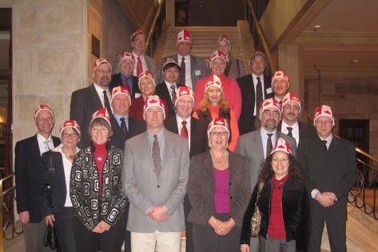
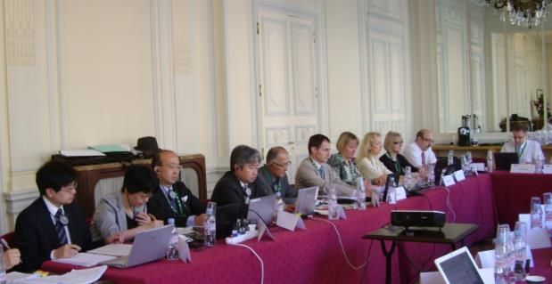
Steering Committee (SC)
Management of VICH
Status | Country/Region | Number of participants
 |  | Government | Industry
Full member | Japan | 3 | 3
 | EU | 3 | 3
 | USA | 3 | 3
Observer | Australia | 1 | 1
 | New Zealand | 1 | 1
 | Canada | 1 | 1
 | South Africa | 1 | 1

Slide 11

VICH Outreach Forum (VOF)
Chaired by VICH/OIE for;
  Wider international harmonisation
  Raising awareness of VICH
  Good governance of VMPs worldwide
Matters to be addressed;
  How to participate in VICH work
  Practical issues for accepting and using VICH guidelines
  Sharing of translations of guidelines
  Collating comments from the initial stage of guideline creation, etc….
Current members
Continent | Country | Regional Organisation
Eurasia | China, India, Korea Malaysia, Taiwan, Thailand Russia, Ukraine | ASEAN
Africa | Morocco, Uganda | UEMOA
America | Argentina, Brazil, Mexico | CAMEVET
Middle East | Saudi Arabia

Slide 12
Expert Working Group (EWG)
SC establishes EWG with a specific mandate
Active EWGs
Safety
Quality
Biological Quality Monitoring
Bioequivalence
Electronic Standards Implementation (Phamacovigilance)
Participants for each EWG
Country/Region | Number*
 | Government | Industry
Japan | 1 | 1
EU | 1 | 1
USA | 1 | 1
*Each member may send one additional advisor when required.
Experts from observer or VOF countries may also be appointed or requested.

Slide 13
VICH -the History
Foundation & Expansion
1980’s - 90’s | First talks & Meetings on VMP harmonisation
1990 - | ICH (human medicines)
1994 - 95 | OIE ad hoc Group on the VMP Harmonisation
1996 - | VICH
2011 - | VICH Outreach Forum (VOF)
International Meetings
33 Steering Committee meetings | Every 9 months
4 VOF meetings
5 VICH Public Conferences | Every 3 to 5 years

Slide 14
VICH guideline creation process
Step | Stage
1: SC agrees to start a topic and appoints an EWG 2: EWG elaborates a draft GL 3: SC approves the draft GL for public consultation | Drafting
4: Draft GL is circulated to stake holders and public 5: EWG prepares a revised GL 6: SC approves the revised GL | Fine-tuning
7: Final GL is circulated to authorities of VICH region 8: Final GL is implemented in VICH region | Publishing
9: SC monitors, maintains and reviews the GL | Maintenance

Slide 15
WHY Participate in ?

Slide 16
Primary Benefits of VICH
Use of Internationally harmonised guidelines to;
  Ensure product quality, safety and efficacy
  Reduce animal testing and costs of development
  Accelerate the development and reviewing process
  Increase availability of new VMPs
  Contribute to animal/public health, environment
Unique opportunity for;
  Regulators and industry to discuss regulatory data requirements
  Discussion between worldwide scientific experts

Slide 17
Secondary Benefits of VICH
  Better understanding of regulations and concerns in the other regions
Opportunity to update regional regulations
  A basis for future global harmonisation of registration guidelines
  Opportunity to discuss emerging global issues and relevant science
  Contribute to the Global One Health approach

Slide 18
Latest VOF topics (2014)-1
Report on the development of a training and communication strategy,
  Outlining VICH’s current thoughts, and requesting feedback from the VOF members;
Progress reports of the Task Forces
  Revision of the guideline on stability : in Climate Zone III and IV (hot and hot/humid climates)
  New guideline on efficacy for combination products originally proposed by China

Slide 19
Latest VOF topics (2014)-2
Links between the legal frameworks for VMPs and VICH GLs in Japan, Canada and EU
Training presentations
  Generics : definitions and related terms
  Technical aspects of bioequivalence
  Waiving of target animal batch safety testing
  How to comment on VICH guideline
  Pharmacovigilance

Slide 20




Latest VOF topics (2014) -3
Updates from VICH Outreach Forum participants
  Implementation of VICH guidelines
  National/Regional activities regarding VMPs
  Antimicrobial resistance national activities
  Group discussions of questions to VOF members and feedback to the SC

Slide 21
HOW to Participate in?

Slide 22
All the members can participate!
OIE members can send comments to draft guidelines during the public consultation
Encouraged to use VICH guidelines as national or regional guidelines
  Free of charge
If you wish to go one step forward
  Deeper understanding of VICH-GLs
  Learning how to implement and use VICH-GLs
  Proposing new topics of interest
  Involved in drafting GLs as an EWG member
VOF may be your choice

Slide 23
How to be a VICH Outreach Forum member
The criteria for participation in VOF:
  Regulation for marketing authorization in place
  Willingness to work towards accepting VICH guidelines
  Regular participation to VOF meetings (every 9 months)
  Paying for participation (travel costs, accommodation)
Interested in participating in VOF activity?
  Write to the VICH secretariat: sec@vichsec.org
  for more information, today!

Slide 24


The VICH public website
(http://www.vichsec.org)
24
Notes:
24

