Slide 1
VICH GL 54, Studies to evaluate the safety of residues of veterinary drugs in human food: General approach to establish an Acute Reference Dose (ARfD)
Brandi L. Robinson, MPH, CPH
ONADE International Coordinator
Center for Veterinary Medicine
U.S. Food and Drug Administration

Slide 2
What is this guideline intended to do?
The current guideline addresses the nature and types of data that can be useful in determining a toxicological acute reference dose (ARfD) for residues of veterinary drugs, the studies that may generate such data, and how the ARfD may be calculated based on these data.

Slide 3
What is this guideline NOT intended to do?
This guideline does not, except in very broad terms address:
When an ARfD would or would not be appropriate to address the concerns of a national or regional regulatory authority
Evaluation of specific pharmacological or toxicological adverse effects that may lead to the determination of an ARfD

Slide 4
What is this guideline NOT intended to do?
Human dietary exposure data that may be appropriate for use with an ARfD in the derivation of an MRL, tolerance, or other tool used to refine an acceptable concentration of veterinary drug residue in food.
Refinement of the exposure calculation for the acute health risk assessment
Routes of human exposure to veterinary drugs other than the oral route.

Slide 5
Acute effects on the gastrointestinal microbiota…
Recognizing international efforts to address possible acute effects of residues of an antimicrobial veterinary drug on the human intestinal microbiota following acute human exposure, the current guideline only provides a harmonized approach to a toxicological ARfD at this time.

Slide 6
The guideline follows a stepwise approach
Before examining the endpoints of acute pharmacological effects and toxicity, and before designing studies, careful consideration should be given to the 3-Rs principles.
refine-reduce-replace

Slide 7
Step 1
Evaluate available pharmacological and toxicological data and information, including data from repeated-dose toxicity studies, in order to establish whether or not acute endpoints (attributable to the first 24 hours of dosing) have been adequately addressed.

Slide 8
Step 2
If additional acute toxicity information is needed, consideration to the 3-Rs principle should be given, for example, by integrating observations/examinations related to acute endpoints in planned standard toxicity studies.

Slide 9
Step 3
If the two options in Steps 1 and 2 are insufficient to provide adequate information on acute endpoints, then a new, specifically designed toxicity study(ies) can be considered.

Slide 10
Use of traditional repeat dose studies
In the absence of data to the contrary, all relevant indications of acute adverse pharmacological and toxicological effects observed in repeat-dose studies can be considered as potentially relevant to setting an ARfD.
Particular emphasis should be given to observations at the beginning of repeat-dose studies.

Slide 11
Use of traditional repeat dose studies
Consideration should be given to dose selection, numbers of animals, and the use of satellite groups.
Elements of study design described in OECD Guidance No. 124, Annex 2 can be helpful.

Slide 12
Use of acute dose studies
A single exposure study specifically designed to support an ARfD for a given drug may be warranted.
It is recommended that the design of an acute effect study include consideration of all available relevant physical, chemical, and toxicological information, and consider the MOA when relevant
Specific guidance on the conduct of a single exposure toxicity study can be found in OECD Guidance 124, Annex 2.

Slide 13
Calculating the ARfD
POD is the point of departure or threshold for pharmacological or toxicological effects of concern
UF is an uncertainty or safety factor, or series of factors that typically account for considerations such as animal to animal variability, interspecies extrapolation, quality of data, severity of response, etc.

Slide 14
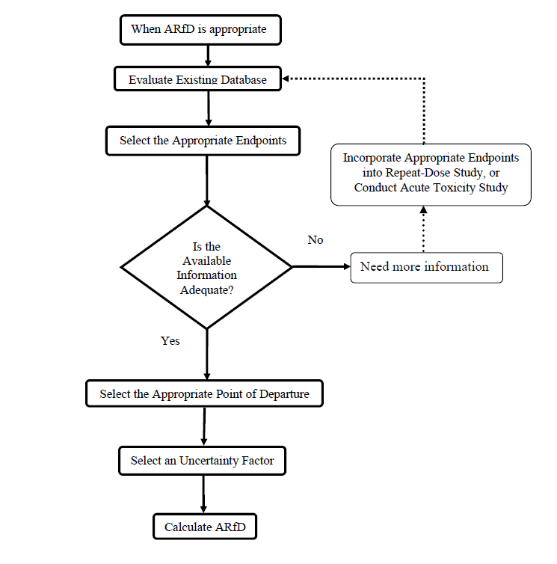

Slide 15
