Slide 1
How to get involved in VICH
Dr. Allen Bryce
Independent consultant
Canberra, Australia
allen.bryce@gmail.com
VICH Workshop: Dar Es Salaam, Tanzania – 24 June 2015

Slide 2
How to get involved in VICH
The public consultation process
How VICH Outreach Forum members can get involved in the working groups
How to make best use of the VICH guideline package
Benefits of using VICH guidelines

Slide 3
The public consultation process
Every new or revised VICH guideline is developed through a 9-step process
Anyone can comment during the public consultation phase
Drafts are usually available for consultation over a 6-month period
Consultation is through the VICH website www.vichsec.org or through VICH members/observers

Slide 4
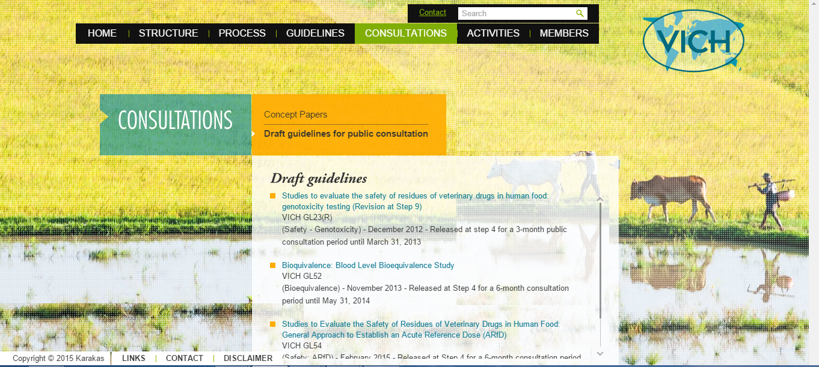
www.vichsec.org

Slide 5
How Outreach Forum members can participate in working groups
Guidelines are developed by expert working groups
Experts must be expert in the relevant technical field – not representatives of their particular regulator or industry sector
Experts can come from the VICH member and observer regions, and from VICH Outreach Forum countries
Any OIE country may join the Outreach Forum if they are committed to work towards implementing VICH guidelines and participate in Outreach Forum meetings
Notes:
In VICH Outreach Forum meetings, VOF members can provide their views on the need for new guidelines, or to revise current guidelines. They may also provide the Steering Committee with a detailed concept paper which outlines the need for a new or revised guideline, to assist the steering committee in considering the matter.
At the Outreach Forum meetings, VOF members can also propose experts from their country or region to participate in particular Expert Working Groups. The Steering Committee will consider any nominations and select experts based on the need for specific expertise for work on each guideline.

Slide 6
The VICH Expert Working Groups
Expert Working Groups work through emails, teleconferences and (where necessary) face-to-face meetings
Currently the following Expert Working Groups are active:
Metabolism and Residue Kinetics
Quality
Safety
Biologicals Quality Monitoring
Pharmacovigilance Electronic Standards Implementation
Bioequivalence (just completed its mandate)
Electronic File Format (just completed its mandate)
Notes:
There have also been specialist working groups set up to consider –
Metabolism and Residue Kinetics in Honey
Target Animal Safety
Target Animal Batch Safety Testing
(only if asked)
Task Forces are used to develop concept papers proposing new work. Recent taskforces have worked on proposals for
revised anthelmintic guidelines
efficacy studies for combination products
revision of the stability testing guideline – GL 3(R)

Slide 7
The VICH Expert Working Groups
Past Expert Working Groups include:
Efficacy – Good Clinical Practice
Efficacy – Anthelmintics clinical studies
Target Animal Safety (Pharmaceuticals and Biologicals)
Environmental Safety
Antimicrobial Safety
Pharmacovigilance
Microbiological safety
Notes:
There have also been specialist working groups set up to consider –
Metabolism and Residue Kinetics in Honey
Target Animal Safety
Target Animal Batch Safety Testing
(only if asked)
Task Forces are used to develop concept papers proposing new work. Recent taskforces have worked on proposals for
revised anthelmintic guidelines
efficacy studies for combination products
revision of the stability testing guideline – GL 3(R)

Slide 8
Making best use of the VICH guidelines
All OIE members are encouraged to use VICH guidelines as national or regional guidelines
Any regulator may incorporate any VICH guideline into their requirements for applications for registration/market authorisation
If necessary, regulators may adapt VICH guidelines to suit local requirements
Regulators may translate VICH guidelines into languages other than English to suit their needs.
Regulators may choose to accept the decisions made by VICH member or observer regulators
Notes:
VICH guidelines are freely available for any regulator to adopt.
When VICH guidelines are translated into other languages, VICH would appreciate the opportunity to refer to these translations, where they have been translated without any change to meaning. The original English version will remain the definitive version of any guideline.

Slide 9
Benefits of using VICH guidelines
Protects public health, animal health & welfare and the environment through effective, multilaterally agreed and harmonised guidelines that ensure high standards of Quality, Safety & Efficacy
Minimises the use of test animals and costs of product development
Facilitates and accelerates the authorisation of veterinary medicines
Reduces costs and time for developing new product and releasing them into the market
Reduces impediments to trade in veterinary medicines and food

Slide 10
The VICH public website www.vichsec.org
10
Notes:
10

