Slide 1
Why regulatory Convergence is important?
5th VICH Conference: Reaching out to the World
October 27-29, 2015.

Slide 2
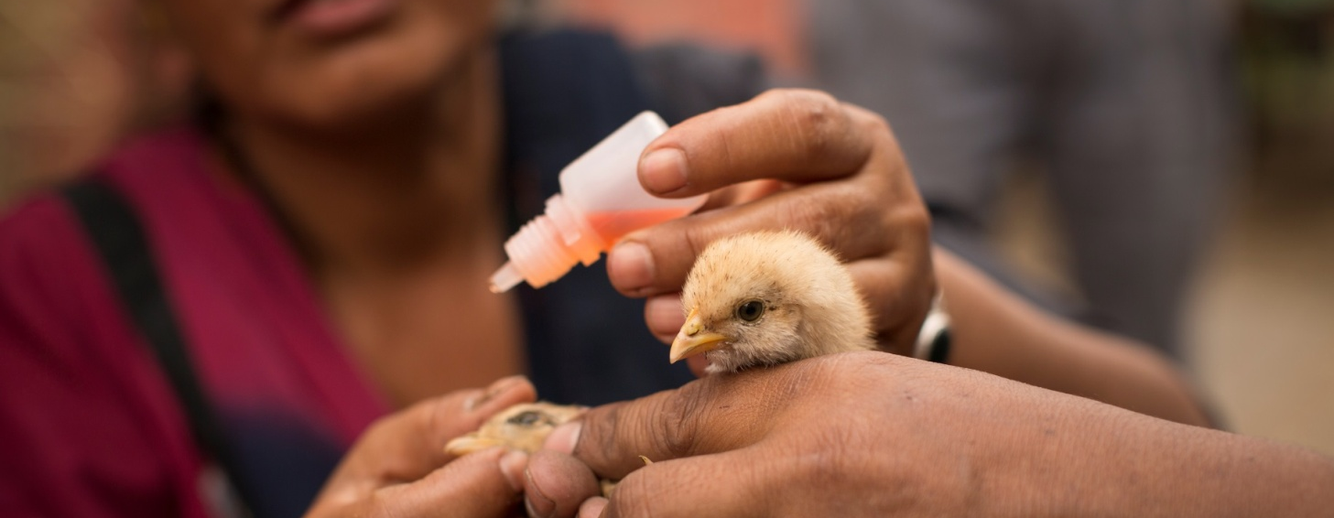
To make quality veterinary medicines and
vaccines available, accessible and affordable.

Slide 3
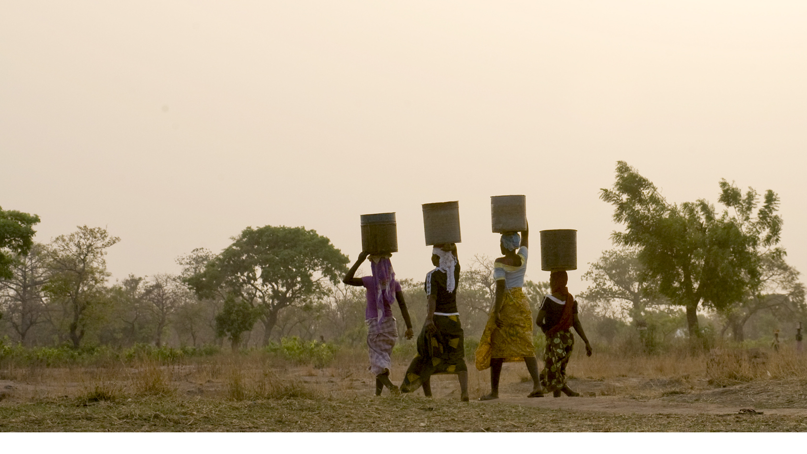
To make quality veterinary medicines and vaccines available, accessible and affordable.
Every Person Deserves the Chance to Live a Healthy, Productive Life.

Slide 4
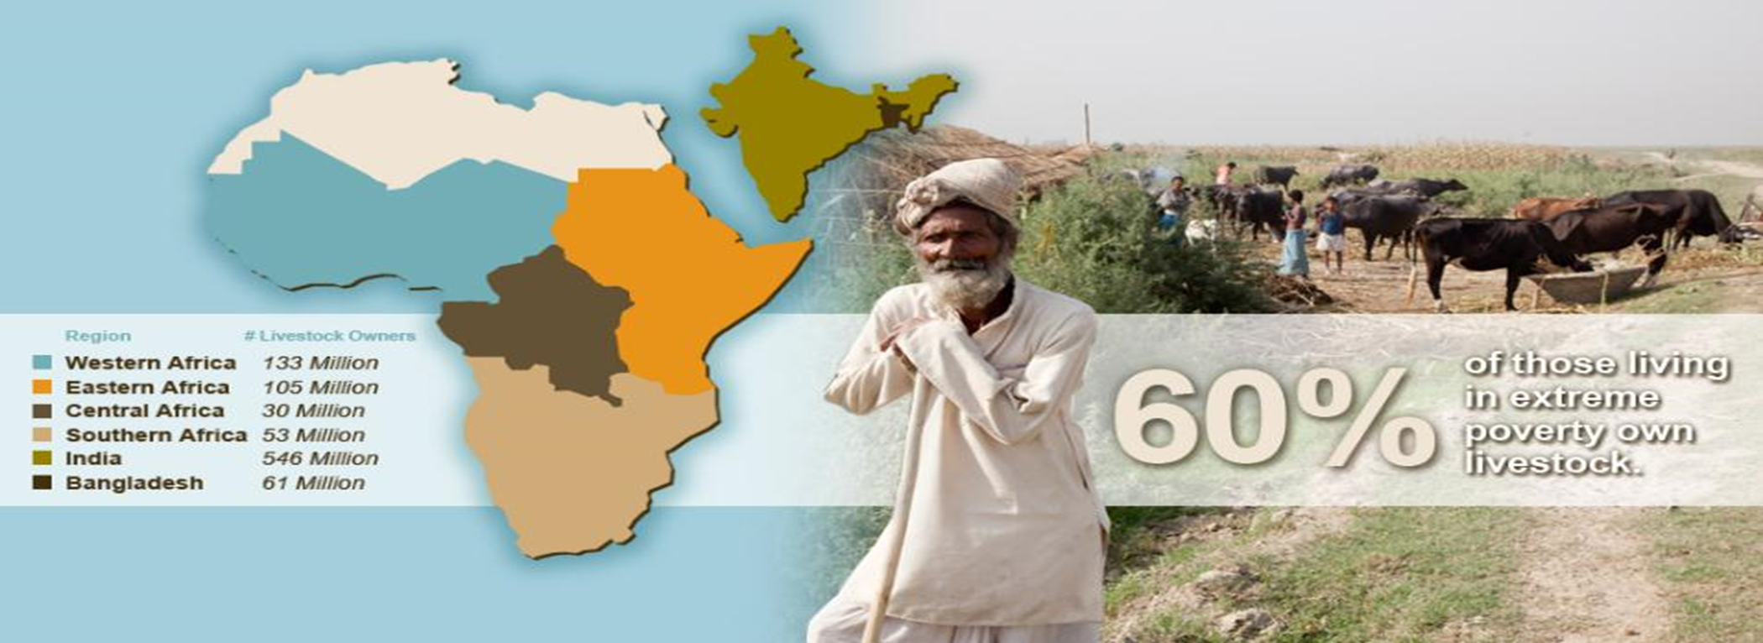
Why is livestock important to smallholder farmers?
► There are a nearly 1 billion livestock keepers.
Number of livestock owners in sub-Saharan Africa and South Asia who earn less than $2 a day:

Slide 5
Livestock can be a sustainable solution for financial and food needs, particularly in sub Saharan Africa and South Asia
1
The poor: with nearly 60% of population living with <$2 / day own livestock
Smallholders: the majority of livestock production comes from smallholders in both SSA and SA
Women: there are numerous livestock interventions and opportunities that benefit women specifically
Who benefits?
Through livestock, we have a significant opportunity to address its target populations in both SSA and SA
Livestock also has the potential to go beyond simply increasing income in helping smallholder farmers develop both financial security and food security
2
Hodo they benefit?
Income: 30% – 45% of annual income comes from livestock
Nutrition: Animal Sourced Foods are essential for food and nutritional security.
Farm Productivity: Enhances farm productivity
Asset accumulation / Cash-flow: provides opportunity to accumulate wealth and financial security
How do they benefit?

Slide 6
Overview of the Gates Foundation Livestock Strategy
Priority Geographies
Priority Species
Burkina Faso
Ethiopia
Ghana
Mali
Nigeria
Tanzania
Uganda
Cattle¹
Small Ruminants (Goats & Sheep)
Poultry
Priority Functions
Bangladesh
India (Bihar, Odisha, Uttar Pradesh)
Livestock Health
Livestock Genetics and Reproduction
Production and Markets
1 For South Asia, we are also exploring water buffalo.

Slide 7
Reducing mortality and morbidity is a critical lever to maximize livestock productivity and production.
~25 - 30% losses due to preventable or treatable diseases and disorders
A primary lever for decision to invest in inputs
ILLUSTRATIVE

Slide 8
Some of the significant losses seen today in sub-Saharan Africa hindering the potential of livestock productivity growth.
High Smallholder Losses
Over $800 Million US
Newcastle Disease (ND)
Greatest problem for village poultry, ND is a continual threat to smallholder flocks and discourages additional smallholder investment in poultry.
GI Endoparasites (Helminths)
Effective control of endoparasites can result in substantial productivity gains for smallholder farmers.
Ectoparasites
In addition to spreading disease, ectoparasites reduce livestock productivity through reduced weight gain and reduced quality for hides and fibers.
Medium Smallholder Losses
$400-800 Million US
Peste des Petits Ruminants (PPR)
PPR is a highly contagious viral disease with high mortality and morbidity resulting in heavy losses .
East Coast Fever (ECF)
A serious, often fatal, tick-borne parasitic disease of cattle that causes major economic losses in eastern, central and southern Africa.
Animal African Trypanosomiasis (AAT)
This parasitic disease caused by Trypanosoma and transmitted by tsetse flies is endemic in parts of Africa. The disease results in chronic illness, reduced productivity, and death.
Contagious Bovine Pleuropneumonia (CBPP)
CBPP is a highly contagious respiratory disease affecting cattle, considered the most economically important disease of cattle in Africa.
Foot and Mouth Disease (FMD)
A highly contagious viral disease that restricts international trade, FMD results in rapid loss of condition and productivity. High mortality can be seen in young animals.
Brucellosis (B. abortus, B. melitensis)*
Infections typically result in abortion and other reproductive disorders in livestock. Brucellosis represents a significant zoonotic threat.
Contagious Caprine Pleuropneumonia (CCPP)
CCPP is one of the most severe diseases of goats. CCPP causes major economic losses in Africa, Asia and the Middle East, where it is endemic.
Low Smallholder Losses
Below $400 Million US
Goat Pox and Sheep Pox (GP, SP)
These highly contagious viral diseases reduce flock productivity, decrease wool and skin quality, increase lamb and kid mortality, and restrict international trade.
Bovine Tuberculosis (TB)*
Bovine TB can cause slow growing chronic infection, emaciation and lost productivity. Also a zoonotic threat.
Lumpy Skin Disease (LSD)
LSD is an acute to chronic viral disease of cattle that is characterized by skin nodules.
Rift Valley Fever (RVF)*
Rift Valley Fever (RVF)*
RVF is an acute viral disease in east and south Africa. Epidemics typically occur during periods of unusually high rainfall. RVF represents a significant zoonotic threat.
An acute viral disease in east and south Africa. Epidemics typically occur during periods of unusually high rainfall. RVF represents a significant zoonotic threat.
* Zoonotic disease that poses a threat to human health

Slide 9
The current value of livestock production will increase by an estimated ~$80 billion by 2030, with most growth coming from ruminants.
South Asia: Value of Production ($ Billion)
Sub-Saharan Africa: Value of Production ($ Billion)
2005
2030e
2005
2030e
98
67
33
23
13
8
10
9
4
3
7
6
2
5
2
1
Ruminant Meat
Ruminant Milk
Non-Ruminant Meat
Other Non-Ruminant Products
Ruminant Meat
Ruminant Milk
Non-Ruminant Meat
Other Non-Ruminant Products
Total Change +$58 Billion
Total Change +$20 Billion
Source: Harvest Choice

Slide 10
Yield gaps are another way of measuring growth potential, with total potential for South Asia and sub-Saharan Africa at ~$300 Billion.
Commodity
Yield Gap, South Asia
%
Yield Gap, sub-Saharan Africa
%
Value of Yield Gap (combined)
$ Billion
Buffalo meat
70
0
3
Buffalo milk
17
0
10
Cattle meat
199
149
20
Chicken meat
94
63
3
Cow milk
754
2,361
242
Goat meat
177
136
5
Goat milk
793
1,642
31
Hen eggs
130
299
8
Pig meat
258
121
3
Sheep meat
137
135
3
Sheep milk
282
639
3
Yield gaps calculated by comparing regional yields to best in class yields from developed countries (e.g., USA, Western Europe)
Source: Harvest Choice, FAO, Quantitative analysis

Slide 11
However, adjusting yield gaps for agro-ecological zones of South Asia and sub-Saharan Africa yields total potential growth of ~$120Bn.
Commodity
Yield Gap South Asia
%
Yield Gap, South Asia: Achievable %
Buffalo meat
70
47
South Asia and sub-Saharan Africa yield gaps adjusted based on similar agro-ecological zones in regions such as South America and Australia
Value of potential growth decreases:
From $164.9Bn to $76.3Bn for South Asia
From $166.5Bn to $42.8Bn for sub-Saharan Africa (not pictured)
Buffalo milk
17
17
Cattle meat
199
118
Chicken meat
94
109
Cow milk
754
328
Goat meat
177
73
Goat milk
793
102
Hen eggs
130
87
Pig meat
258
130
Sheep meat
137
67
Sheep milk
282
85
SOURCE: Harvest Choice, FAO, Quantitative analysis

Slide 12
There is tremendous opportunity for livestock demand growth in sub-Saharan Africa due to underlying macroeconomic drivers and wide productivity gaps.
Population is expected to increase, especially in Sub-Saharan Africa
Furthermore, demand will be stimulated by increased per capita incomes
…as well as increased urbanization rates, which stimulates consumption preferences
This is expected to drive demand for livestock products, which in turn would support high growth rates in livestock sector
Sub-Saharan Africa Population, 2010-2050e
Million People
Sub-Saharan Africa Per Capita Income Growth, 1951-2050e²
Percent
Sub-Saharan Africa Urbanization Rates, 2000-2030e
Percent
Sub-Saharan Africa Demand for Livestock Products, 2010-2050e
Million Tons
+103%
Rural
Urban
+167%
1,753
2.0
2.6
58
1,194
66
60
55
49
37
863
22
-0.1
34
40
45
51
2010
2025e
2050e
1951-73
1981-05
2006-50e
2000
2010
2020e
2030e
2010
2025e
2050e
1 Additional analyses available in the appendix.
2 Steinfeld et al (“Livestock’s Long Shadow,” FAO, 2006) found that as income grows, so does expenditure on livestock products
Source: FAO, UN Population database, Hillebrand “Global Distribution of Income”, McKinsey Global Institute, Livestock’s Long Shadow

Slide 13
Why regulatory convergence important? from a livestock development perspective….
Developing world context
Developed world context
Reduce avoidable losses
Maximize production
Improve income
Decrease poverty
Improve food security
Assure nutritional security
Reduces impact on climate
Realize export aspirations
Reduce risks of disease transmission
Improves quality of imports
Reduces impact on climate
Better planning and management of global animal resources

Slide 14
AU-IBAR report in 2004 “The Veterinary Pharmaceutical Industry in Africa” Grasswitz, et. al.
“Regulatory framework governing the development, registration and licensing of medicines is still the main obstacle both for the development of new products and making better use of existing ones”
Today, many African Nations are part of VICH Outreach Forum.
Our intent is to partner with regulatory agencies globally and accelerate the improvement of Regulatory Framework for veterinary medicines and vaccines in sub-Saharan Africa and South Asia to realize the potential of livestock.

Slide 15
Thank you

