Slide 1
GL10 – Impurities: Guideline on Impurities in New Veterinary Drug Substances

Slide 2
Disclaimer
These slides have been provided for training purposes only. The presenter has made every attempt to ensure that they are consistent with relevant VICH guideline(s).
As always, the original Guideline(s) should be used as the primary source of information for working with regulators.

Slide 3
Quality guidelines on impurities
GL 10 is one of the guidelines which belongs to the group of guidelines dealing with impurities:
GL10 (R) – Impurities in New Veterinary Drug Substances
GL11 (R) - Impurities in New Veterinary Medicinal Products
GL18 (R) – Impurities – Residual Solvents in New Veterinary Medicinal Products, Active Substance and Excipients

Slide 4
Table of contents
Introduction
Scope
Classification of impurities
Rationale for reporting and control of impurities
Organic Impurities
Inorganic Impurities
Solvents
Analytical procedures
Reporting impurity content of batches
Listing of impurities
Qualification of impurities
Decision Tree

Slide 5
Introduction
The objective of GL10 is to provide guidance for registration applications on the content and qualification of impurities in new drug substances (DS) intended to be used for new veterinary medicinal products (VMP), produced by chemical syntheses and not previously registered in a region or member state.
Alternative approaches may be used.
The following types of DS are not covered in this guideline: biological/biotechnological, peptide, oligonucleotide, radiopharmaceutical, fermentation products and semi-synthetic products derived therefrom, herbal products, and crude products of animal or plant origin.

Slide 6
Classification of Impurities
Inorganic impurities can result from the manufacturing process. They are normally known and identified and include:
• Reagents, ligands and catalysts
• Heavy metals or other residual metals
• Inorganic salts
• Other materials (e.g., filter aids, charcoal)
Excluded from this document are: (1) extraneous (2) polymorphic forms, and (3) enantiomeric impurities
For solvents and organic liquids please refer to GL18 on residual solvents

Slide 7
Classification of Impurities (contd.)
Impurities can be classified into the following categories:
Organic impurities (process- and drug-related)
Inorganic impurities
Residual solvents
Organic impurities can arise during the manufacturing process and/or storage of the new drug substance. They can be identified or unidentified, volatile or non-volatile, and include:
Starting materials
By-products
Intermediates
Degradation products
Reagents, ligands and catalysts

Slide 8
Identification, reporting and qualification thresholds:
Identification, reporting and qualification thresholds:
Identification ² | As per ICH* 0.20%**
Reporting ^{1,2} | As per ICH* 0.10%**
Qualification ² | 0.50%
* drug substance used in veterinary and human medicine
** drug substance not used in human medicine
¹ Higher reporting thresholds should be scientifically justified
² Lower thresholds can be appropriate if the impurity is unusually toxic

Slide 9
Rational for reporting and control of impurities
Organic impurities
The applicant should summarize the actual and potential impurities most likely to arise during the synthesis, purification, and storage of the new drug substance
The studies conducted to characterise the structure of actual impurities present in the new DS at a level greater than (>) the identification threshold should be described.
Any impurity > than identification threshold observed in batches manufactured by the propossed commercial process as well as observed during stability should be identifed.
When identification is not feasible, a summary of studies performed should be presented

Slide 10
Rational for the reporting and control of impurities
Organic impurities (contd.)
Identification:
Identification of impurities present at an apparent level of not more than (≤) the identification threshold is generally not considered necessary.
However, analytical procedures should be developed for those potential impurities that are expected to be unusually potent, producing toxic or pharmacological effects at a level not more than (≤) the identification threshold.

Slide 11
Rational for the reporting and control of impurities
Inorganic impurities
Inorganic impurities are normally detected and quantified using pharmacopoeial or other appropriate procedures.
Carry-over of catalysts to the new drug substance should be evaluated during development.
The need for inclusion or exclusion of inorganic impurities in the new drug substance specification should be discussed.
Acceptance criteria should be based on pharmacopoeial standards or known safety data
Solvents
Please refer to GL18 Residual Solvents

Slide 12
Analytical procedures
Analytical procedures are validated and suitable for the detection and quantification of impurities (see VICH GLs 1 & 2 for Analytical Validation)
The use of lower precision techniques (e.g., thin-layer chromato-graphy) can be acceptable where justified and appropriately validated.
The quantitation limit for the analytical procedure should be not more than (≤) the reporting threshold
Organic impurity levels can be measured by a variety of techniques, including those that compare an analytical response for an impurity to that of an appropriate reference standard or to the response of the new drug substance itself.

Slide 13
Reporting impurity content of batches
Analytical results should be provided in the application for all batches of the new DS used for clinical, safety, and stability testing, as well as for batches representative of the proposed commercial process.
Avoid terms like “complies“ or “meets limit“
Below 1.0%, the results should be reported to two decimal places (e.g., 0.06%,0.13%);
At and above 1.0%, the results should be reported to one decimal place (e.g., 1.3%).
Impurities should be designated by code number or by an appropriate descriptor, e.g., retention time
All impurities at a level greater than (>) the reporting threshold should be summed and reported as total impurities.

Slide 14
Listing of impurities in specifications
The rational for selection of impurities in the new DS specification should be based on the impurities found in batches manufactured by the proposed commercial process. This rationale should include a discussion of the impurity profiles observed in the safety and clinical development batches
Those individual impurities with specific acceptance criteria included in the specification for the new drug substance are referred to as "specified impurities". Specified impurities can be identified or unidentified

Slide 15
Listing of impurities in specifications (contd.)
Acceptance criteria should be set no higher than the level that can be justified by safety data, and should be consistent with the level achievable by the manufacturing process and the analytical capability.
Where there is no safety concern, impurity acceptance criteria should be based on data generated on batches manufactured by the proposed commercial process, allowing sufficient latitude to deal with normal manufacturing and analytical variation and the stability characteristics of the new DS.
The use of two decimal places for thresholds does not necessarily indicate the precision of the acceptance criteria for specified impurities and total impurities.

Slide 16
Listing of impurities in specifications
The new drug substance specification should include, where applicable, the following list of impurities:
Specified identified impurities:
should be included along with specified unidentified impurities estimated to be present at a level greater than (>) the identification threshold
Specified, unidentified impurities
should be referred to by an appropriate qualitative analytical descriptive label (e.g., “unidentified A", “unidentified with relative retention of 0.9”).
Unspecified impurities
A general acceptance criterion of not more than (≤) the identification threshold for any unspecified impurity

Slide 17
Listing of impurities in specifications
Total impurities
An acceptance criterion for total impurities should be included
Residual solvents
Inorganic Impurities

Slide 18
Qualification of impurities
Qualification is the process of acquiring and evaluating data that establishes the biological safety of an individual impurity or a given impurity profile at the level(s) specified.
The applicant should provide a rationale for establishing impurity acceptance criteria that includes safety considerations.
The level of any impurity present in a new drug substance that has been adequately tested in safety and/or clinical studies would be considered qualified.
Impurities that are also significant metabolites present in animal and/or human studies are generally considered qualified
A level of a qualified impurity higher than that present in a new DS can also be justified based on an analysis of the actual amount of impurity administered in previous relevant safety studies.

Slide 19
Qualification of impurities
If data are unavailable to qualify the proposed acceptance criterion of an impurity, studies to
obtain such data can be appropriate when the usual qualification thresholds given in
Attachment 1 are exceeded.
If data are unavailable to qualify the proposed acceptance criterion of an impurity, studies to obtain such data can be appropriate when the usual qualification thresholds given in Attachment 1 are exceeded.

Slide 20
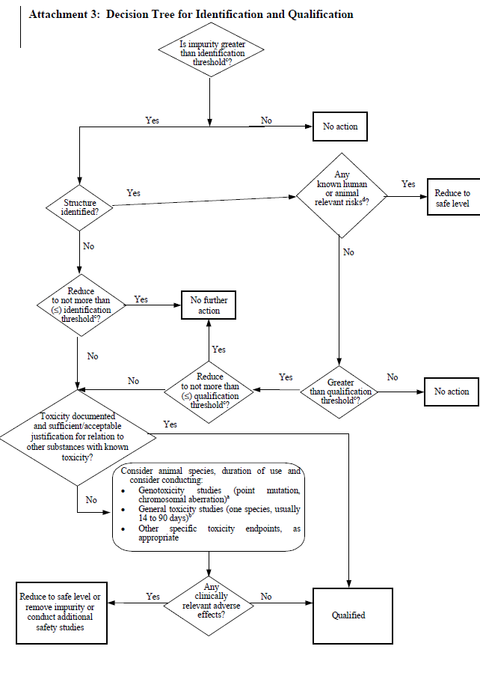
Decision tree

Slide 21
Notes on Decision tree
a) If considered desirable, a minimum screen (e.g., genotoxic potential), should be conducted. A study to detect point mutations and one to detect chromosomal aberrations, both in vitro, are considered an appropriate minimum screen.
b) If general toxicity studies are desirable, one or more studies should be designed to allow comparison of unqualified to qualified material. The study duration should be based on available relevant information and performed in the species most likely to maximise the potential to detect the toxicity of an impurity. On a case-by-case basis, single-dose studies can be appropriate, especially for single-dose drugs. In general, a minimum duration of 14 days and a maximum duration of 90 days would be considered appropriate. Lower thresholds can be appropriate if the impurity is unusually toxic.
d) E.g., do known safety data for this impurity or its structural class preclude human or animal exposure at the concentration present?

Slide 22
Table illustrating reporting of impurity results
‘Raw’ Result Action (%) | Reported Result (%) | Action | Action
 |  | Identification (Threshold 0.20%) | Qualification (Threshold 0.50%)
0.166 | 0.17 | None | None
0.1963 | 0.20 | None | None
0.22 | 0.22* | Yes | None
0.649 | 0.65* | Yes | Yes*
*Actions may be necessary after identification, e.g. if the response factor differ from the assumptions

