Slide 1
GL 51 – Statistical evaluation of stability data

Slide 2
Disclaimer
These slides have been provided for training purposes only. The presenter has made every attempt to ensure that they are consistent with relevant VICH guideline(s).
As always, the original Guideline(s) should be used as the primary source of information for working with regulators.

Slide 3
Presentation plan
General objective / scope of guideline GL 51
When use VICH GL 51 guideline?
General principles of stability data evaluation
Basic concepts
Data presentation
Extrapolation
Rules for establishing retest period / shelf life
Drug substances and drug products intended for room temperature storage
Drug substances and drug products intended for storage below room temperature
Statistical approaches

Slide 4
Scope of GL51
GL51 addresses additional guidance for the evaluation of stability data for drug substances and medicinal products intended for storage at (or below) room temperature (i.e. for which formal stability studies are performed in long-term conditions at 5°C, 25°C or 30°C).
Label recommendations for excursions outside the recommended storage conditions are not covered by this guideline.

Slide 5
Objective of the guideline
Provide recommendations on how to use stability data generated in accordance VICH guideline GL 3 to propose a retest period or shelf life in a registration application.
Describe when and how extrapolation can be considered when proposing a retest period / shelf life that extends beyond the period covered by available data from long-term stability studies.
Application of this guideline is entirely optional. It is up to the Applicant to decide whether or not to use statistical analysis to support the claimed retest period/shelf-life.

Slide 6
When use VICH GL 51 guideline?
In the parent guideline GL 3, some recommendations are provided for analyzing the data of a quantitative attribute that is expected to change with time.
Where multiple factors are involved in a full- or reduced-design study, guideline VICH GL 51 can be used as additional guidance (guideline GL 3 includes few details and does not cover these situations).
When statistical analysis is called for to support extrapolation of the stability behaviour of drug substances or medicinal products beyond available long-term stability data (due to variability of results or to the degradation trend observed), further guidance is provided in this guideline.

Slide 7
General principles of stability data evaluation

Slide 8
General principles of stability data evaluation:
Basic concepts

Slide 9
General principles: basic concepts (section 2)
Evaluation of stability of drug substances and medicinal products:
The design and execution of formal stability studies should follow the principles of parent guideline GL 3 with testing of a minimum of three batches.
It is important that the veterinary medicinal product be formulated with the intent to provide 100% of the labeled amount of drug substance at the time of batch release, not to overestimate the shelf life.
Each critical quality attribute should be assessed separately, and an overall assessment should be made.
The retest period or shelf life proposed should not exceed that predicted for any single critical quality attribute.
The basic concepts of stability data evaluation are the same for single- versus multi-factor studies and for full- versus reduced-design studies (as presented in VICH guideline GL 45).

Slide 10
General principles: basic concepts (section 2) cont./
The recommendations on statistical approaches in this guideline are not intended to imply that use of statistical evaluation is preferred when it can be justified to be unnecessary.
The guideline outlines a stepwise approach to stability data evaluation and when and how much extrapolation can be considered for a proposed retest period or shelf life (decision tree in Appendix A), based on sequential evaluation of:
Stability results in accelerated conditions
Stability results in intermediate conditions (if appropriate)
Stability results in long-term conditions

Slide 11
General principles: basic concepts (section 2) cont./
Three criteria are used to evaluate data and progress in the decision tree:
Do results show significant changes (as defined in guideline GL3 ⁽¹⁾)?
Do results show little or no change / little or no variability?
Was a statistical analysis of long-term data performed ⁽²⁾?
Also see section 2.4.2 of the guideline GL 51, where examples are provided for physical changes not to be considered as significant changes in accelerated condition.
Whether data are not amenable to statistical analysis or that statistical analysis was not performed

Slide 12
General principles: basic concepts (section 2)
General principles of statistical analysis (when used):
Qualitative attributes and microbiological attributes are not amenable to statistical analysis.
In general, certain quantitative chemical attributes (e.g., assay, degradation products, preservative content) can be assumed to follow zero-order kinetics during long-term storage, making data amenable to statistical analysis as described in Appendix B (linear regression, poolability testing).
Although the kinetics of other quantitative attributes (e.g., pH, dissolution) is generally not known, the same statistical analysis can be applied, if appropriate.
Additional guidance on statistical procedure (other than described in Appendix B) can be found in the references listed in section B.6 of the guideline (but do not cover all applicable statistical approaches).

Slide 13
General principles of stability data evaluation: Presentation of data

Slide 14
General principles: data presentation (section 2.2)
How should data be presented in the regulatory dossier?
Stability data:
Data for all attributes should be presented in an appropriate format (e.g., tabular, graphical, narrative).
The values of quantitative attributes at all time points should be reported as measured (e.g., assay as percent of label claim).
Evaluation of data to support the proposed retest period / shelf life:
Evaluation of data should be included in the application*.
If a statistical analysis is performed, the procedure used and the assumptions underlying the model should be stated and justified.
A tabulated summary of the outcome of statistical analysis and/or graphical presentation of the long-term data should be included.
(* Refer to section 2.4 of the guideline for more details on justifications/discussions to provide for each case)

Slide 15
General principles of stability data evaluation: Extrapolation

Slide 16
General Principles: extrapolation (section 2.3)
Extrapolation is the practice of using a known data set to infer information about future data.
Importance of data analysis for extrapolation:
Extrapolation to extend the retest period or shelf life beyond the period covered by long-term data can be proposed, particularly if no significant change is observed at the accelerated condition.
The degree of variability of stability data (within and between batches) may affect the confidence that future production batches will remain within specification throughout its retest period or shelf life → when results show variability, performing statistical analysis can justify longer extrapolation.

Slide 17
General Principles: extrapolation (section 2.3)
How assess if extrapolation is appropriate?
Whether extrapolation of stability data at the long-term condition is appropriate depends on:
The extent of knowledge about the change pattern
The goodness of fit of any mathematical model
The existence of relevant supporting data
The correctness of the assumed change pattern is critical, which implies that:
The goodness of fit of any mathematical model used should be checked by statistical methods before proposing extrapolation of a retest period / shelf life.
The initial assumption that the same change pattern will continue to apply beyond the period covered by long-term data should always be verified post approval by additional long-term stability data as soon as they are available.

Slide 18
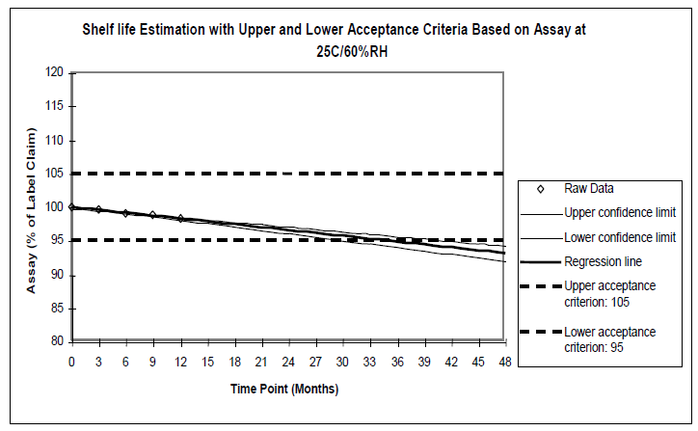
General Principles: extrapolation (Section B.7)
Example of graphical presentation of extrapolation data: assay

Slide 19
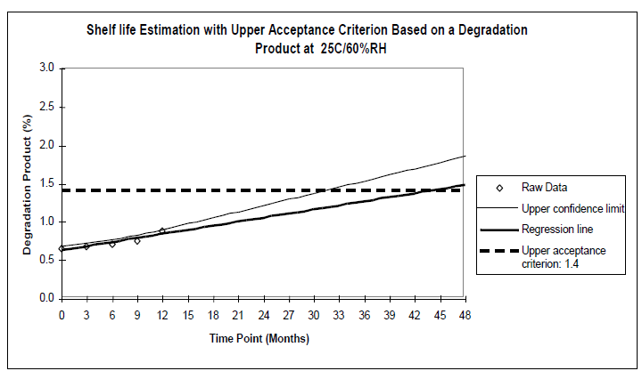
General Principles: extrapolation (Section B.7)
Example of graphical presentation of extrapolation data: degradation product

Slide 20
Rules for establishing retest periods / shelf lives
Drug substances and drug products intended for room temperature storage
Drug substances and drug products intended for storage below room temperature

Slide 21
How to establish retest periods / shelf lives:
Appendix A: Decision tree for data evaluation
What is the possible extension of retest periods / shelf lives beyond available long-term stability data at the time of regulatory approval?
There are four cases presented in the guideline:
Outcome 1: extrapolation up to twice the stability time points X available at the long-term condition, with a maximum of X + 12 months.
Outcome 2: extrapolation up to 1,5 x the stability time points X available at the long-term condition, with a maximum of X + 6 months.
Outcome 3: maximum 3 months extrapolation at long-term condition.
Outcome 4 (no extrapolation): retest period/shelf life to be based on long-term real time data.

Slide 22
Drug substances and drug products intended for room temperature (RT) storage

Slide 23
How to establish retest periods / shelf lives:
Substances/products - RT storage (section 2.4)
The first step is the analysis of results of accelerated data after 6 months’ storage, with two cases:
Absence of any significant change at accelerated condition
Significant change after 6 months at accelerated condition

Slide 24
Substances/Products intended for room temperature (RT) storage:
Case of no significant change after 6 months storage at accelerated condition

Slide 25
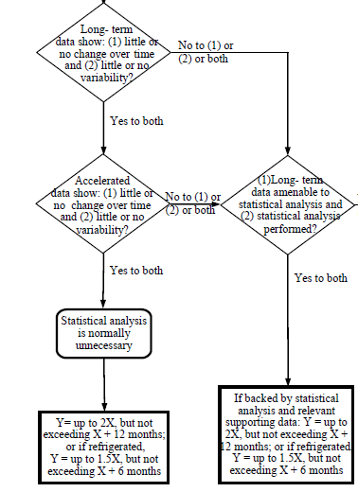
How to establish retest periods / shelf lives:
Substances/products - RT storage (section 2.4)
No significant change is observed at accelerated condition
Outcome 1: conditions allowing for maximum extrapolation
(2X, maximum X + 12 months)

Slide 26
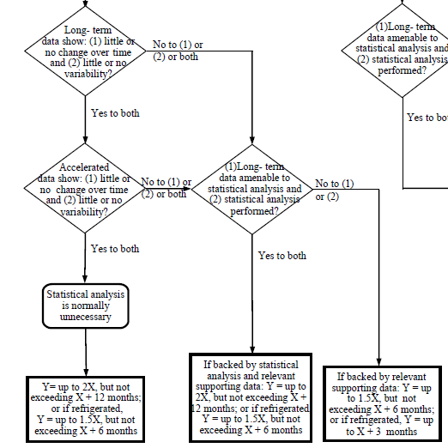
How to establish retest periods / shelf lives:
Substances/products - RT storage (section 2.4)
No significant change is observed at accelerated condition
Outcome 2: conditions allowing for limited extrapolation
(1.5X, maximum X + 6 months)

Slide 27
Substances/Products intended for room temperature storage:
Case of significant change after 6 months storage at accelerated condition

Slide 28
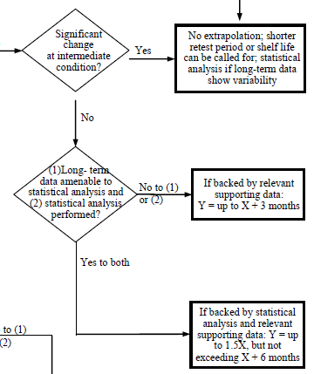
How to establish retest periods / shelf lives:
Substances/products - RT storage (section 2.4)
Case where significant change is observed at accelerated condition
Outcome 2: conditions allowing for limited extrapolation
(1.5X, maximum X + 6 months)

Slide 29
How to establish retest periods / shelf lives:
Substances/products - RT storage (section 2.4)
Case where significant change is observed at accelerated condition
Outcome 3:
3 months extrapolation
Outcome 4:
No extrapolation possible

Slide 30
Drug substances and drug products intended for refrigerated storage

Slide 31
How to establish retest periods / shelf lives:
Substances/products - refrigerated storage (section 2.4)
The first step is the analysis of results of accelerated data after 6 months’ storage, with two cases:
Absence of any significant change at accelerated condition
Significant change after 6 months at accelerated condition
NB: for substances/products intended for refrigerated storage, extrapolation based on results at the accelerated condition is always limited to a maximum of 1.5 X, not exceeding X + 6 months.

Slide 32
Substances/Products intended for regrigerated storage:
Case of no significant change after 6 months storage at accelerated condition

Slide 33
How to establish retest periods / shelf lives:
Substances/products - refrigerated storage (section 2.5.1)
No significant change is observed at accelerated condition
Outcome 2: conditions allowing for maximum extrapolation
(1.5X, maximum X + 6 months)

Slide 34
How to establish retest periods / shelf lives:
Substances/products - refrigerated storage (section 2.5.1)
No significant change is observed at accelerated condition
Outcome 3: conditions allowing for limited extrapolation
(maximum X + 3 months)

Slide 35
Substances/Products intended for refrigerated storage:
Case of significant change after 6 months storage at accelerated condition

Slide 36
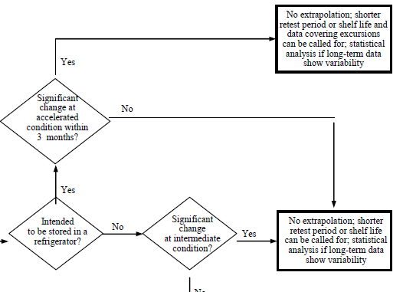
How to establish retest periods / shelf lives:
Substances/products - refrigerated storage (section 2.5.1)
Outcome 4:
No extrapolation possible
Case where significant change is observed at accelerated condition

Slide 37
STATISTICAL APPROACHES

Slide 38
Statistical Approaches (Section 2.6)
When a statistical analysis was employed to evaluate long-term data due to a change over time and/or variability,
the same statistical method should also be used to analyse data from commitment batches to verify or extend the originally approved retest period or shelf life.

Slide 39
Statistical Approaches (Section 2.6)
Statistical methodology:
Regression analysis is considered an appropriate approach for a quantitative attribute. Data may be transformed for linear regression analysis.
The relationship can be represented by a linear or non-linear function on an arithmetic or logarithmic scale. In some cases, a non-linear regression can better reflect the true relationship.
Depending on the stability trend of the attribute, either a one-sided 95 percent confidence limit (in case of a decreasing or increasing trend) or two-sided 95 percent confidence limits should be compared to the acceptance limit(s).
The statistical method used for data analysis should take into account the stability study design to provide a valid statistical inference for the estimated retest period or shelf life.
The guideline also provides recommendations for the levels of significance of statistical tests.

Slide 40
Statistical Approaches (Section 2.6)
Appendix B provides examples of statistical approaches :
Data analysis for a single batch
Data analysis for One-Factor (single strength, single container size), Full-Design studies:
Analysis of individual batches
Conditions for pooling batch data (ANCOVA and other methods)
Data analysis for Multi-Factor (e.g. several strengths or container sizes), Full-Design studies:
Evaluation wether all factor combinations support the proposed shelf life
Testing for poolability
Data analysis for bracketing design studies
Data analysis for matrixing design studies
List of literature references on statistical analysis applied to estimate shelf lives

