Slide 1
GL 5 – Photostability Testing of New Veterinary Drug Substances and Medicinal Products

Slide 2
Disclaimer
These slides have been provided for training purposes only. The presenter has made every attempt to ensure that they are consistent with relevant VICH guideline(s).
As always, the original Guideline(s) should be used as the primary source of information for working with regulators.

Slide 3
Presentation plan
General objective / scope of guideline GL 5
Description of the stepwise approach for generating photostability data for regulatory submission
Particular cases requiring in-use photostability testing on the drug product
Formal photostability studies: design and analysis
Number of batches
Illumination stress and light sources
Presentation of samples to light
Analysis of samples
Evaluation of results

Slide 4
General objective / scope of the guideline
Why a specific guideline?
Light exposure may result in degradation of drug substances or medicinal products during handling, storage, transport or end use, requiring specific precautionary measures.
Formal stability studies conducted under standard long-term, accelerated and intermediate conditions (as described in VICH guideline GL 3) do not simulate the potential indoor or outdoor daylight exposure as might occur during handling, storage, transport or use of drug substances and products.
→ Need for additional guidance on how to generate relevant photostability data to support pharmaceutical development (e.g. precautional measures during manufacture, choice of primary and secondary packaging) and label recommended storage conditions.

Slide 5
General objective / scope of the guideline
Objective of the guideline:
It addresses the generation of photostability information for submission in Registration Applications for new molecular entities and associated drug products.
It provides recommendations for a systematic stepwise approach to photostability testing.
Alternative approaches may be used if they are scientifically sound and justification is provided.
What is not covered by the guideline:
The guideline does not cover the photostability of drugs after administration (i.e. under conditions of use).
The guideline does not cover formal labeling requirements (label requirements are established by national/regional requirements).
The guideline does not cover those applications not covered by the Parent Guideline.

Slide 6
Systematic stepwise approach recommended for photostability testing

Slide 7
Stepwise approach to photostability testing:
- 1^{rst} step: Drug Substance testing (Section 2 of the guideline)

Slide 8
Stepwise approach to photostability testing:
First step: Testing on the drug substance (section 2)
Photostability testing on the drug substance
PRELIMINARY FORCED DEGRADATION TESTING
Objective:
- Evaluation of photosensitivity / elucidation of degradation pathway
- Development of a stability indicating method
Procedure: One batch is sufficient. The design of experiments is left to the applicant’s discretion (exposure levels used should be justified)
CONFIRMATORY STUDIES
Objective:
- Provide the information necessary for handling, packaging and labeling of the drug substance.
Procedure:
- If the drug is clearly photostable or photolabile, a single batch can be selected as described in section 2.1.3 of parent guideline GL 3
- The light exposure procedure should meet requirements of sections B (Light sources) and C (Procedure) of the guideline
- If the results of the confirmatory study are equivocal, testing of up to two additional batches should be conducted

Slide 9
Stepwise approach to photostability testing:
- 2nd step: Drug Product testing (Section 3 of the guideline)

Slide 10
Stepwise approach to photostability testing:
Second step: Tests on the drug product
Logic of sequential photostability testing of the drug product(1/2):
Testing should progress starting from direct exposure of the drug product up to exposure of the drug product in its marketing pack. Testing can be stopped at the step at which results demonstrate that the drug product is adequately protected from light.
Exception: where it is demonstrated that the immediate pack is completely impenetrable to light (e.g. aluminum tubes), testing should normally only be conducted on directly exposed drug product.

Slide 11
Stepwise approach to photostability testing:
Second step: Tests on the drug product
Logic of sequential photostability testing of the drug product (2/2):
Management of changes:
1.A: Preamble of the guideline: “Normally, photostability testing is carried out on a single batch of material selected as described under Selection of Batches in the Parent Guideline. Under some circumstances these studies should be repeated if certain variations and changes are made to the product (e.g., formulation, packaging). Whether these studies should be repeated depends on the photostability characteristics determined at the time of initial filing and he type of variation and/or change made.”
This is particularly applicable to drug products.

Slide 12
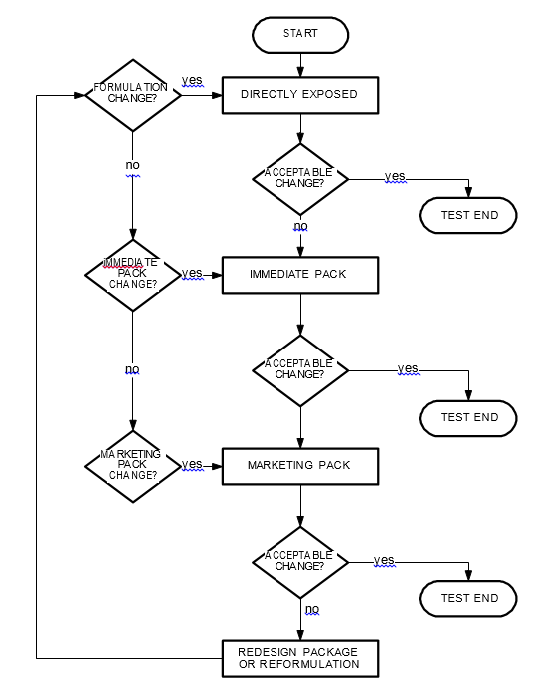
Stepwise approach to photostability testing:
Second step: Tests on the drug product (section 3)
Sequential testing of Drug Products:
Immediate pack (Glossary):
Constituent of the packaging that is in direct contact with the drug substance or drug product, and includes any appropriate label.
Marketing pack (Glossary):
Combination of immediate pack and other secondary packaging such as a carton.
Acceptable change (Section A):
Change within limits justified by the applicant.
NB (Sections 2.C and 3.C): for evaluation of results, it is important to consider the results from other formal stability studies.

Slide 13
Drug product photostability testing:
Particular cases requiring in-use studies
Particular cases requiring in-use photostability studies (not covered by the guideline):
It may be appropriate to test certain products such as infusion liquids, dermal creams, etc., to support their photostability in-use.
The extent of this testing should depend on and relate to the directions for use, and is left to the applicant's discretion.

Slide 14
Design of formal photostability studies:
Number of batches

Slide 15
Design of stability studies: number of batches
 | Number of batches | Section
Drug Substances | Normally, only one batch of drug substance is tested during the development phase, and then the photostability characteristics should be confirmed on a single batch selected as described in the Parent Guideline if the drug is clearly photostable or photolabile. If the results of the confirmatory study are equivocal, testing of up to two additional batches should be conducted. Samples should be selected as described in the Parent Guideline. | 2
Medicinal products | Normally, only one batch of drug product is tested during the development phase, and then the photostability characteristics should be confirmed on a single batch selected as described in the Parent Guideline if the product is clearly photostable or photolabile. If the results of the confirmatory study are equivocal, testing of up to two additional batches should be conducted. | 3

Slide 16
Design of formal stability studies:
Illumination stress and light sources

Slide 17
Design of stability studies:
illumination stress and light sources
Formal photostability studies aim at simulating the effect of exposure to indoor and outdoor light (as might occur during handing, storage or use of drug substances and drug products). For that purpose, samples should be exposed to the following illumination stress:
1.2 million lux overall exposure
Integrated UV of NLT 200 watt hours/m²
Option 1:
- Any light source can be used if designed to produce an output similar to the D65/lD65 emission standard (D65: internationally recognized standard for outdoor daylight as defined in ISO 10977, ID65: equivalent indoor indirect daylight standard)
Option 2:
Same samples exposed to both a cool white fluorescent lamp and a near ultraviolet lamp

Slide 18
Design of formal photostability studies:
Presentation of samples to light

Slide 19
Design of stability studies:
Presentation of samples to light (1/2)
The guideline provides recommendations regarding the procedure for presentation of samples to light (sections 1.C, 2.A and 3.A), in order to reduce variability of results and ensure that any observed degradation does not result from effects of other factors (e.g. temperature increase, humidity, oxidation…):
Assurance that the specified light exposure is obtained can be ensured by a validated chemical actinmetric system, or using calibrated radiometers/lux meters. An example of an actinometric procedure is provided in the Annex of the guideline.
Efforts should be made to ensure that the physical changes (e.g. cooling and/or placing the samples in sealed containers to avoid evaporation or melting).
If direct exposure is not practical (e.g., due to oxidation of a product), samples should be placed in a suitable protective inert transparent container (e.g., quartz).
Possible interactions between the samples and any material used for containers, or for general protection of the sample, should be considered.

Slide 20
Design of stability studies:
presentation of samples to light (2/2)
The guideline also provides recommendations to ensure maximum and uniform exposure of samples to the light source:
For solid drug substances, the powder should be spread across the container to give a thickness of typically not more than 3 millimeters
For solid drug products tested outside their packaging, samples should be positioned to provide maximum area of exposure to the light source (e.g. tablets, capsules, etc., should be spread in a single layer).
If testing of the drug product in the immediate container or as marketed is needed, position (vertical/horizontal) of samples should be selected to provide for the most uniform exposure.
Some adjustment of testing conditions may have to be made when testing large volume containers (e.g., dispensing packs).

Slide 21
Design of formal photostability studies:
Analysis of samples

Slide 22
Analysis of stability results:
analysis of samples
At the end of the exposure period, samples should be examined for any changes in physical properties (e.g., appearance, clarity, or color of solution, dissolution/disintegration for dosage forms such as capsules) and for assay and degradants by a method suitably validated for products likely to arise from photochemical degradation processes.
For solid oral dosage form products, testing should be conducted on an appropriately sized composite of, for example, 20 tablets or capsules
Sampling considerations also applies to other materials that may not be homogeneous after exposure (e.g., creams, ointments, suspensions).
The analysis of the exposed sample should be performed concomitantly with that of any protected samples used as dark controls (used in the test).

Slide 23
Analysis of photostability results:
Evaluation of results

Slide 24
Analysis of stability results:
evaluation of results
Drug Substance:
For the evaluation of results, it is important to consider the results from other formal stability studies in order to assure that the drug will stay within justified limits at time of use.
The confirmatory studies should identify precautionary measures needed in manufacturing or in formulation of the drug product, and if light resistant packaging is needed.
Drug Product:
For the evaluation of results, it is important to consider the results from other formal stability studies, in order to assure that the product will stay within proposed specifications during the shelf life and throughout use.
Depending on the extent of change special labeling or packaging may be needed to mitigate exposure to light.

