Slide 1
The Implementation of VICH GL6 and GL38 in Evaluating the Environmental Impact of Animal Drugs in the US
Presented by
Wesley Hunter, Ph.D.
Leader, Environmental Team 1
Office of New Animal Drug Evaluation
Center for Veterinary Medicine
November 2021

Slide 2
Outline
US FDA Environmental Regulatory Framework
NEPA Overview
Tools
Implementing VICH GL6
Implementing VICH GL38
Example

Slide 3
Abbreviation List
VMP = Veterinary Medicinal Product
US terminology = animal drug
EIA = Environmental Impact Assessment
US terminology = Categorical Exclusion, Environmental Assessment (EA), or Environmental Impact Statement (EIS)

Slide 4
National Environmental Policy Act (NEPA, 1969)
Requires US Federal Agencies to consider the environmental impact of their actions (40 CFR Part 1500-1508)
US FDA promulgated regulations for implementing NEPA (21 CFR Part 25)

Slide 5
Regulatory Tools for NEPA
Environmental Impact Statements (EIS)
Environmental Assessments (EA)
Categorical
Exclusions
Exclusion from the need to prepare an EA or EIS
Public document; concise analysis to determine if significant environmental impacts would occur
Public document; complex analysis of the impacts of the proposed action and any alternatives
CFR, Title 40, Part 1500 - 1508

Slide 6
Categorical Exclusions
Proposed Action (e.g., new drug, indication, etc.)
21 CFR 25.33
Actions which the agency has predetermined do not individually or cumulatively have a significant effect on the human environment; and therefore, ordinarily do not require the preparation of an EA or EIS
Based primarily on agency actions that result in limited animal drug use or do not increase the animal drug use
Meets criteria
Categorical Exclusion

Slide 7
Categorical Exclusions
Proposed Action (e.g., new drug, indication, etc.)
21 CFR 25.33
Actions that do not increase use of an animal drug
Naturally occurring substances
Drugs for nonfood animals
Anesthetics that are individually administered
Nonsystemic topical and ophthalmic animal drugs
Drugs for minor species
Prescription drugs for terrestrial animals
Investigational use of animal drugs
Withdrawal of NADAs, ANADAs, or FAPs
Meets criteria
Categorical Exclusion

Slide 8
Categorical Exclusions
Extraordinary Circumstances:
If extraordinary circumstances are identified that indicate a specific proposed action, that ordinarily would be excluded, may significantly affect the quality of the human environment, then an EA will be required (21 CFR 25.15 and 25.21).

Slide 9
Environmental Impact
Agency Action
New Drug
Changes to Approved Drug
Meets Criteria
Does Not Meet Criteria
Extraordinary
Circumstances
Categorical Exclusion
Environmental Assessment (EA)
Acceptable Risk
(Mitigations if necessary)
Unacceptable Risk
Finding of No Significant
Impact (FONSI)
Environmental Impact
Statement (EIS) &
Record of Decision (ROD)

Slide 10
Implementation of VICH GL6 in the US
Adopted as FDA/CVM Guidance for Industry #89
In the US, reference to a Phase I EIA in VICH GL6 is equivalent to either a categorical exclusion (CE) or an environmental assessment (EA) under US regulations

Slide 11
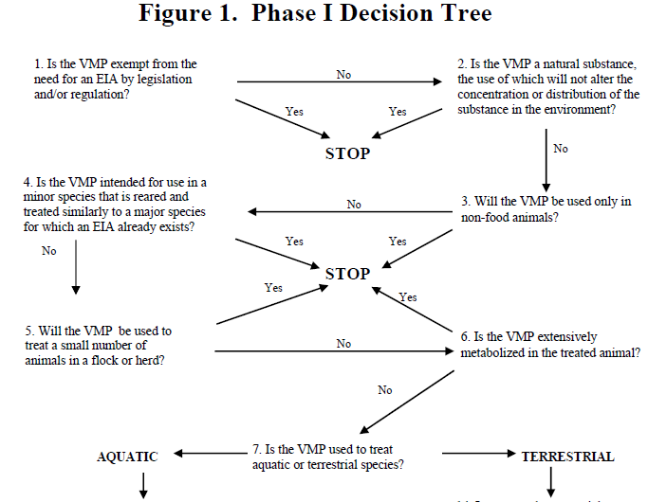
Boxed items may qualify for a categorical exclusion in the US

Slide 12
VICH GL6
Footnotes added to explain US terminology or when categorical exclusions could apply
Example 1:
Decision tree, Question 3: Will the VMP be used only in non-food animals?⁷
Footnote 7: In the US, these VMPs are usually categorically excluded under NEPA. (21 CFR 25.33(c), 25.33(d)(1), 25.33(d)(2), 25.33(d)(3), 25.33(d)(4), and 25.33(d)(5)).

Slide 13
VICH GL6
Example 2:
Decision tree, Question 6: Is the VMP extensively metabolized in the treated animal?⁸
Footnote 8: In the US, information provided in response to this question must be provided in an EA that includes documentation and mitigations, as appropriate, to support a FONSI. (21 CFR 25.40)

Slide 14
Implementation of VICH GL38 in the US
Adopted as FDA/CVM Guidance for Industry #166
Provides guidance for testing requirements for Phase II EA
Does not provide harmonized guidance on how to derive Predicted Environmental Concentrations (PEC)
CVM is currently working on guidance for the US for deriving PECs for drugs used in terrestrial animals and drugs used in aquaculture to supplement VICH GL6 and GL38

Slide 15
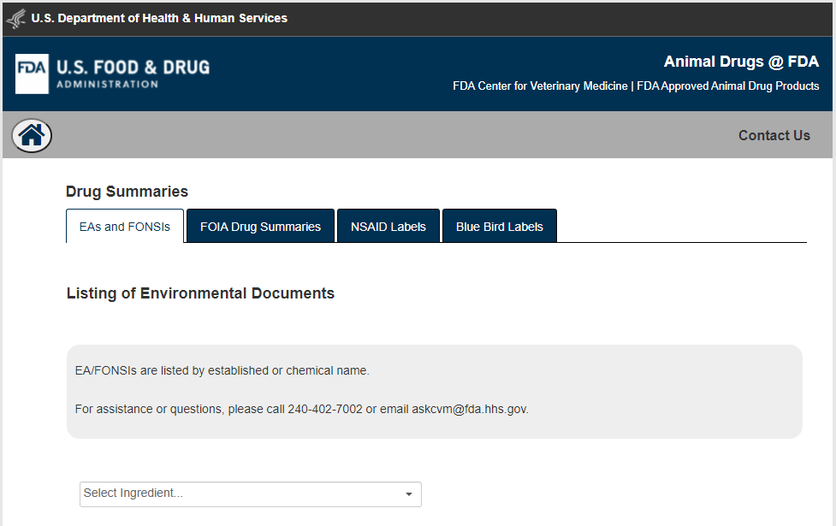
Publicly Viewable EAs and FONSIs
EAs (many following VICH GL6 and GL38) and FONSIs for approved animal drugs can be viewed at Animal Drugs @ FDA (https://animaldrugsatfda.fda.gov/adafda/views/#/environmentalAssessments)

Slide 16
Implementation of VICH GL6 and GL38
Agency Action
(e.g., new drug)
Environmental Assessment
VICH GL6 Phase I analysis
PEC_{soil}<100 ppb; PEC_{water}<1 ppb
Does not meet criteria
Categorical Exclusion / VICH GL6 decision tree
Extraordinary
circumstances
VICH GL38 Phase II analysis
Tier A (Acute)
Unacceptable risk
VICH GL38 Phase II analysis
Tier B (Chronic/reproductive)
Finding of No Significant Impact (FONSI)
Unacceptable risk
VICH GL38 Phase II analysis
Tier C (Further analysis)
Environmental Impact Statement (EIS) &
Record of Decision (ROD) / VICH GL38 Phase II analysis
Unacceptable risk
Risk Mitigation Options

Slide 17
Example Implementation of VICH GL6 and GL38
NEPA evaluation of 100 mg narasin/kg feed for prevention of coccidiosis in broiler chickens (NADA 118-980)
https://animaldrugsatfda.fda.gov/adafda/app/search/public/document/downloadEA/150

Slide 18
VICH GL6

Slide 19
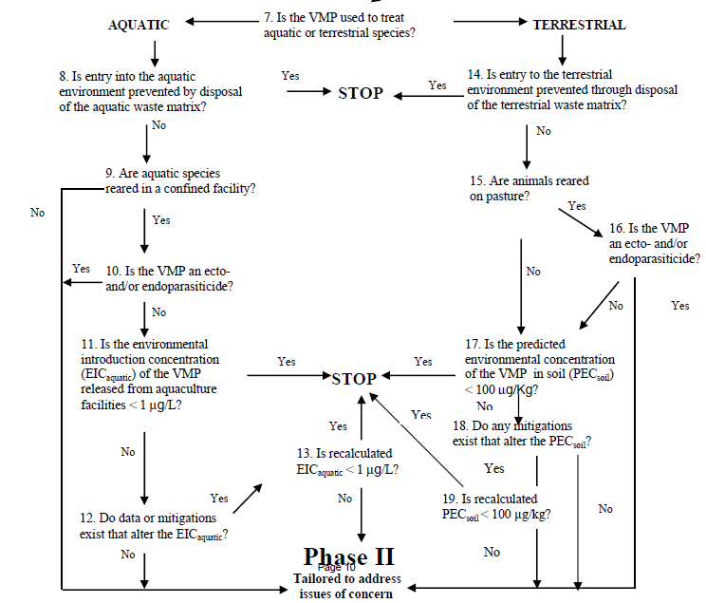

Slide 20
EA Following VICH GL36 for Narasin
EA contained data for:
Physical and chemical properties
Environmental fate
Toxicity to terrestrial and aquatic organisms
Risk was evaluated by calculating risk quotients (RQ):
RQ = PEC_{soil} or PEC_{water} divided by PNECs from Tier A (acute) toxicity tests
RQs < 1 for terrestrial and aquatic organisms. Therefore, no further evaluation needed and CVM prepared a Finding of No Significant Impact (FONSI)

Slide 21
Questions
AskCVM@fda.hhs.gov

