Slide 1
Rick Clayton Technical Director HealthforAnimals
Workshop on good regulatory practice
in an Asian context
November 2015, New Delhi
Feedback
Notes:
The Workshop Team
Workshop Moderator: Claire Davidson,
Session 1: Ruby Singh, FDA, USA (with help from Philippe Sabot, Merial)
Session 2: Ken Noda and Atsushi Yamamoto, MAFF, Japan, and Jean-Pierre Orand, ANSES, France
Session 3: Jason Todd, Veterinary Medicines Directorate, UK (with help from Philippe Sabot, Merial)
Session 4: Gilly Cowan, GALVmed and Rishendra Verma, Regulatory expert, India (with help from Philippe Sabot, Merial)
Session 5: Kevin Rice, FDA, USA (with help from Erik de Ridder, Elanco)
Session 6a: Jean-Pierre Orand, ANSES, France (with help from Erik de Ridder, Elanco)
Session 6b: David Murphy, European Medicines Agency (with help from Rick Clayton, HealthforAnimals)
Session 7: Melanie Leivers and David Mackay, European Medicines Agency

Slide 2
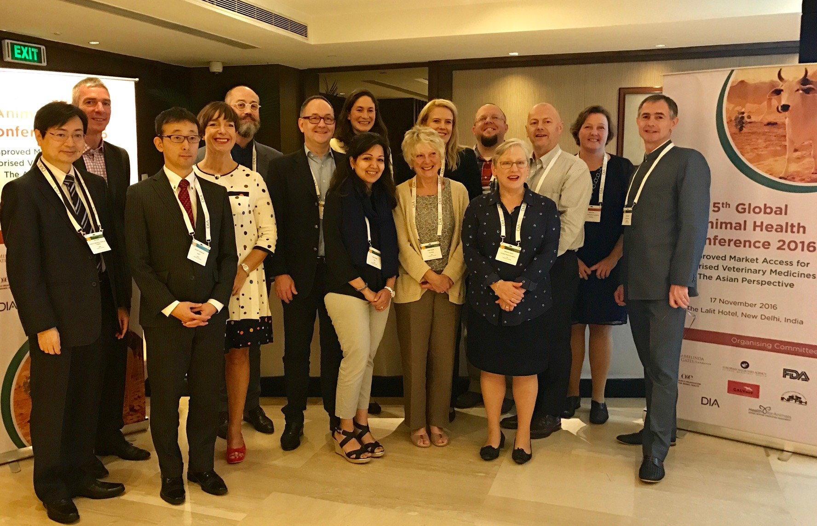
Thank
you

Slide 3
Workshop aims
The aim of this workshop is
to share knowledge and understanding of good regulatory practices and
to promote further close cooperation amongst a regional network of regulatory agencies.
This serves the wider aim of promoting animal health and contributes to the One Health approach.
Notes:
Specific objectives are to review and discuss:
The essential elements of a regulatory system for the marketing authorisation of veterinary products and the opportunities for stimulating the entry of new quality assured, safe and effective products on the market.
The roles of legislation and guidance documents, and alignment with international standards.
Good manufacturing practices (GMP), authorisation procedures for veterinary products and pharmacovigilance.
The benefits and hurdles of mutual recognition of marketing authorisation processes from other regions with internationally recognised regulatory systems, including GMP.
The benefits and hurdles of the formation of regional organisations to pool resources and the advantages of alignment with international standards.
The processes necessary for market control of veterinary products. How to tackle falsified products? What are the critical elements and where should resources be focussed?

Slide 4
Workshop objectives
To review and discuss – share knowledge and experience
The essential elements of a regulatory system
The roles of legislation and guidance documents
Authorisation procedures, GMP and pharmacovigilance
Mutual recognition - benefits and hurdles
Formation of regional organisations - benefits and hurdles
Market control of veterinary products

Slide 5
Workshop content
Session 1 – General
Session 2 – Legislation and Guidance
Session 3 – Manufacturing controls
Session 4 – Authorisation procedures
Including mutual recognition procedures
Session 5 – Logistics
Submission routes/formats, fees
Session 6 – Post-authorisation control
Variations, counterfeits, pharmacovigilance
Session 7 – Enabling factors
Encouraging investment, best use of resources

Slide 6
Workshop structure
Short presentation to introduce the topic (10’)
7 sessions / topic areas
Discussion of the topic
By table group (6 people from different backgrounds / countries)
As a full workshop
With a professional moderator
Summary ppt of key points and recommendations

Slide 7
Workshop structure
Workbook – presentations + notes pages
Roundtable seating x 6 groups

Slide 8
Workshop outcomes
Individual statements on their “take home” actions
All presentations/workbook publically available on the HealthforAnimals website
Workshop report
Mailed to each participant
Reports in two journals
Individual follow-up at 2 months and 6 months

Slide 9
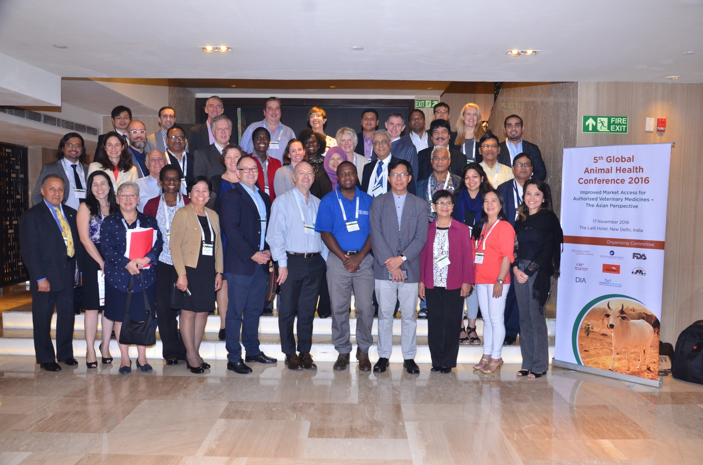
Global Animal Health Conference Workshop

Slide 10
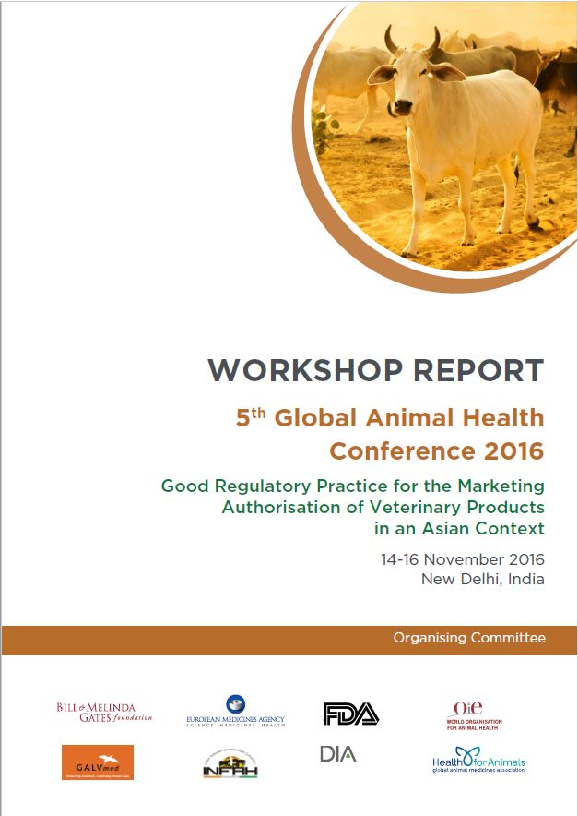
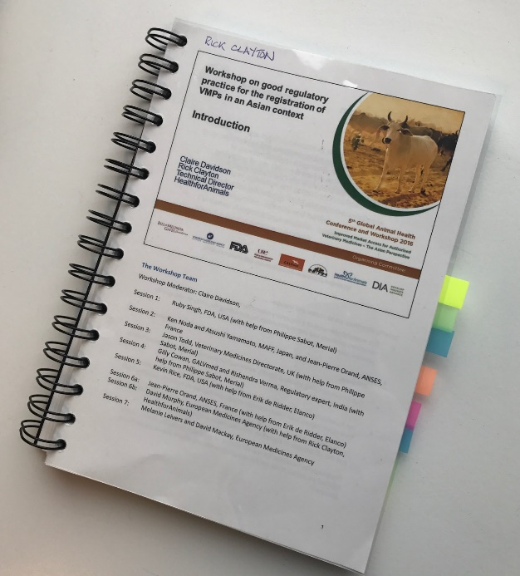
Global Animal Health Conference Workshop

Slide 11
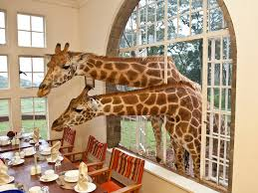
Global Animal Health Conference Workshop
Next event
Nairobi, Kenya, 12-14 June 2017

Slide 12
Annex
Workshop summary presentation

Slide 13
Session 1 - General
One Health concept
Benefits of
a good regulatory system and good quality control
alignment to international standards
active communication with stakeholders
Developing medicines regulation
human versus veterinary sectors
adapting the human regulations to the vet sector?
major differences in resources and benefit:risk
Recommendation: separate veterinary regulation

Slide 14
Session 1 - General
Challenges
Counterfeits – porous borders
Consistency in implementation of guidelines and standards
Training – industry – assessors
Senior Committee – discuss/agree – issue a ‘communication’ with consensus view
Regulatory collaboration, e.g.
Examples: ASEAN, ZaZiBoNa; also Int’l Trade Center
Memorandum of understanding – scope clearly defined
Recommendation: join VICH Outreach Forum

Slide 15
Session 2 – Legislation and Guidance
Responsibilities – Min of Ag vs Min of Health
Conclusion: needs good collaboration MoAg vs MoH
Responsibilities – who does what – must be defined
Joint human+vet or veterinary separate
Conclusion: there is not one common system used in the different countries due to different reasons
International and regional standards
Codex MRLs, OIE standards and VICH guidelines and ASEAN standards are extensively used
Local guidelines also used: e.g. Philippines ‘Good Husbandry Practice’
Guidelines implemented via manuals or administrative orders

Slide 16
Session 2 – Legislation and Guidance
Guidelines
Are a “guide” and not normally legally binding
Use of “shall” versus “can”
Could different approach be used if justified?
VICH guidelines – they do allow for national conditions
Developing guidelines
Critical to involve industry experts
Public consultation is important

Slide 17
Session 3 – Manufacturing controls
Formal approval of manufacturers
All countries – manufacturers are inspected/approved
Recognition of e.g. VICH countries inspection reports and products
Requirements for approval
Several GMP standards exist
Adapt GMP GLs to needs of VMP sector
EU Eudralex separates human and veterinary
Developing GMP guidelines
Do not waste resources but use the existing GLs

Slide 18
Session 3 – Manufacturing controls
Inspectors – resources needed
E.g.: 1 inspector per 30 sites; 80 days on site p.a.
Time: 1-3 days depending on complexity of site
UK: 3 inspectors for 100 VMP-only manu sites; shared facilities – rely on human meds inspections; 10 inspections/inspector/p.a.
Cooperation between countries is important
Recommendation: use risk-based approach
Focus resources to areas of higher risk
Accept inspections done by e.g. VICH countries
Length of validity of GMP certificate vs re-inspection schedule

Slide 19
Session 3 – Manufacturing controls
Inspectors – training
Mentoring: joint inspections; join visiting inspectors
Opportunities: Some countries run GMP training workshops; OIE capacity building (support from OIE Collaborating Centers) and OIE bios manu stds; US FDA on-line videos; PIC/S training facility
Ensure inspectors impartiality
Recommendations:
Need identified for VMP specific GMP training
Need a template for a 5-year inspector training program

Slide 20
Session 4 – Authorisation procedures
Dossier structure
Need different templates for human vs VMP and also pharmaceuticals vs biologicals
“We tried using human format but that did not work”
Harmonisation between countries is helpful;
Regional organisations are highly beneficial
(e.g. Gulf states; EAC; ASEAN; EU)
Benefits of electronic dossiers
easier for reviewers; take care of security of system

Slide 21
Session 4 – Authorisation procedures
Experts
Types (appointed by applicant or regulatory authority)
What is an expert; qualifications
What is the expert’s affiliation with the applicant?
What is an expert report; scope and purpose
List of experts, both gov. experts and company experts
New technology: experts only in the company?
Important
Define the qualifications; avoid conflicts of interest

Slide 22
Session 4 – Mutual recognition procedures
Benefits
to regulators and applicants
Faster availability of VMPs on several markets
Avoids duplication (efficient use of/sharing resources)
Examples: EU; USA/Canada; EAC
Builds trust between country authorities
Reduce animal use – “3Rs”
Key message
Leads to more robust and consistent assessments

Slide 23
Session 4 – Mutual recognition procedures
Challenges
Division of responsibilities
Resources
Fee allocation
Lack of consistent implementation of standards
Lack of political support behind MRP (+legislation)
Key message
Needs political support behind MRP (+legislation)

Slide 24
Session 4 – Authorisation procedures
The scientific review process
Define the review timelines
predictability and transparency are important to applicants
Can the applicant inter-act with the assessor?
E.g. via defined channels and time-points in the process
Fast-track procedures?
Often possible, e.g. via special import licence
Shared liability system with the manufacturer
Conditional/provisional; basic safety, reasonable expectation of efficacy
Appeal process
Formal defined process or via normal channels of dialogue

Slide 25
Session 5 - Logistics
Dossier – paper or electronic?
VICH countries – mostly electronic + Brazil
Other countries – paper dossiers; interested in e-dossiers but need resources and capacity building
Archiving and security
Secure archiving critical; life-cycle management
Security to protect proprietary data essential – trust
Confidentiality and transparency – right balance
Stimulates commercial investment and collaboration
Summary of key information for the public (e.g. EPAR)

Slide 26
Session 5 - Logistics
Applicant (or user) fees
Most countries have a fee system; others considering
Transparency – publish fee schedule
Fair ‘fees for service’;
but be efficient and avoid unnecessary admin costs
Scale of fees depending on product type
Some aspects may be ‘set’ in legislation
Fees can support a good regulatory system;
Investment in staff, experts and infrastructure
Fosters innovation in VMPs
“Regulatory capture” not an issue (it is a matter of compliance)

Slide 27
Session 6 – Post-authorisation control
Handling variations to the dossier
Manufacturing changes
Required changes (e.g. response to PHV reports)
Risk based: requires assessment or not (approval from regulator or just notification from manufacturer)
If variation in several countries are not harmonised; the manufacturer may need two parallel productions (new and old version of product)
Controlling admin burden
E.g. grouping of variations and regional worksharing

Slide 28
Session 6 – Post-authorisation control
Tackling falsified and counterfeit products
3 pillars: Marketing authorisations, inspections and market surveillance
Control distribution chain (from manu. to customer)
Risks from illegal / counterfeit products (no efficacy; or high toxicity; consumer risk)
Correct storage along distribution chain
Inspections needed at each level of distribution chain
GMP, but also need Good Distribution Practice
Manufacturer: recall and complaints handing systems
Key message
Inspectors: need powers, rules and defined duties

Slide 29
Session 6 – Post-authorisation control
Legal market and counterfeit products
Use a risk-based approach – focus on bigger risks
Antibiotics, notifiable diseases, high risk to user
Testing product sampled from marketplace
Quality (active ingredient), potency of vaccines;
Accredited lab and capacity building
Cooperate with neighbours internationally
Control of internet sales – a growing issue
On-farm inspections
record keeping, storage conditions, prescription compliance

Slide 30
Session 6 - Pharmacovigilance
Essential elements were presented:
Definition, importance, benefits, legislation and guidelines, how to develop and promote a system
Discussion
Most countries have, or are in the process of establishing, a pharmacovigilance system
Adaptation of human meds system to VMP sector
N.B. VMP sector has much less resources and very different risk:benefit scenario
Legislation is needed
Regional cooperation (use international standards/definitions)
VICH guidelines exist
Need to make reporting easy and promote awareness

