Slide 1
Regulation of medicated animal feeds In New Zealand
Warren Hughes
Ministry for Primary Industries, New Zealand

Slide 2
Topics
The veterinary medicine and animal feed regulatory regime in New Zealand
Medicated Animal Feeds

Slide 3
ACVM Act

Slide 4
The ACVM Act
MPI administers the Agricultural Compounds and Veterinary Medicines (ACVM) Act 1997 and the ACVM (Exemptions and Prohibited Substances) Regulations 2011
The ACVM Act and Regulations manage the importation, manufacture, sale, and use of all veterinary medicines, agricultural chemicals, vertebrate toxic agents, animal feeds, fertilisers etc.

Slide 5
ACVM Act – Purpose
Manage risks associated with use of agricultural compounds being
Risks to animal welfare
Risks to public health
Risks to agricultural security
Risks to trade in primary produce
Plus
Ensure that the use of agricultural compounds does not result in breaches of domestic food residue standard
Ensure the provision of sufficient consumer information about agricultural compounds
ACVM Act 1997

Slide 6
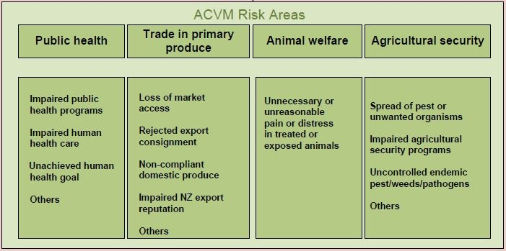
ACVM Act - Regulatory Framework
Out of Scope
Risk Areas
Agricultural Security
Trade
Animal Welfare
Public Health
No
Is the product an Agricultural Compound
Ensure compliance with Domestic Residue Standards
Yes
Product
can be imported, manufactured, sold and used subject to Conditions and Regulations (as applicable)
Authorisation required under ACVM Act
RISK
Passive
Regulatory
Oversight
Meets exempt from registration criteria under ACVM(E&PS) Regs
Yes
Low
No
Meets GRAS criteria
Section 8B
Risk Assessment
Authorised
Active
Regulatory
Oversight
Or
Meets Special Circumstances criteria
Section 8C
Or
High
Meets Registration criteria
Section 9

Slide 7
Exemption from Registration
Low risk and/or non therapeutic products - no ongoing active regulatory management is required
Includes oral nutritional compounds (animal feeds), compounding by veterinarians, fertilisers
Exemptions from registration are listed in the ACVM (Exemptions & Prohibited Substances) Regulations by product group
Manufacturers and users are required to ensure exempt products are fit for purpose, and meet the conditions of exemption applied to each group

Slide 8
Registration
Risks are such that assessment and active regulatory oversight is required
Focus is on therapeutic uses and pest control
Includes antibiotics, drenches, vaccines, fungicides, herbicides, and insecticides
Trade Name Products
Defined formulation
In a discrete package

Slide 9
Registration
Level of regulatory oversight for a product requiring registration is based on its risks
In general, veterinary medicines are treated either as
Over the Counter (ie any person can purchase the product); or
Restricted Veterinary medicine (RVM)
The Act being outcome based legislation, the above are specified.
Provides flexibility

Slide 10
Registration Requirements
Therapeutic Substance
Information requirements:
Product Chemistry and stability
Manufacturing including Good Manufacturing Practice approval
Efficacy and Target Animal Safety
Residues
Label

Slide 11
Registration Requirements
Therapeutic Substance
The product may be restricted over its sale and use by requiring a veterinary authorisation
Key label requirements:
Animal species and associated condition being treated
Dose rate to be applied to feed
Contraindications
Withholding Period

Slide 12
Restricted Veterinary Medicines

Slide 13
Restricted Veterinary Medicines (RVMs)
Restrictions to manage greater risk associated with sale, purchase or use
Risks to Welfare
Treats a condition that needs a veterinary diagnosis
Needs veterinary monitoring during or after use
Needs veterinary administration
Needs post-administration monitoring for side effects
Antibiotics, anaesthetics, certain vaccines, controlled substances

Slide 14
Restricted Veterinary Medicines (RVMs)
Risks to Trade
To meet overseas country’s obligations
To comply with an international standard
To comply with a domestic standard
Use of therapeutic compounds for which residues are not permitted in certain species (e.g. phenylbutazone)

Slide 15
RVMs – Veterinarian’s Role
Veterinary Authorisation
A veterinary authorisation is set of instructions from a registered practising veterinarian authorising a specified person to:
Purchase a RVM
Use a RVM in accordance with the authorisation
Hold a RVM in anticipation of later use
Equivalent to the commonly used term ‘veterinary prescription’

Slide 16
RVMs – Veterinarian’s Role
Registered practicing veterinarians are recognised under the ACVM Act to authorise RVMs
Veterinarians must comply with the ACVM Notice: Requirements for Authorising Veterinarians
Recognition can be revoked

Slide 17
Medicated Animal Feeds

Slide 18
Regulatory Oversight
Medicated Animal Feeds
How to manage medicated animal feeds versus animal feeds as their risk profiles are different
Mechanisms are:
ACVM Regulations exempting animal feeds from registration
ACVM Act for registration of therapeutic substances

Slide 19
Regulatory Oversight
Animal Feeds
Exempt from registration under Regulations
Feed and Feed Additives are defined
Feed means providing nourishment
Feed Additive means a substance added to feed to improve its preservation, digestion, colour, palatability, texture or nutritive value
Exemption is in Schedule 2, number 25

Slide 20
Regulatory Oversight
Animal Feeds v Medicated Animal Feeds
Conditions on the exemption
Therapeutic or pharmacological substances can only be added to the animal feed if:
The substance is registered; and
Its incorporation into the animal feed is consistent with its label instructions and conditions of registration
If not compliant with this condition, then the animal feed containing the substance is no longer an animal feed, rather a therapeutic product – it would require registration.

Slide 21
Regulatory Oversight
Medicated Animal Feeds must not:
Contain unregistered products, or therapeutic/pharmacological ingredients
Make therapeutic claims based on nutritional (“normal” feed) ingredients
Make claims that are prohibited for the registered product (e.g. unsupported therapeutic claims, GP claims when prohibited for TNP)
These would also make the feed non-compliant with the condition of exemption, requiring it to be registered as its own product.

