Slide 1
Registration of veterinary products in developing countries
Differences with VICH member countries Acceptance of studies conducted according to VICH GLs
MV Carlos Francia
CAPROVE – Argentina
8th Outreach Forum – Buenos Aires- 2017

Slide 2
Contents
Registration of veterinary products in developing countries
Differences with VICH member countries
Epidemiologic and productive situations
Register System
Acceptance of studies conducted according to VICH GLs
Conclusions

Slide 3
Contents
Registration of veterinary products in developing countries
Differences with VICH member countries
Epidemiologic situations
Register System
Acceptance of studies conducted according to VICH GLs
Conclusions

Slide 4
Different epidemiologic situations
Differences in prevalence of several pathologic conditions
Importance of ectoparasites
Tropical and subtropical regions: Different species; same species, different challenges
Cold regions
Endectocides
Endoparasites resistant strains
Resistance to Antimicrobial Drugs
Approach varies between countries

Slide 5
Different productive situations
Extensive productive systems
Cattle confined fattening vs feed lot
Subsistence productive systems
Different species (sheep, Camelidae, etc): criteria for minor species uses

Slide 6
Contents
Registration of veterinary products in developing countries
Differences with VICH member countries
Epidemiologic and productive situations
Register System
Acceptance of studies conducted according to VICH GLs
Conclusions

Slide 7
Differences in Register System
Innovative and generic approach vs new products approach
Mexican experience in change the systems
Application form
Why is needed
Development
Draft guidelines to complete the Application forms (pharma and bio products)

Slide 8
Contents
Registration of veterinary products in developing countries
Differences with VICH member countries
Epidemiologic and productive situations
Register System
Acceptance of studies conducted according to VICH GLs
Conclusions

Slide 9
Acceptance of studies conducted according to VICH GLs
As general models the VICH guidelines are recognized and recommended by authorities to develop studies required for register
The epidemiologic and productive differences provoke the need of local studies in several cases
Lack of original studies for important local pathologic conditions.
Official campaigns
Doubts about challenge
Local approach to AMR
Minor species criteria
Lack of adequate training (both sides)

Slide 10
Contents
Registration of veterinary products in developing countries
Differences with VICH member countries
Epidemiologic and productive situations
Register System
Acceptance of studies conducted according to VICH GLs
Conclusions

Slide 11
Conclusions
Training
The CAMEVET project
Flexibility in the guideline use
Translation
Inclusion of studies in different climatic zones in the development process of new products.
Development of local guidelines for specific situations

Slide 12
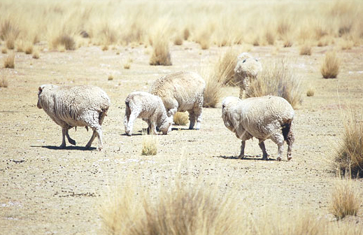
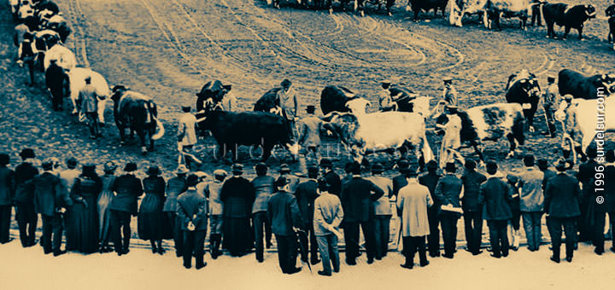
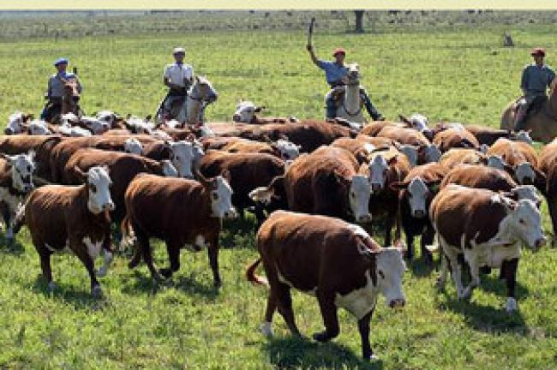
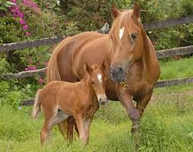
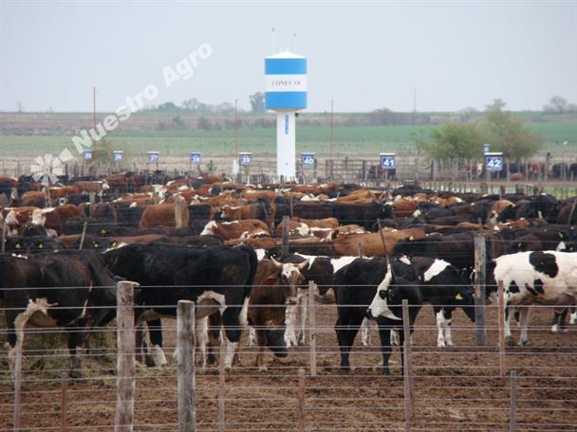
Thank You!

