Slide 1
VICH Public Conference 6: February 2019 STATUS UPDATE
Dr A T Sigobodhla
November 2017

Slide 2
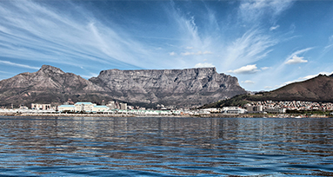
THEME: “GETTING IT TOGETHER IN AFRICA”
Thinking behind the theme:
The event will provide an excellent forum from which harmonised collaboration and recent cutting-edge technologies and science can be fostered.
In addition, the event will allow us to pursue active discussion on opportunities and challenges faced by medicines regulators and the industry around the world and in Africa in particular in support of regulatory convergence..

Slide 3
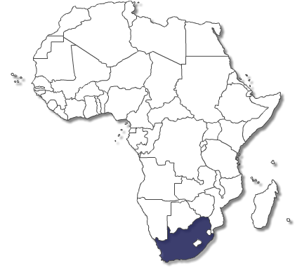
LOCATION: CAPESUN
Telephone: +27 21 488 5100, Fax: +27 21 423 8875 Email Us: sscapesun.reservations@tsogosun.com
Physical Address 23 Strand Street Cape Town, 8000
GPS Coordinates 33°55'17.29'' S | 18°25'18.73'' E

Slide 4
PROPOSED AGENDA SESSIONS
Session 1: Official opening
History/benefits of VICH and OIE
Session 2: Keynote addresses
Session 3: How to use VICH guidelines
Session 4: Voice of Industry
Session 5: Contribution to animal welfare

Slide 5
PROPOSED AGENDA ….. cont
Session 6: VICH now
Session 7: Topics of interest to Observers and VOF members
Session 8: Global perspectives
Session 9: Finale

Slide 6
WEBSITE: HOME PAGE
Home Programme SC meetings Outreach Forum sessions Venue Accommodation Exhibitions Travel information Airport transfers Tours
“GETTING IT TOGETHER IN AFRICA” COUNT DOWN TIMER
6th International Cooperation on Harmonisation of Technical Requirements for Registration of Veterinary Medicinal Products (VICH) Conference
Cape Town, South Africa, February 27-28 2019

Slide 7
Organising Task Team
Contact details
General conference enquiries can be directed to:
Dr Rachel Cumberbatch: RCumberbatch@ahi.org
Dr Hervé Marion at: sec@vichsec.org
Dr Alice T Sigobodhla at: sigobA@health.gov.za
Mr Ernest Schay at: ernest.schay@bayer.com
We look forward to welcoming you in Cape Town, South Africa.

Slide 8
THANK YOU

