Slide 1
ARGENTINE STRATEGY FOR THE CONTROL OF ANTIMICROBIAL RESISTANCE
DIRECCIÓN NACIONAL DE AGROQUÍMICOS, PRODUCTOS VETERINARIOS Y ALIMENTOS

Slide 2
SENASA Join the National Health Ministery and with the colaboration of:
Universities
Professional associations
World Organisation for Animal Health. OIE

Slide 3
Join Resolution Nº 834/2015 y 391/15 Ministry of Health Ministry of Agroindustry

Slide 4
Join Resolution Nº 834/2015 y 391/15 Ministry of Health Ministry of Agroindustry
Creates Argentine Strategy for the Control of Antimicrobial Resistance

Slide 5
Join Resolution Nº 834/2015 y 391/15 Ministry of Health Ministry of Agroindustry
Establish the National policies for the control of AMR.
Integrated Policies

Slide 6
Join Resolution Nº 834/2015 y 391/15 Ministry of Health Ministry of Agroindustry
Need to create a surveillance system of AMR in animal health

Slide 7
Resolution SENASA 591/15
Program of surveillance of AMR in animal health

Slide 8
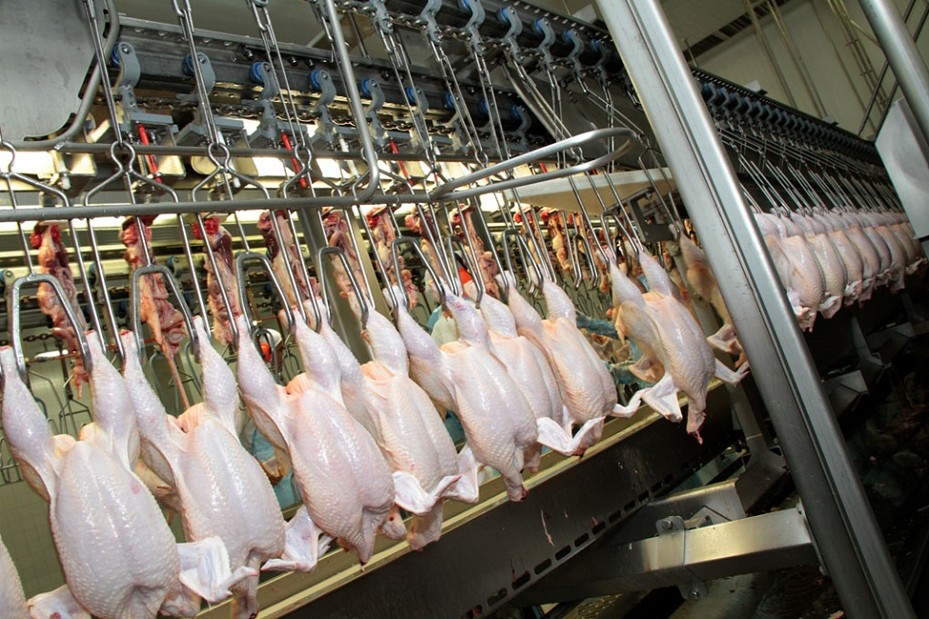
Program of surveillance of AMR in animal health
Fecal Samples taken in slaughterhouse
SENASA has enabled slaughterhouse
Pigs: 313
Bovines: 322
Poultry: 65

Slide 9
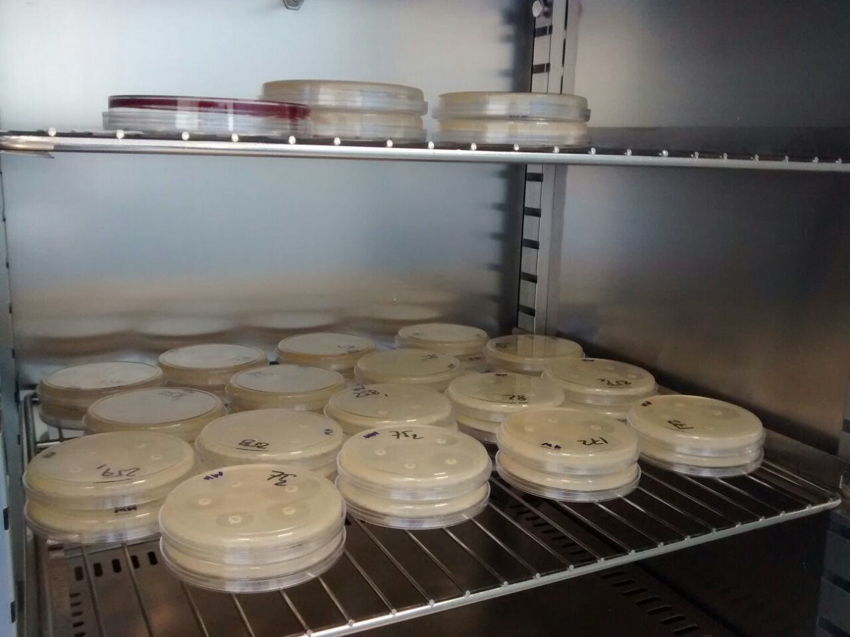
Program of surveillance of AMR in animal health
Bacterial isolation
As Indicators: Escherichia coli y Enterococcus spp
As Zoonotics: Campylobacter spp y Salmonella spp

Slide 10
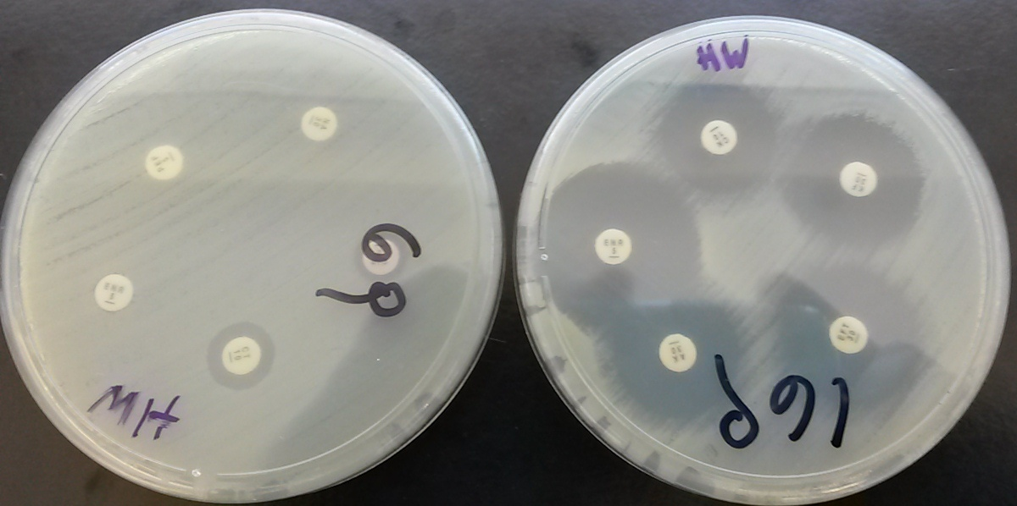
Program of surveillance of AMR in animal health
Test of antimicrobial sensibility

Slide 11
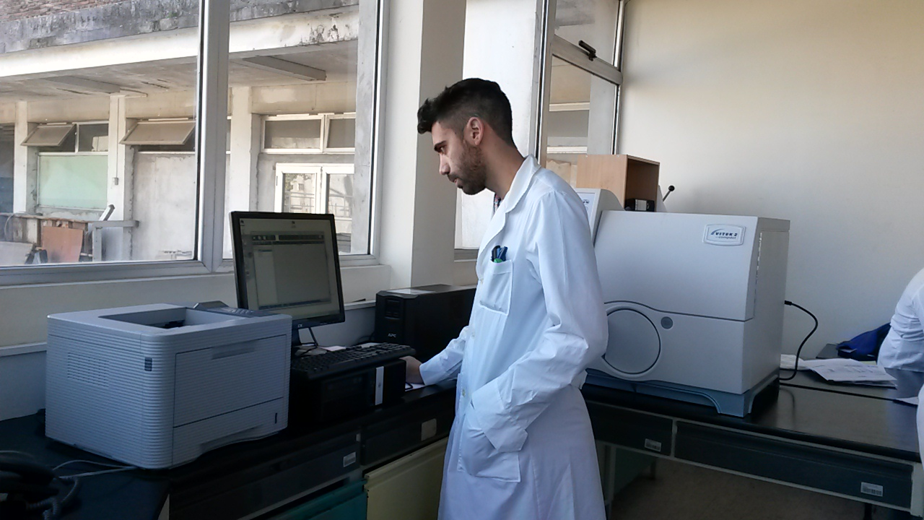
Program of Surveillance of AMR in animal health
The Information concerned to resistance will be recorded and analized in WHONET

Slide 12
Program of Surveillance of AMR in animal health
Expected Benefits
To Know the antimicrobial resistance phenotypes
To evaluate the impact that mitigation actions have on the prevalence of AMR

Slide 13
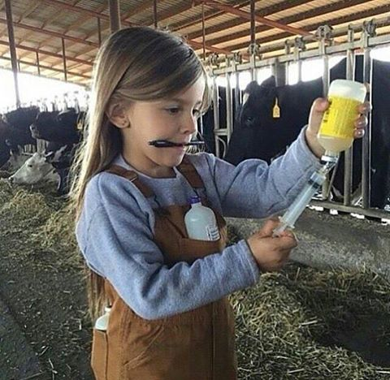
Mitigation Actions
Good livestock practices.
Racional use of veterinary products
“PRESCRIPTION” of veterinarian productos.
Regulation of marketing authorization for veterinary products

Slide 14
Prospects to the future
Take more samples per species.
Communication and education.
Communication to another countries

Slide 15
Thanks you very much

