Slide 1
Dr Mária Szabó
Chargée de mission OIE Science and New Technologies Department
The OIE report to the 8th VICH Outreach Forum Meeting
Buenos Aires (Argentina), 28 Feb-1 March 2017

Slide 2
The OIE activities since in Veterinary Medicinal Products since June 2016 :
Further update on support provided by the OIE
Promotion of VOF activities
Meetings with the OIE involvement, which might also be of interest to the VICH
Update on Publications

Slide 3
Further update on support provided by OIE

Slide 4
Support provided by the OIE
Dissemination of information on VICH to OIE member countries
Feedback to OIE Delegates of Outreach Member countries
Promotion of VICH and Outreach Forum objectives
Support to VICH: Training Strategy development, surveys
Liaison with OIE Specialist Commission (BSC)

Slide 5
Support Provided by the OIE
Liaison with Specialist Commissions, for example Biological Standard Commission (BSC)
Information exchange on waiving Target Animal Batch Safety Test (TABST) in live and attenuated vaccines
To achieve greater harmonisation with the OIE Chapter 1.1.9 Chapter and further guideline(s) on general principles for detection of extraneous viruses in veterinary vaccines and defining the testing of seeds and materials of animal origin (2) a list of extraneous viruses.

Slide 6
Support Provided by the OIE
Liaison with Scientific Commissions for example Biological Standard Commission (BSC)
Update on the Manual Chapter 3.3.4 (the role of official bodies in the international regulation of veterinary biologicals via OIE collaborating Centers
Permanent contact with the VICH, VOF and the OIE-BSC

Slide 7
Information to OIE Member Countries
After 33nd VICH SC / 7th Outreach Forum meeting, a letter has been sent to all 180 OIE Member Countries (28 November 2016) :
Summary of the meetings
Recommendations from the meetings
Invitation letters sent to the Delegates, copied to Focal Points for Veterinary Products and also the Representative to the VICH (12 December 2016)

Slide 8
Outreach Forum Countries
Objective:
Highlight the VICH Outreach Forum activities
Remind the OIE position and provide supports
Support participation by Outreach Forum Countries and underline the need for sustainability

Slide 9
Promotion of VOF activities

Slide 10
Promotion of VICH Forum activities
4th cycle OIE Focal Points for Veterinary Products training seminars has been completed by the European Seminar in Budapest (11-13 October 2016):
Next:
December 2017, Swaziland  EN speaking African region
October 2017, Amman  Middle East
Notes:
I will talk later (in other presentation) on the VICH Survey which we conducted in the European Seminar .

Slide 11
Promotion of VOF activities
4 ^{th} cycle seminar in Budapest was targeted mainly to non-EU Member Countries (MCs) as some
not yet provided data for the OIE questionnaire on collection of data on the use of antimicrobial agents
not yet demonstrated interest on VICH Outreach Forum (except Russia and Ukraine )
do not have well developed procedures for authorising veterinary drugs and vaccines.
The seminar was also open to OIE National Focal Points from the EU Member Countries (53 Member Countries)
Notes:
Who were interested to updating their knowledge on the OIE and its role in supporting OIE Delegates, as well as enriching other Member Countries with their experience on issues related to antimicrobial resistance (AMR) and collection of data and interesting to boarding their network

Slide 12
Not just Promotion of VOF activities
The aim of this seminar was:
the AMR including the Global Action Plan, the OIE database on the use of antimicrobial agents.
Overview of authorization system of drugs and vaccines in EU and non-EU MC.
Antiparasitic drugs and challenges; - quality of veterinary products including the counterfeit medicines.
General principles and implementation of VICH guidelines, update on VICH Outreach Forum activities.
Experience-sharing and FP activities as well as discussion among countries in the region.

Slide 13
Meetings with the OIE involvement, which might also be of interest to the VICH

Slide 14
Meetings with the OIE involvement, which might also be of interest to the VICH (1)
23rd Session of the Codex Committee on Residues of Veterinary Drugs in Foods (CCRVDF23)
Houston, Texas, United States of America (17 – 21 October 2016)
The OIE provided a written and an oral report including and highlighting the VICH activities
Joined the Electronic WG on prioritisation of MRLs for veterinary drugs
Notes:
The OIE will continue to address food safety-related issues as a high priority in its standard-setting work and will work closely with CAC and its Committees, and with other international organisations in promoting safe international trade in animal and their products
The Working Group will develop and apply prioritization criteria to create a list of ten high priority veterinary drugs in need of Codex MRLs.

Slide 15
Meetings with the OIE involvement, which might also be of interest to the VICH (2)
13th Meeting of the World Custom Organisation (WCO) Counterfeiting and Piracy (CAP) Group- 28th-30th November 2016 Brussels
The OIE provided a presentation on “OIE activities to protect animal and human health: Potential contributions in the fight against counterfeit drugs“.
The topic “ the fight against counterfeit products” could be developed further in the 5th Cycle of the OIE training seminar programmes.
Notes:
The OIE invited the WCO to deliver a presentation and participated in the discussion on the difficulties associated with detecting counterfeit drugs. The professional collaboration between the OIE and the WCO facilitates dialogue between relevant key players. As a result of this dialogue, the OIE was invited to give a presentation about how they can contribute to the fight against counterfeit veterinary products. The following question is still open: how can the OIE and WCO collaborate most productively, in partnership with the relevant stakeholder(s), to decrease and eventually eliminate the trade in falsified/counterfeit products?

Slide 16
Meetings with the OIE involvement, which might also be of interest to the VICH (3)
2nd International Symposium on Alternatives to Antibiotics (ATA), organised by the USDA with support from the OIE, OIE Headquarters in Paris, France from 12-15 December 2016.
Second OIE Global Conference on the Use of Antimicrobial Agents and Antimicrobial Resistance on is scheduled in 2018 - to be confirmed

Slide 17
Meetings with the OIE involvement, which might also be of interest to the VICH(4)
The OIE AD HOC GROUP Meeting ON ANTIMICROBIAL RESISTANCE, Paris, 24 – 26 January 2017
Included the discussion on the development of the formula for measuring animal biomass to be used as a denominator in evaluating AMU trends over time.
Significant milestone: Release of the first “OIE Annual Report on the Use of Antimicrobial Agents in Animals: Better understanding of the global situation : http://www.oie.int/fileadmin/Home/eng/Our_scientific_expertise/docs/pdf/AMR/Survey_on_monitoring_antimicrobial_agents_Dec2016.pdf
Notes:
The OIE Antimicrobial Resistance Strategy provides an important cornerstone to the success of this significant global undertaking, and well supports the OIE’s strategic commitment, “protecting animals, preserving our future”.

Slide 18
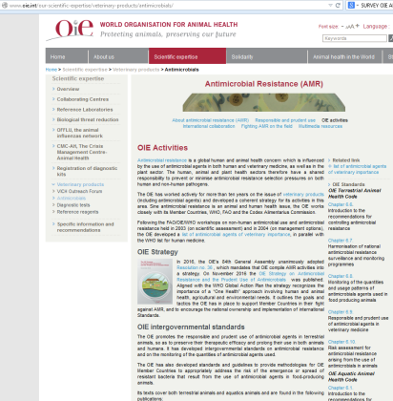
Update on Publications : OIE Annual Report on the use of antimicrobial agents in animals
http://www.oie.int/en/our-scientific-expertise/veterinary-products/antimicrobials/
Notes:
This report provides for the first time an overview of the global use of antimicrobial agents in animals. It presents the findings of the first annual reporting of data on the use of antimicrobial agents in animals, providing a global and regional analysis based on data ranging from 2010 to 2015.

Slide 19
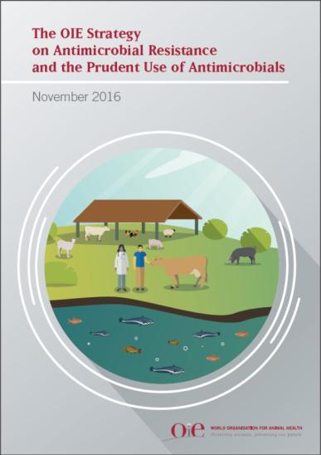
Update on Publications: OIE Strategy on AMR and Prudent Use of Antimicrobials
http://www.oie.int/fileadmin/Home/eng/Media_Center/docs/pdf/PortailAMR/EN_OIE-AMRstrategy.pdf

Slide 20
Update on Publication OIE Strategy on AMR and Prudent Use of Antimicrobials
Context
2015 Global Action Plan on AMR and the Tripartite Partnership
OIE World Assembly Resolutions on AMR in 2015 and 2016
OIE Strategy launched in November 2016
Outlines a consolidated work programme under key objectives aligned with the Global Action Plan
Objectives
Improve awareness and understanding
Strengthen knowledge through surveillance and research
Support good governance and capacity building
Encourage implementation of international standards
Notes:
The OIE Antimicrobial Resistance Strategy provides an important cornerstone to the success of this significant global undertaking, and well supports the OIE’s strategic commitment, “protecting animals, preserving our future”.

Slide 21
Thank you for your attention
Mária Szabó
m.szabo@oie.int

