Slide 1
Efficacy Requirements & Stability Studies
Animal and Plant Health Inspection Service
USDA Center for Veterinary Biologics
1920 Dayton Ave.
Ames, IA 50010
November 2017

Slide 2
Requirements for Licensure
Pure
Safe
Efficacious
Potent

Slide 3
Guidelines
VS Memorandum 800.50
Basic License Requirements
VS Memorandum 800.200
General Licensing Consideration
VS Memorandum 800.202
Efficacy Studies
VS Memorandum 800.203
Compatibility of Components

Slide 4
Efficacy vs Potency
Efficacy (immunogenicity):
Direct effect of a treatment on an individual subject
Pivotal host animal vaccination-challenge study
Potency:
Serial or batch measure
Direct or indirect

Slide 5
Product Potency
Live Virus Vaccine
Efficacy + 0.7 Log₁₀+ 0.5 Log₁₀ (or actual loss from the stability study)
Live bacterial Vaccine
Efficacy x 2
Killed or Inactivated Products
Efficacy serial or batch serial potency + actual loss from stability study

Slide 6
Efficacy Study Design
Experimental product for an Efficacy Study:
Outline of Production
Production facilities
Seed and Cell passage
Volume
Product quality

Slide 7
Challenge Design
Methods of Challenge:
Vaccination and Challenge
Natural Challenge
Natural Exposure

Slide 8
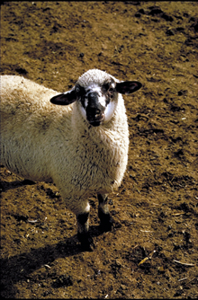
Efficacy Study Design
Subjects:
Enrollment Criteria
Identification
Environment
Number

Slide 9
Efficacy Study Design (cont.)
Group Assignment & Treatment:
Experimental unit
Group assignment
Treatment allocation
Group proportion
Describe vaccine trial

Slide 10
Efficacy Study Design (cont.)
Experimental Unit Passive/Active Immunity:
Dam -
Vaccination of dam for the passive protection of offspring.
Adult-Neonate unit -
Vaccination of dam and her offspring for the protection of offspring.
Individual Unit -
Vaccination of dam & the offspring for active and passive protection.

Slide 11
Efficacy Study Design (cont.)
Observations:
Time and Frequency
Blinding or Masking
Masked treatment allocation
Masked group membership
Clinical observations
Lab measurements
Postmortem examinations

Slide 12
Efficacy Study Design (cont.)
Study Outcome:
Outcome specification
Case definition
Severity categorization
Natural scale of measurement
Primary outcome
Single primary outcome for each label claim
Composite observations – if clinically relevant

Slide 13
Efficacy Study Design (cont.)
Describe Data analysis:
Proposed method of analysis
Justification of appropriateness
Define Conclusion criteria

Slide 14
Efficacy Report Submission
Submit:
All data
Adverse event report
Lab procedures
Serological outcomes

Slide 15
Efficacy Criteria – Label Claims
This product has been shown to be effective for the vaccination of healthy (insert name of species) X weeks of age or older against (insert name of agent or disease). For more information regarding efficacy and safety data, see productdata.aphis.usda.gov.
Single tier label claims – Generic claim with study data on our website.

Slide 16
Efficacy Criteria

Slide 17
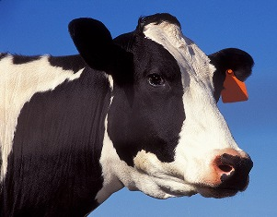
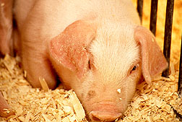
Host Species

Slide 18
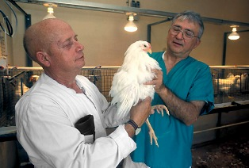
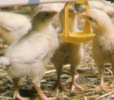
Vaccination Route of Administration

Slide 19
Treatment Regimen

Slide 20
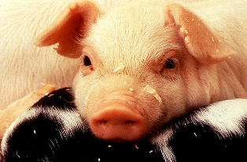
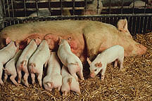
Type/Form of Disease

Slide 21
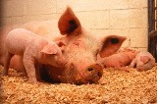
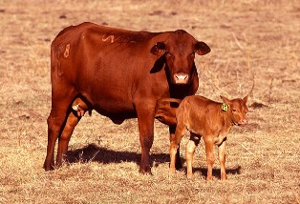
Maternal Antibody Interference
If maternal antibody interferes with immunization of young animals, then:
Data to demonstrate efficacy in the presence of expected antibody levels
Recommend revaccination when interfering levels are no longer present

Slide 22
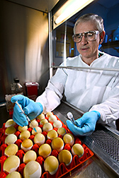
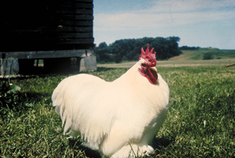
Immunity Claim
Specific claims
Onset of immunity
Duration of immunity (DOI)
Rabies Vaccine
Specific label claims are made relative to product DOI
“New” product fractions

Slide 23
Vaccine Stability

Slide 24
CVB potency testing framework
Data-driven Criteria
Consistent Principles
Coherent System

Slide 25
CVB potency testing framework
Data-driven – Test criteria based on experimental and observed data, rather than arbitrary standards.
Consistent – General principles consistent across all classes of assays and products.
Coherent – The various elements of a potency testing system must work together in a coordinated way.

Slide 26
Potency test specifications
Throughout-dating specification The minimum potency required at any time during the dating period
Release specification – The minimum potency required for lot release
Dating period – The period of time during which a lot may be marketed (“shelf life”)
Release
Throughout-Dating
Dating Period

Slide 27
Potency test specifications
A change in one specification affects the others

Slide 28
Potency test specifications
A change in one specification affects the others
Assay variance affects each

Slide 29
CVB Stability
Stability – Effect of time on the potency of a product stored under specified conditions.
(Does not consider other product characteristics.)
Stability indicating assay – Validated analytical procedure that can detect quantitative changes in the potency of the product over time.
(Many potency assays are not stability-indicating.)

Slide 30
CVB Stability
Stability Study Required
New licenses (“confirmation of dating”)
Later changes to dating period or the release or throughout-dating specs
Significant changes to the potency test
Significant changes to the product

Slide 31
CVB Stability
Stability Study Design
Use stability-indicating assay (Many potency tests are not stability-indicating)
Use three representative lots
Begin test sequence immediately after fill or final formulation (Sharpest drop in potency is usually at the start of storage)
Test sequence – 3, 6, 9, 12, 18, 24 months, and annually thereafter for longer dating periods

Slide 32
CVB Stability
Stability Study Analysis
Estimate precision of potency test
Assay + manufacturing variance
Estimate mean potency degradation profile
Profile may be obscured by imprecision

Slide 33
CVB Stability
Set Potency Specifications
Throughout dating spec
Pivotal potency – potency of lot used in pivotal efficacy study
Potency variance – rewards assay and manufacturing precision
Release spec
Add mean potency loss over the desired dating period, or…
Dating period
Set dating period for desired mean potency loss allowance

Slide 34
CVB Stability
Stability Monitoring
After stability study is completed, test intermittent lots near the end of dating
Other Considerations
Stability of test system, particularly relative potency assays that rely on references

Slide 35
Questions?

