Slide 1
The expectations from VICH Outreach Forum members. A perspective from Argentina
5th VICH Conference – Reaching to the World
MV Carlos FRANCIA
CAPROVE – Cámara Argentina de Productos Veterinarios

Slide 2
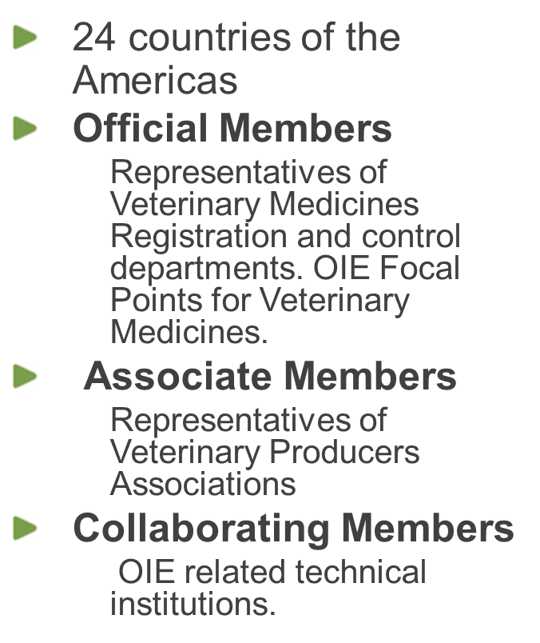
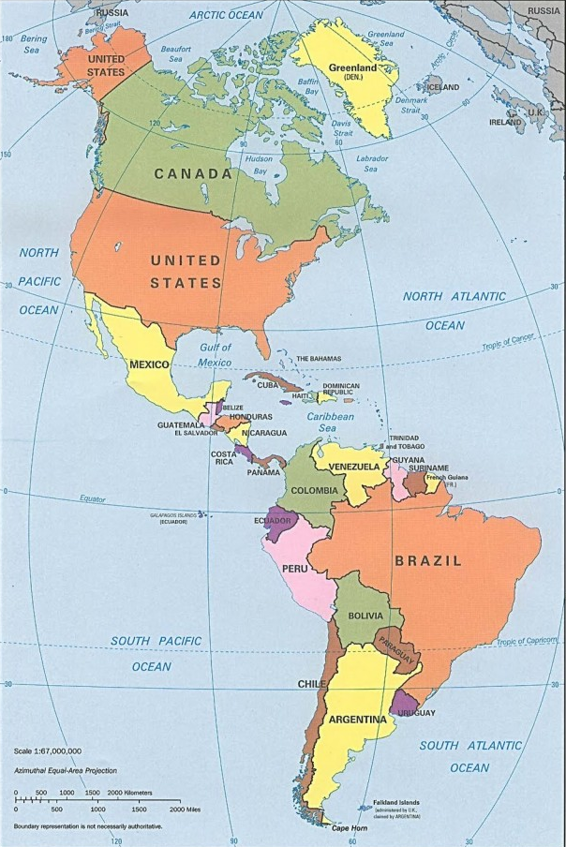
Introduction
CAMEVET Regional Organization

Slide 3
Introduction
What do all CAMEVET countries share?
A veterinary medicines register system based on the «new product» concept. Every product, innovative or not, are under the same kind of requirements.
A local veterinary industry (stakeholders) with different development degrees. This defines the balance between imported and exported veterinary products.

Slide 4
Argentina situation
Argentinian Veterinary Industry as example
Pretty well developed, with three different goals:
Global market
Regional market
Local market.
This situation defines different, even contradictory, scenarios and expectations

Slide 5
Shared points
Recognize, share and evaluate the information generated in the global harmonization process.
To be aware about the new requirements implementation as soon as possible in order to evaluate what would be the impact in the local veterinary industry
To participate in the harmonization of new technical guidelines and whenever a variation take place, in order to include in it, whenever it’s possible, the regional specific requirements.
To set clear and technically founded requirements to facilitate the organization of clinical and safety tests that are mandatory to register a new product.

Slide 6
Final Goal
More predictability in the local regulatory environment
The harmonized GLs are seen as useful instruments
To set clear and technically well defined requirements
To orient investments

Slide 7
Process
GL adoption and adaptation
Everyone must be flexible and open minded about the way every GL is adopted and adapted to the local environment.
Time line
Equivalence criterion?

Slide 8
Thanks a lot!

