Slide 1
REGISTRATION SYSTEM –ARGENTINA
VET Laura Sbordi
NATIONAL DIRECTORATE FOR AGROCHEMICALS, VETERINARY PRODUCTS AND FOOD

Slide 2
REGISTRATION SYSTEM IS BASED ON REGULATIONS
Legislation/regulation is the unique source for registration requirements.
Regulations need a long administrative process to be established, ammended or withdrawn.
Recommendations are not a current tool.
Thus, Regulatory Authorities just suggest through informal ways following recommendations such as VICH GLs.
Assesing how to formally recommend those valuable tools.
Notes:
First of all I’d like to highlight that Any requirement for registration of a veterinary product in our country has legal bases, via a regulation. It depends on the importance of the issue, the level of the regulation. Then, our legal base consists on lawss and decrees, signed by president, resolutions signed by ministries and dispositions signed by national directors .
So, New requirements led to new regulations or perhaps to a modification of the existing norm or even the withdrawn of the current one. Those changes implies a long administrative process.
Recommendations such as guidelines or guidance documents on how to meet the registration requirements are not current use in our country.
Therefore, the adopted VICH GLs (3, 48 and 49) are strongly but informally recommended by the regulatory authorities. I mean they are not actually mentioned in our web site or within a regulation, but they are being recommended via conferences, presentatios, when developing studies to support a dossier.
By now formal recommendation is under study.

Slide 3
LEGAL FRAMEWORK - BACKGROUND
1967: LAW 13636 & DECREE 583- registration of veterinary products and manufactures became mandatory.
90’s: MERCOSUR generated the core of our VPs legislation = MERCOSUR VPs application form.
-1995 Biosafety requirements for laboratories producing biological VPs were set.
-1999 National Commission for Agricultural Biotechnology was set. It evaluates vaccines involving GMO.
From 2000 till now, additional regulation updated our regulatory frame:
GMP for VPs : 2002
Complementary requirements for VPs registration.
Dietary supplements 2014
Notes:
In 1967 the 583 Decree established the obligation of registrating veterinary products as well as manufacters and facilities.
During the 90s MERCOSUR developed the main aspects of VP legislation in our country. It developed the current application form wich is called Mercosur application form for Pharmaceutical Veterinary Products as well as its homonimous for Biogical Veterinary Products.
From year 2000 and on, several regulations updated the regulatory frame for VPs registration. The main topics covered were GOOD MANUFACTURING PRACTICES for VPs, complimentary requirement for registration, new application forms for dietary supplements and cosmetics.
Regarding biologicals, main topics developed were……

Slide 4
APPLICATION FORMS FOR VETERINARY PRODUCTS
By definition a VP includes a wide variety of products intended for veterinary medicine: pharmaceuticals, biologicals, diagnostic kits, cosmetics and dietary supplements.
A suitable application form is currently available to fit each cathegory:
PHARMACEUTICALS (1994)
BIOLOGICALS (1994)
COSMETICS (2002)
DIAGNOSTIC KITS (2003)
DIETARY SUPPLEMENTS (2014)
Notes:
According to legislation

Slide 5
NEW VETERINARY PRODUCTS VS OLD VETERINARY PRODUCTS
For registration purposes, «all VPs are considered as New Products»
Bioequivalence does not fit to current registration form.
Anyway there is a tacit criteria to label a product as
«original/new VP» or «tradicional/old VP/formulations»
How to deal with this?
New products must comply all requirements with original studies
Old products must comply all requirements with either studies or bibliographic data. It depends on each requirement.
Notes:
-Another differencial characteristic to highliggt in our registration system is that …..for registrations …….
But without the Word “new” . They are just a VP. We don’t have “new animal drug” and “another new animal drug”.
So we don´t use bioequivalence for registration purposes. It does not fit to….
Having said that, we do have a tacit criteria to asses a VP as ….
I’ll give you some examples: a new product coulb be the tulatromicina presented 3 o 4 years ago. On the other hand a long lasting oxitetracicline 20 % is an old product. WE do know its pharmacodinamic, its pharmacokinestics, etc.
How to deal….

Slide 6
SPECIFIC REQUIREMENT FOR BOTH VPs, «new» as well as «old»
Stability studies.
Food safety, either ADI or MRLs establishment, are relied on international bodies: CODEX ALIMENTARIUS or on EMA, FDA as well.
Food safety concerning withdrawal times need to be demonstrate for all products with a residue depletion studies for parenteral/intrammary and pour on formulations.
Specific efficacy trials are recquired for FMD, mange, ticks and melophagus acoording to local regulations and must be performed in our country.

Slide 7
DIFFERENCES FOR «ORIGINAL» VS «OLD VPs»
Some waivers for «old products»:
Confirmatory residue depletion studies are accepted for old VP.
Veterinary drugs with no Codex MRLs nor EMA/FDA but with an ADI could apply for national MRLs. Extremely difficult situation.
Bibliographic data are accepted for TAS
Bibliographic data are accepted for efficacy (antiparasitic products excluded).
Notes:
Finally, here we have some examples of waivers for old products.
To support WT, confirmatory resdiue depletion studies are accepted for old VPs instead of traditional studies that involve 16 animals, 4 sampling time points, and a high cost. Confirmatory studies just reduce the trial to 6 animals, 1 sampling time point and sometimes only the target tissue processed.
-Then, there is a special case when an old veterinary drug hasn’t a Codex MRL or an EMA or FDA MRL but it has an international ADI established. Then it could apply for national MRLs. But this is an extremely difficult situation because it could develope trade problems for our country when exporting comodities or VPs. Some countries does not authorized a VP if it hasn’t a CODEX/EMA/FDA MRL. Some times we have to intensify the residue control of our commodities to avoide trade problems when exporting to a country that hasn´t an authorized use of that molecula.

Slide 8
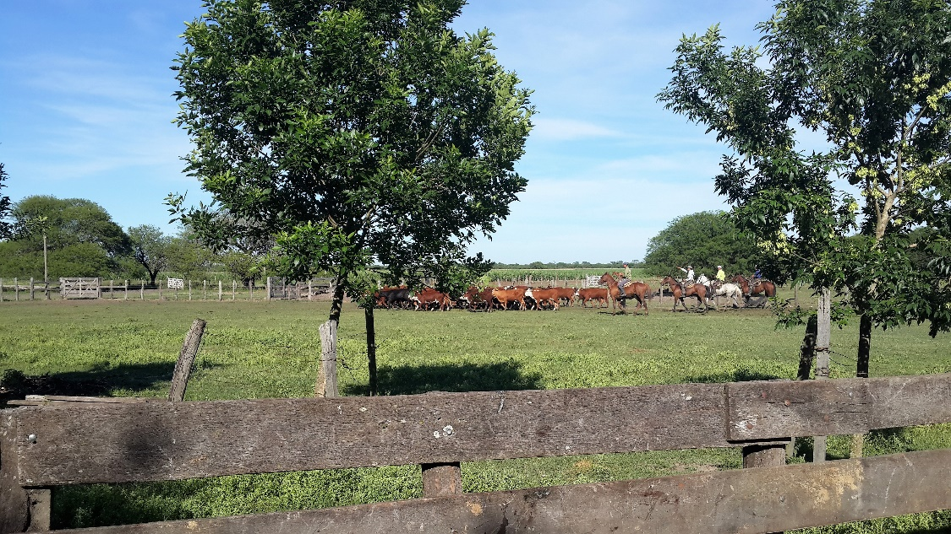
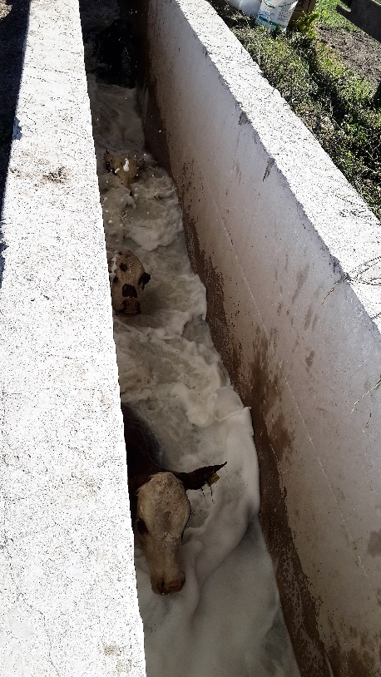
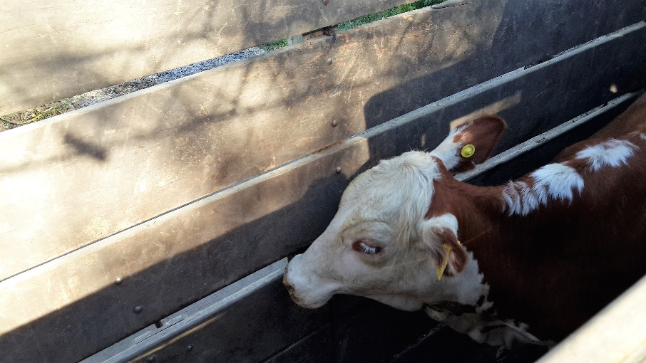
Old product / new formulation

Slide 9
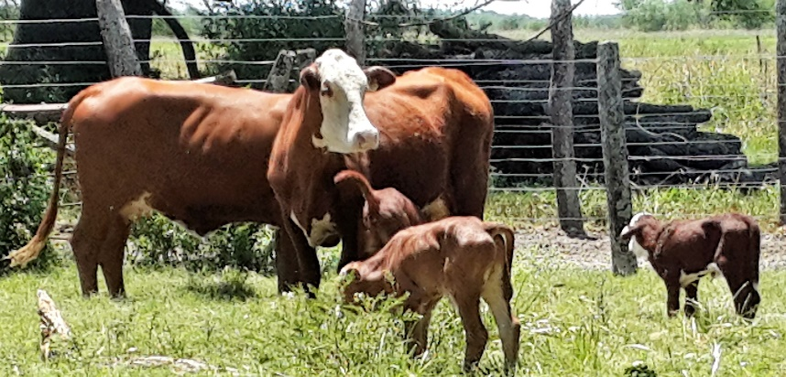
THANK YOU!
Vet. Laura Sbordi
lsbordi@senasa.gob.ar

