Slide 1
Veterinary Pharmacovigilance Discussion
Veterinary Outreach Forum
February 2017
Linda Walter-Grimm, DVM
Center for Veterinary Medicine
Office of Surveillance and Compliance
linda.walter-grimm@fda.hhs.gov
240-402-5762

Slide 2
Veterinary Pharmacovigilance
Pharmacovigilance (PV) is defined by the World Health Organization as the science and activities related to the detection, assessment, understanding and prevention of adverse effects or any other drug-related problem

Slide 3
Veterinary Pharmacovigilance: Historical Scope of Harmonization Efforts
EMA – drugs and biologics
Japan MAFF – drugs and biologics
FDA CVM – drugs and product problems
USDA CVB – biologics
Canada VDD – drugs
Canada CCVB - biologics

Slide 4
VICH Pharmacovigilance Harmonization Achievements
International Harmonization of Reporting Veterinary Adverse Events
GL24 AE Terms, Definitions, Management
GL29 PSUR Standardization, Management
GL42 Data Elements for Submission of AE
GL30 Controlled Lists of Terms (24 lists!)
GL35 Electronic Standards (Data Transfer)
http://www.vichsec.org/guidelines/pharmacovigilance.html

Slide 5
Pharmacovigilance Group Discussion
Please describe or give a brief overview of your country’s pharmacovigilance process.
Does your country have a single, centralized pharmacovigilance reporting site?
Is adverse drug event reporting mandatory (by regulation) or voluntary?
How do reporters submit ADE reports and to whom? Do they predominantly utilize paper forms, or is there an electronic reporting option (computer form or phone app?)
What challenges does your country experience in either obtaining information or utilizing the information you receive?

Slide 6
Pharmacovigilance Group Discussion
What processes/systems are in place for reviewing and analyzing ADE data?
Do you have an information sharing platform to communicate adverse event concerns or counterfeiting?
Are there opportunities for regional cooperation? If so, how is this being achieved?
Promoting pharmacovigilance – how is this being accomplished?

Slide 7
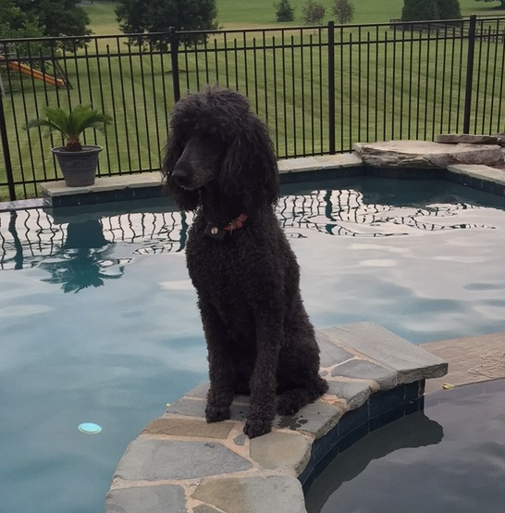
Thank you!

