Slide 1
Enabling The Business of Agriculture – Livestock Indicator
Presenter: Edna Massay Kallon (ekallon@worldbank.org)
VICH 5 Conference, October 28, Tokyo, Japan

Slide 2
PRESENTATION STRUCTURE
Brief history and summary of the World Bank Group Enabling the Business of Agriculture (EBA) project
Description of areas covered by the EBA – Livestock Indicator and selected preliminary data from the pilot year
Lessons learned and next steps
While this session relates to the industry, the EBA project incorporates multiple perspectives including that of the industry.

Slide 3
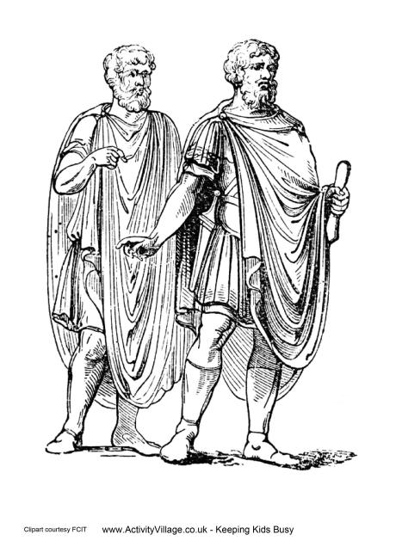
THE VALUE OF BENCHMARKING
You [Socrates] have discovered the reasons why some farmers are so successful that husbandry yields them
all they need in abundance, and others are so inefficient that they find farming unprofitable. I should like to hear the reasons in each case, in order that we may do what is good and avoid what is harmful.
Xenophon, 4th Century BC
Notes:
Benchmarking helpful to identify best practices and improve performance in agriculture, but also useful for fostering policy learning and change: effective strategy for policy makers.
International influences, such as actions and experiences of other countries in making policy changes, play a critical part in catalyzing policy shifts.
By allowing cross-country comparison of practices and conditions, benchmarking indicators can point to issues in a country’s enabling environment for agriculture, helping to raise awareness among policy makers and other stakeholders. In fact, the more that cross-country benchmarking reveals weaknesses in domestic policies—often through quantitative indicators exposing poor performance in international rankings—the less difficult it is for reform-oriented policy makers to justify the need for change.
Benchmarking indicators may serve as a source of negative feedback, by measuring poor performance by a country in certain areas—but they also offer prospects for positive feedback as performance improves. Both types of feedback can be important in spurring recognition of the need for policy change. Moreover, benchmarking indicators provide a ready source of information on viable alternatives, another aspect shown to be essential in encouraging policy change.

Slide 4





king Public Procurement
hISTORY of the EBA project
June 2012
G8’s call for the World Bank “to develop options for a Doing Business in Agriculture Index”
October 2012
WBG senior management committed to merging the efforts of the Agriculture Global Practice with those of the Global Indicators Department to develop a benchmarking product
January 2013
EBA officially launched (6 core topic, 10 countries)
November 2014
EBA progress report published
(http://eba.worldbank.org/).
Notes:
The Doing Business indicators have been used extensively by policymakers as a guide for reforms in the area of business regulation for several years. Doing Business measures the ease of doing business in 189 countries based on measures of regulatory quality, agency efficiency and compliance cost to the private sector. By providing quantitative data to compare business regulation environments across economies and over time, Doing Business encourages countries to strive towards more efficient regulation. It offers measurable benchmarks for reform and serves as a resource for investors, analysts, and others interested in the business climate of each country. It is a flagship product produced in partnership by the World Bank and IFC that garners worldwide attention on regulatory barriers to entrepreneurship.

Slide 5
WHAT THE EBA IS AND DOES
A Tool for Improved Policy Making
Provide policy makers with an evidence-backed tool
for measuring and monitoring relevant policies and regulations that shape the enabling environment
for local and regional agriculture related businesses (e.g. producers, input suppliers, output distributors)
Comparable
&
actionable
indicators
Notes:
The aim is to develop and offer a tool which will allow countries not only to compare their enabling environment for agribusiness to others’, primarily in terms of policies and regulations, but to track their own progress over time. By providing comparative data on their regulatory framework with that of others, it highlights areas which require attention for improving the agribusiness enabling environment.

Slide 6
EBA TOPIC AREAS
Crop specific production inputs (Seeds, Fertilizer, Machinery)
Agricultural Finance
Agricultural Land
Agricultural Markets
Water
Livestock specific production inputs (AnGR, veterinary medicinal products, feed resources)
ICT
Transporting agricultural goods
Gender and Environmental Sustainability

Slide 7
Country Selection

Slide 8
PRESENTATION STRUCTURE
Description of areas covered by the EBA – Livestock Indicator and selected preliminary data from the pilot year
Brief history and summary of the World Bank Group Enabling the Business of Agriculture (EBA) project

Slide 9
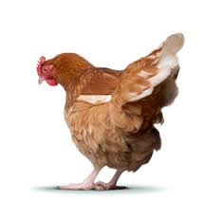
WHY EBA LIVESTOCK INDICATOR: AN EXAMPLE
On January 16th, 2015, Nigeria notified the World Organization of Animal Health (OIE) of an outbreak of the Asian strain of the highly pathogenic avian influenza virus. The disease quickly spread to Niger, Cote d’Ivoire, Ghana and Burkina Faso negatively impacting production costs, livelihoods, trade and business revenues. In Burkina Faso, the Elevages Moablaou poultry farms located 26 km outside of Ouagadougou, was severely hit by the outbreak. Mr. Abou Simbel Ouattara, founder and owner of the company, was required to cull and burn his entire flock. Mr. Ouattara essentially lost his 28-year old business.

Slide 10
EBA LIVESTOCK INDICATOR TOPIC AREAS
Indicators are developed around factors impacting doing business in the livestock sub-sector and the safety and quality of production inputs.
Selected data points are included to assess the existence and quality of specific infrastructure and systems such as gene banks, testing laboratories and databases.
Indicators do not address specific livestock value chains nor specific livestock species.
Livestock Genetic Resources Availability and Conservation
Livestock Disease Prevention and Control
Feed Resources Safety
Notes:
Tested issues related to food safety but the decision was made to look solely at inputs specific to animal product

Slide 11
DESIGN AND IMPLEMENTATION
Technical note, consultations and design of indicators
Creation of questionnaire and data collection
Analysis of data and creation of report
Academia/Research institutions
Private sector
The voice of the industry is incorporated along with the voices of other private sector actors
Public sector
Notes:
Public Sector examples
Ministry of agriculture or livestock, medicines regulatory agency
Private sector examples
Industry
Lawyers
Business owners

Slide 12
EBA 2014-2015 CYCLE & PILOT OF LIVESTOCK INDICATOR
EBA 10 (2013 – 2014)
EBA 40 (2014 – 2015)
Notes:
East Asia and Pacific (EAP): Cambodia, Loas PDR, Myanmar, Philippines and Vietnam
Europe and Central Asia (ECA): Bosnia & Herzegovania, Georgia, Kyrgz Republic, Russian Federation, Tajikistan, Turkey, Ukraine
Latin America & Caribbean (LAC): Bolivia, Colombia, Guatemala, Nicaragua
Middle East and North Africa: Jordan, Morocco
OECD Countries: Chile, Denmark, Greece, Poland, Spain
South Asia (SAS): Bangladesh, Nepal, Sri Lanka
Sub-Saharan Africa (SSA): Burkina Faso, Burundi, Cote D’Ivoire, Ethiopia, Ghana, Kenya, Mali, Mozambique, Niger, Rwanda, Sudan, Tanzania, Uganda, Zambia

Slide 13
Livestock Indicators Area: Genetic Resources
Livestock Genetic Resources Availability and Conservation
Breeding Laws and Regulation
Conservation of Genetic Resources
Importing Genetic Resources

Slide 14
Selected Preliminary Data: Livestock Genetic Resources
As the report is not yet published, we kindly ask that you please refrain from sharing or utilizing the data presented until the report is released. Changes may occur.

Slide 15
Livestock Indicators Area: Animal Health
Livestock Disease Prevention and Control
Harmonization and Mutual Recognition schemes
Information Availability
Importation
Registration of Vaccines

Slide 16
Selected Preliminary Data: Disease Prevention and Control
*Registration time for Zambia and Nepal not available
As the report is not yet published, we kindly ask that you please refrain from sharing or utilizing the data presented until the report is released. Changes may occur.

Slide 17
Livestock Indicators Area: Feed Resources
Feed Resources Safety
Laws and Regulations
Existence and Accreditation of testing laboratories
Labelling Requirements

Slide 18
Selected Preliminary Data: Feed Resources Safety
As the report is not yet published, we kindly ask that you please refrain from sharing or utilizing the data presented until the report is released. Changes may occur.

Slide 19
PRESENTATION STRUCTURE
Lessons learned and next steps
Description of areas covered by the EBA – Livestock Indicator and selected preliminary data from the pilot year
Brief history and summary of the World Ban Group Enabling the Business of Agriculture (EBA) project

Slide 20

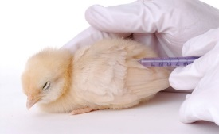
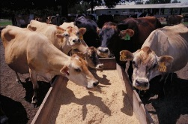
LESSONS LEARNED: SPECIFIC INDICATOR AREAS
Animal Genetic Resources Availability and Conservation
Feed Resources Safety
Livestock Disease Prevention and Control
Importing of genetic resources will be clarified
Perspective of the regulators will be incorporated into market authorization methodology
Regulations related to feed production to be added
Quality of animal disease database to be developed
Assessment of the efficiency and capacity of harmonized registration systems to be addressed
Availability and quality of information related to market authorization processes to be measured
Selected case studies into pharmacovigilance systems will be included
Market structure metrics related to breeding will be included (e.g. # of breeding associations, and species coverage)
Registration of manufacture animal feed resources to be incorporated
Importing data points dropped as not seen as an issue
Notes:
All EBA indicators cover common regulatory areas:
Institutional framework
Market entry
Operations

Slide 21
NEXT STEPS (Tentative) : 2015-2016 EBA CYCLE
EBA 10 (2013 – 2014)
EBA 40 (2014 – 2015)
EBA 60 (2015 – 2016)

Slide 22

THANK YOU!

