Slide 1


Session 5: 3Rs statement
VICH5 Conference, October 2015, Tokyo

Slide 2
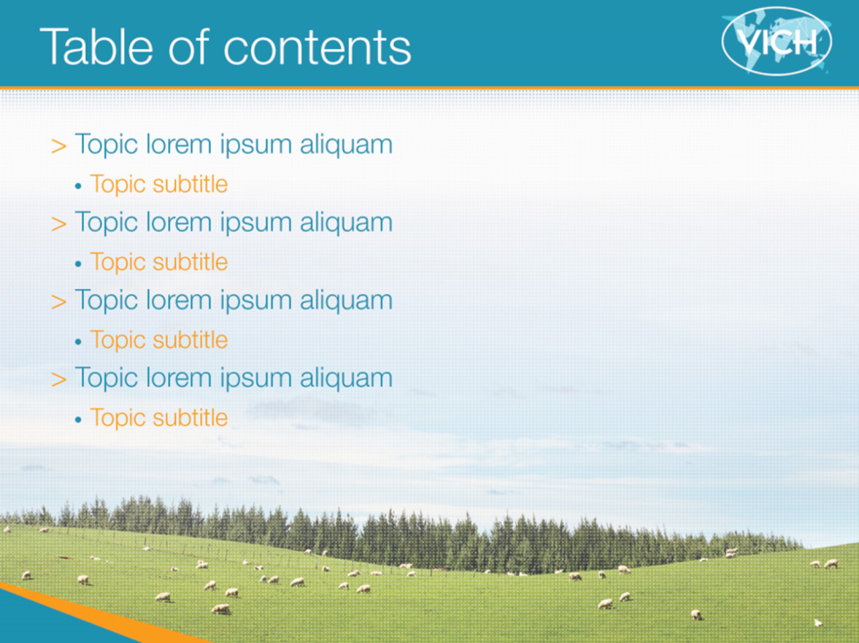
The 3Rs:
Replacement
Reduction
Refinement
of animals used for regulatory testing

Slide 3

3Rs: Replacement, Refinement, Reduction
Replacement: testing approaches that avoid or replace the use of live animals (eg, in-vitro tests)
Reduction: approaches that minimise the number of animals being used (eg, by maximising the information obtained per animal)
Refinement: modification of a procedure to minimise the pain, suffering, distress or lasting harm experienced by the animal (eg, use of anaesthetics)

Slide 4
Animal welfare
Ethical and animal welfare considerations require animal use to be limited as much as possible
Harmonisation of requirements means that the same animal studies are acceptable in different regions - avoids unnecessary tests
VICH goes beyond that…

Slide 5
A VICH objective
The VICH will:
Establish and implement harmonized technical requirements for the registration of veterinary medicinal products in the VICH regions, which meet high quality, safety and efficacy standards and minimise the use of test animals and costs of product development.
…

Slide 6
Statement of principle
In 2007, the VICH Steering Committee agreed a “Statement of principle on 3Rs”, expressing support for the 3Rs principle and recognising that its international status and influence provides a unique opportunity to encourage the use of alternative methods
Reflected in organizational charter: Expert Working Groups developing guidelines involving animal testing have a specific responsibility to consider the possibilities for replacement, reduction and refinement of animal testing
=> VICH guidelines are written – and updated – with the 3Rs
considerations firmly in mind

Slide 7
Examples
VICH GL32 – Developmental toxicity testing:
  A tiered approach: testing only required in second species if no teratogenicity seen in first species
VICH GL48 – Marker residue depletion studies to establish product withdrawal periods
  If withdrawal period will clearly be driven by injection site, then two injections can be administered per animal (on different days) in order to obtain injection site data from two time points per animal
VICH GL47 – Laboratory animal comparative metabolism studies
  Use of in vitro metabolism tests (primary hepatocytes, liver microsomes, whole cells…) in examining metabolite profile

Slide 8
3Rs concerns may be the driver
VICH GL23(R) – genotoxicity testing
  Considering the need for a default in vivo test
VICH GL22 – reproduction toxicity
  Investigate the case for allowing an extended one generation reproduction toxicity study as alternative to 2 generation test
VICH GL50 – harmonisation of criteria to waive TABST for inactivated vaccines
  After 10 batches the test can be waived

Slide 9
VICH in 3Rs
VICH has a positive role to play in relation to 3Rs:
Harmonisation of data requirements reduces repetitious testing and the number of animals used
VICH requires consideration of 3Rs in development of its guidelines

Slide 10
VICH Statement of Principle
At its 19th meeting on 23-24 January 2007 in Washington D.C., USA, the VICH Steering Committee reiterated its ambition to minimise animal testing and specifically expressed its support for the 3Rs principle – replacement, refinement and reduction of animals in research.
VICH has always striven to eliminate repetitious and unnecessary testing through harmonisation of regulatory requirements for the registration of veterinary products, a goal that undoubtedly leads to a reduction in the number of animals used for product development and registration.
While the validation of alternative testing protocols falls outside the remit of VICH, the Steering Committee recognises that the international status and influence of VICH provide a unique opportunity to encourage the use of validated alternative methods. To this end, Expert Working Groups developing guidelines involving animal experimentation have a specific responsibility to consider animal welfare, and particularly the possibilities for replacement, refinement and reduction of animal testing

Slide 11


The VICH public website
(http://www.vichsec.org)
11
Notes:
11

Slide 12

Thank you

