Slide 1


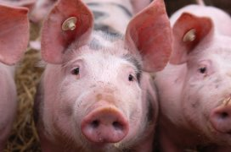
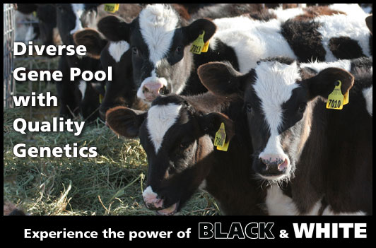

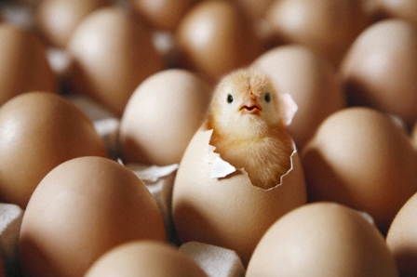
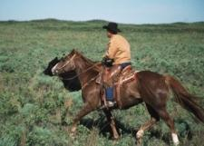
Regulatory Perspective on Trends
in Veterinary Biologics
Byron Rippke, DVM
Nancy Clough, DVM, PhD
Director, Center for Veterinary Biologics
U.S. Department of Agriculture
Animal and Plant Health Inspection Service
November 2015

Slide 2

Predominating Trends
Increased pressure to bring products to market more quickly
Increased interest in customized biologicals to meet regional or individual needs
Notes:
We have seen many product innovations and regulatory challenges in recent years, but the two predominating trends I’ll focus on today are the increased pressure to bring products to market more quickly and and increased interest in customized biologcals.

Slide 3

Regulating at the Speed of Change
Increased pressure to bring products to market as quickly as possible:
    Highly mutable agents
    Emerging diseases
    Novel technologies
vs.
USDA’s mission to ensure licensed products are pure, safe, potent, and effective

Slide 4
Conditional Licenses
This product license is conditional. Efficacy and potency test studies in progress.
9 CFR 102.6
To meet emergency conditions, limited market, local or special circumstance
Reduced requirements for proof of efficacy (“reasonable expectation”) but otherwise must meet all licensing requirements for full licensure
Notes:
Historically the USDA had limited regulatory options to expedite product licensure except for conditional licenses.

Slide 5
Conditional Licenses:
Limitations
This product license is conditional. Efficacy and potency test studies in progress.
Special labeling to disclose conditional status, no trade names
Restricted distribution—requires permission from State or importing authorities
Annual or biannual license renewal
Conditionally licensed fractions cannot be mixed with fully licensed fractions
Once a similar product has full license, no additional conditional licenses are issued
Notes:
The conditional license has several restrictions and shortcomings.

Slide 6

Influenza virus changes
Veterinary Services Memorandum 800.111, first published in 2007
Arose from need to keep vaccine Seeds up to date with rapid, frequent virus shift/drift
Once manufacturer has a full license for killed product, can add, remove, exchange Seeds of same HN type(s) in expedited manner
Requires only similar serological response. No large-scale field safety
Updated product receives full license
Notes:
In 2007 we published guidance on expedited processes to update influenza virus isolates in killed equine and swine influenza vaccines.

Slide 7
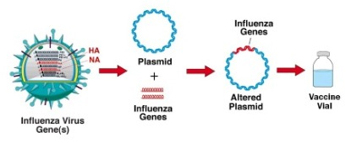
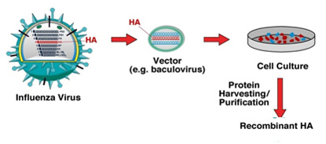
Platform Technology
VS Memorandum 800.213, first published 2013
Inactivated, non-replicating protein or nucleic acid vaccines (any agent) from recombinant technology
Unchanging part of vector construct + consistent manufacturing method = production platform
Can prepare limitless vaccine constructs differing only in inserted gene sequence
Notes:
The idea of an expedited process for swapping out Seeds to meet emerging disease needs was expanded beyond influenza viruses in 2013. With the mainstreaming of vectored vaccines, we published guidance for using an established vector system and standardized production and product formulation methods to expedite strain changes for potentially any agent, not just influenza viruses. The platform system also streamlines licensing of vaccines against new agents (not just strain changes).

Slide 8
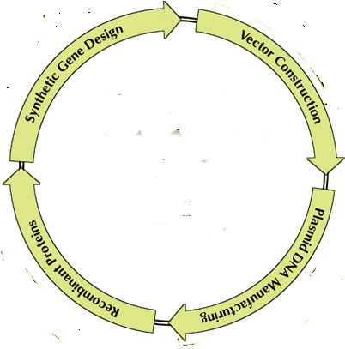
Production Platforms
First license using a defined platform-- traditional requirements
Subsequent licenses for same platform expedited
Depending on similarity of new insert to licensed insert(s):
  Abbreviated inactivation kinetics
  Abbreviated field safety studies
  Abbreviated risk assessment
Notes:
The reduction in time to licensure depends on the similarity of the new gene insert to one that has been previously licensed. Strain changes for the same agent experience the greatest streamlining, but even genes from new agents benefit from the “recycling” of an accepted production platform.

Slide 9
Production Platforms
Platform-based Seeds (vector + gene insert) that only have reasonable expectation of efficacy (“conditional” license) may be combined with fully licensed Seeds from same platform
May be eligible for conditional license even if similar full licenses exist
Notes:
Eligibility criteria for conditional licensure (i.e., only a reasonable expectation of efficacy) is the same for platform and conventional products, but a benefit of developing a conditionally licensed platform product is that multi-valent combinations can be licensed while the new agent is still in conditional status.

Slide 10

Emerging Diseases
Recent examples: Pandemic H1N1 influenza (2009), porcine epidemic diarrhea virus (2013), H3N2 canine influenza viruses (2015)
To expedite product licensure, USDA obtained, tested Master Seeds for direct distribution to biologics manufacturers. Applicants could use these Seeds in product development with minimal or no additional testing.
Provided challenge virus and standardized challenge protocol for PEDV
Notes:
Another service we have recently provided to firms is a pre-tested Master Seed or a challenge isolate/protocol for emerging diseases—this can shorten licensing time by several months.

Slide 11
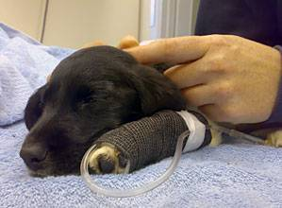
Products for Grave Diagnoses
Niche products for diseases with grave diagnoses (e.g., cancer) may be conditionally licensed on limited efficacy and safety data with expectation more will be gathered
Typically evaluated in well-controlled clinical trials with rolling enrollment
Notes:
We typically provide additional regulatory flexibility for products intended to treat diseases with grave prognoses, such as cancer. Efficacy data are often generated in clinical trials, sometimes being compared to historical control data. Initial safety data often include those animals enrolled in the clinical trial, plus a few healthy animals. We proceed to conditional licensure as soon it appears the product has some efficacy and is reasonably safe use.

Slide 12
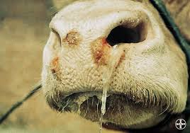
Products for Emergency USDA Use
Foreign animal diseases
Can be used under exemption with no license/permit (9 CFR 106.1)
BUT current goal is to use only licensed product in emergencies
Increased reliance on pre-existing foreign dossiers and other streamlined processes to justify conditional licenses or restricted import permits for emergency use
Notes:
Products solely for emergency USDA use, such as those for a foreign animal disease incursion, may be used by the USDA under an exemption with no license/permit or review by the biologics program. There is increasing expectation, however, for emergency products to be reviewed and accepted by the USDA prior to use in U.S. livestock. To this end, we have used regulatory flexibility to issue conditional licenses or permits for emergency products based on detailed review of foreign dossiers (increased reliance compared to other products) and other streamlined requirements.

Slide 13
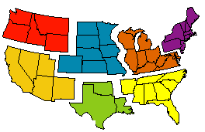
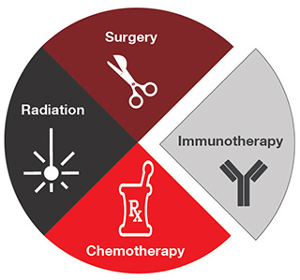
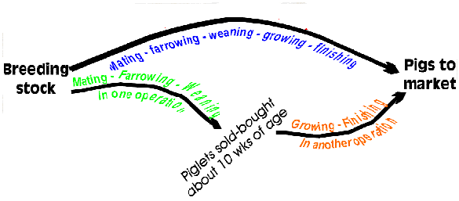
Customized Biologicals
To meet distinct needs in:
  A geographic region
  An integrated animal production system
  Individual animals
Notes:
The second regulatory trend I’d like to discuss today is an increased demand for customized biologicals. This may involve vaccines specific for a specific geographical region or the need to standardize vaccinations across diverse geographical regions because of animal movement in integrated production systems. It also involves the ever-expanding arena of autologous cancer therapeutics.

Slide 14
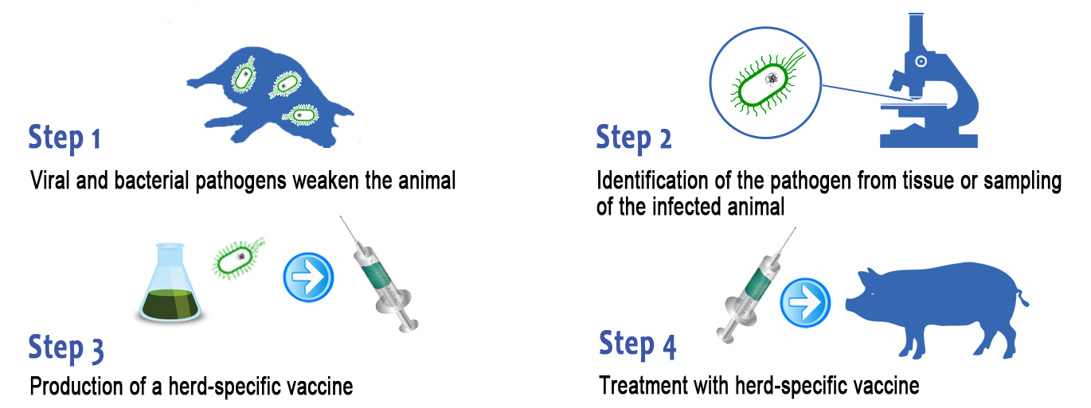
Autogenous Products
9CFR 113.113 and VS Memo 800.69
Traditional Seeds
Open-ended license to make conventional vaccine from an isolate from a source herd
Purity tested only. No efficacy or safety testing.
Can only be used in source herd and adjacent premises
Notes:
Historically the only regulatory mechanism for custom products was via autogenous products. Autogenous regulations have very specific requirements as to where the Seed may be obtained and where the product may be administered. Autogenous products are only tested for purity, not efficacy or safety.

Slide 15

Prescription Products
VS Memo 800.213 (added 2015)
Open-ended license to create custom recombinant formulations based on established production platform
Requires prescribing veterinarian
Serials (batches) tested for safety, purity. Vet assumes liability for efficacy.
Gene sequence for platform Seed may be obtained from prescribing veterinarian or other epidemiological data
Notes:
Just this year we published guidance to allow for a new class of customized product called Prescription Product. The Prescription Product differs from autogenous in that the scope of administration is determined by a prescribing veterinarian and not exact geographical location. The manufacturer also tests for safety in addition to purity. The gene sequence for the custom Seed does not necessarily have to come from a source herd isolate and is subject to the discretion of the prescribing vet.

Slide 16
Prescription Products
May be used in geographically distant sites, as veterinarian deems appropriate.
May include gene sequences animals are at risk for exposure but not yet in herd
Prescription fraction may be combined with fractions licensed for non-prescription products
Notes:
Another key component of the Prescription Product is that is may be combine custom-prepared Seeds with other commerically available vaccine Seeds.

Slide 17
Prescription products
Restricted labeling—similar to conditional
Restricted distribution—only by State permission
Individual serial (batch) release by USDA
License issued for 2 years, subject to renewal
Notes:
Prescription product does have many similarities to Conditional licenses, however.

Slide 18

Autologous cancer therapeutics
Immunotherapy as an adjunct to other cancer treatment
Vaccines prepared from patient’s tumor cells stimulate immune response against same cells
Custom products prepared in small quantity solely for administration to the same patient are considered a laboratory
service and NOT regulated
as biologicals by the USDA
Notes:
We have seen a large increase in inquiries regarding autologous cancer therapeutics. We have determined, however, that this is a lab service and not a regulated biologic.

Slide 19
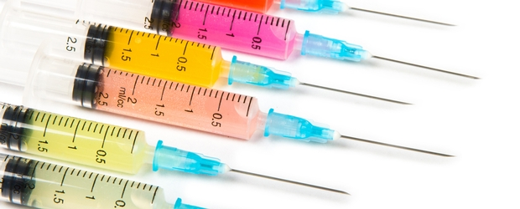
Summary
Expediting time to licensure
  Conditional licenses
  Streamlined updates of influenza strains
  Production Platforms
  USDA provides Seeds for emerging diseases
  Products for USDA emergency use
  Products for grave diagnoses
Custom Products
  Autogenous products
  Prescription products
  Autologous cancer therapeutics

Slide 20
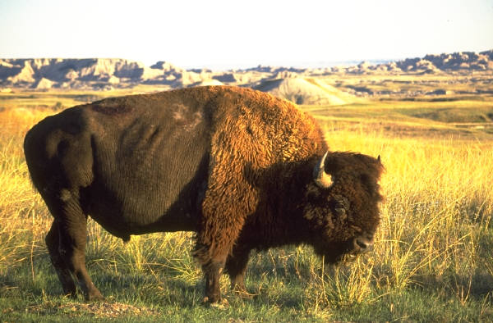
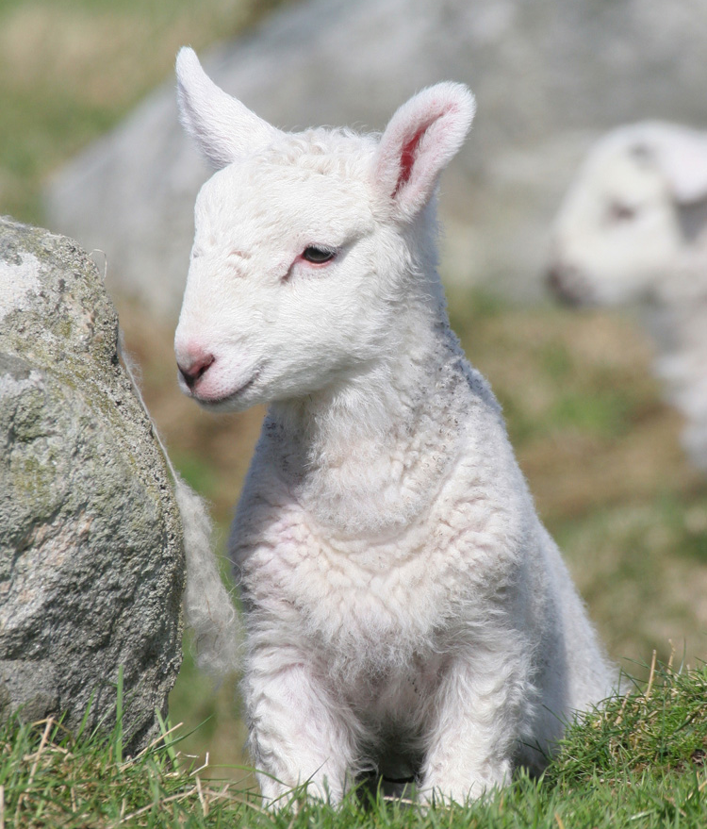


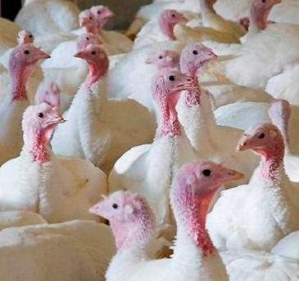
Questions?

