Slide 1


VICH and veterinary medicines availability
VICH5 Conference, October 2015, Tokyo
Jean-Pierre Orand, ANSES, France, OIE Reference Centre

Slide 2
Why Veterinary Medicines are not available ?
VMPs are essential for animal health, for producing safe food, for economical development… for human health
Quality, efficacy and safety of VMPs are also essential
Need for a minimum of studies, clinical trials, requirement for manufacturing, for surveillance (pharmacovigilance) to be sure that risks for animal health, human health and environment are managed
Studies, clinical trials represent high investment for industries and need a long time.

Slide 3
Why Veterinary Medicines are not available ?
Costs to develop a VMP
It takes a long time to develop a new product :
  7.5 years for farm animal products,
  4.3 years for companion animal products,
  4.0 years for MS minor species products.
And the direct costs are high :
  €8.0M-€50M for farm animal products,
  €5.0M-€48M companion animal products,
  €0.5M-€20M for Minor Species products.
Data based on a 2011 IFAH survey in Europe.

Slide 4
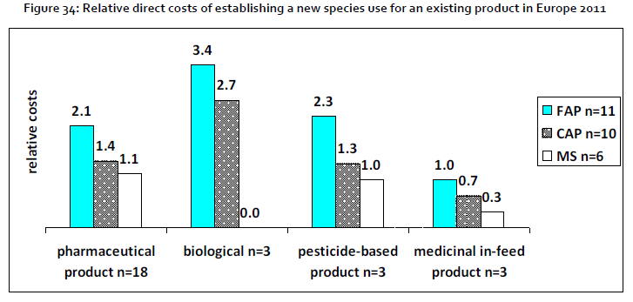
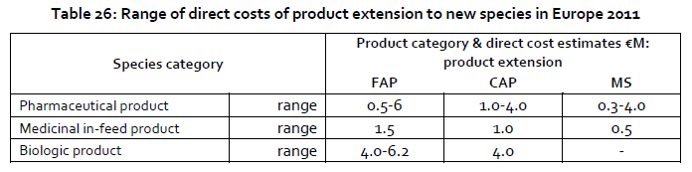
Costs to develop VMP – new species

Slide 5
Why Veterinary Medicines are not available ?
Each country has its own specificities:
  Regarding the animal population (aquaculture in Asia is more developed)
  Regarding the animal diseases (FMD, IA… different serotype in different regions)
  Specific requirement for registration (studies, labelling..)
  Specific regulation, specific fees….
If the market is not sufficient, industry will not invest and develop products
Need of a balance between economical cost of product development and safety and efficacy of a product

Slide 6

Goals of VICH
VICH establishes harmonized technical requirements for registration of veterinary medicinal products thereby reducing or obviating duplication of testing carried out during the research and development of veterinary medicines
To avoid divergent future requirements through harmonisation of selected topics
To contribute to the protection of public health, of animal health from an international perspective;
Notes:
6
Harmonized protocols for studies needed by regulatory agencies to demonstrate product safety, efficacy, and quality

Slide 7
Goals of VICH
VICH aims at a wider dissemination and acceptance of VICH guidelines and co-operation on a more global level. Its objective is a wider international harmonisation of technical requirements, which is, through the VICH Outreach Forum implemented in June 2012
Objectives of the global Outreach:
  international harmonisation,
  better access to VMPs,
  mutual recognition and regional approaches
Notes:
7
Harmonized protocols for studies needed by regulatory agencies to demonstrate product safety, efficacy, and quality

Slide 8

VICH =
International Cooperation
on Harmonisation of Technical Requirements
for Registration of Veterinary Medicinal Products (VMPs)
Full Members
Russia
Canada
EU
Ukraine
Korea
Japan
USA
China
Morocco
ASEAN
Taiwan
India
Thailand
Outreach
Forum
Mexico
UEMOA
Malaysia
Brazil
Australia/
New Zealand
CAMEVET
South
Africa
Argentina
Observers

Slide 9
VICH Objectives
Establish and implement harmonised requirements for veterinary medicines in the VICH regions, which
  Meet high standards of Quality, Safety & Efficacy to protect public health, animal health & welfare and the environment
  Minimise the use of test animals and costs of product development
Ensure efficient processes for maintaining and monitoring consistent interpretation of data requirements following implementation
Provide technical guidance enabling response to significant emerging global issues and science of relevance

Slide 10
VICH Guiding Principles
The decision making process in VICH should be through consensus between industry and competent authorities
Procedures should ensure the smooth and consistent functioning of the process for preparation, consultation and adoption of Guidelines
New topics for development of Guidelines requires acceptance of all full VICH members
Harmonised requirements should replace corresponding regional requirements
Transparent and cost-effective procedures, open for public comments
  Consultation by all regulatory authorities in VICH
  Consultation procedure by dissemination to OIE Member Countries through OIE
  VICH public website

Slide 11
VICH Guidelines
General (7)
  -GCP (1)
  -Pharmacovigilance (5)
  -File Format (1)
Biologicals (6)
-Quality (3)
-Target Animal Safety (3)
Pharmaceuticals (40)
  -Quality (14)
  -Efficacy (10)
  -Environmental Safety (2)
  -Metabolism and Residues (4)
  -Toxicology (7)
  -Target Animal Safety (1)
  -Antimicrobial Safety (2)

Slide 12
Achievements
Opportunity for regulators and industry to discuss topics, to jointly create review or update draft guidelines on regulatory requirements
  All VICH GLs are adopted by consensus
Reduce the use of animal testing
Wider harmonisation through the observers, Outreach Forum, opportunity to update regional standards
World wide harmonisation of requirements for development of Veterinary products, reduce development costs and therefore increase availability of Veterinary Medicines

Slide 13



Thank you for your attention!

