Slide 1
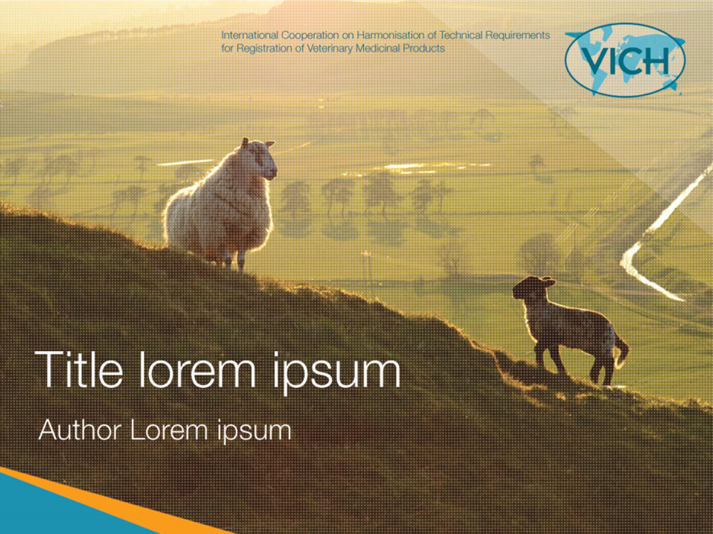

Session 9:
The Vision for the Future
Dr. Yuko Endo
JMAFF

Slide 2
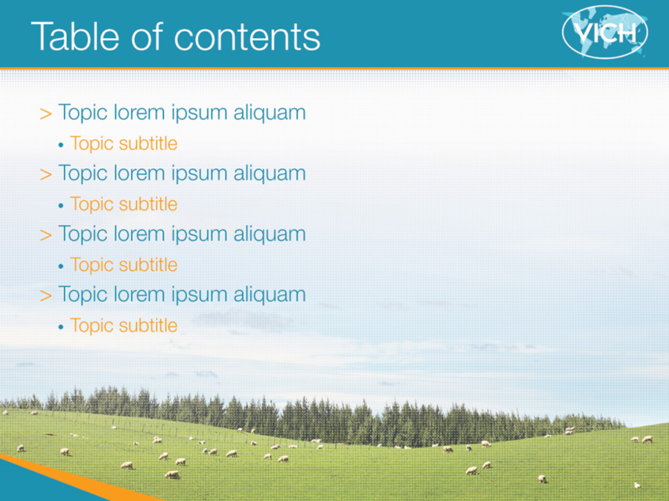
1. Outcome of VICH to the World
2. Phase 4 VICH Priorities (2016-2020)
3. Vision for the Future

Slide 3

Outcome of VICH to the World

Slide 4


VICH has contributed to VICH regions
Harmonization of technical requirements in VICH regions
VICH Guidelines (53 final GLs)
Pharmaceuticals (40)
-Quality (14)
-Efficacy (10)
-Environmental Safety (2)
-Metabolism and Residues (4)
-Toxicology (7)
-Target Animal Safety (1)
-Antimicrobial Safety (2)
Biologicals (6)
-Quality (3)
-Target Animal Safety (3)
General (7)
-GCP (1)
-Pharmacovigilance (5)
-File Format (1)

Slide 5
VICH has contributed to the VICH regions
Harmonization of technical requirements in VICH regions
VICH GLs are very useful for VICH regions to
Ensure product quality, safety and efficacy
Reduce animal testing and costs of development
Accelerate the development and reviewing process
Increase availability of new veterinary medicinal products
Contribute to animal/public health, environment

Slide 6
Great Outcome of VICH for participants
Industries and regulators
Situations in VICH regions
Latest Science
Full Discussion to reach the best consensus in SC, Task Forces and EWGs
Mutual understanding & Trust among VICH participants

Slide 7

VICH GLs are useful for non-VICH countries
VICH and OIE aim to disseminate the outcome of VICH to the World through VICH Outreach Forum.
Russia
Canada
EU
Ukraine
Korea
Japan
USA
China
Morocco
ASEAN
Taiwan
India
Thailand
Mexico
UEMOA
Malaysia
Brazil
Australia/
New Zealand
CAMEVET
South
Africa
Argentina

Slide 8
2. Phase 4 VICH Priorities

Slide 9
Draft-VICH Priorities Phase 4: 2016-2020
This presentation is made based on the draft 4 – VICH Priorities Phase 4: 2016-2020 (14 September 2015)
1. History
2. The Scope of VICH
3. Drivers behind the priorities for VICH phase 4
4. Priorities for the period 2016-2020
VICH Steering Committee will soon publish the phase 4 VICH Priorities for next five years (2016-2020) on the VICH website (http://www.vichsec.org/).

Slide 10
Draft-VICH Priorities Phase 4: 2016-2020
3. Drivers behind the priorities for VICH phase 4
The drivers for VICH phase 4 include:
Needs to produce/maintain VICHGLs
Desire to expand geographical reach of VICH (VICH Outreach Forum)
Desire for effective cooperation with the OIE
Drive to Harmonize Technical Requirements
Desire to Reduce the Use of Animals
Needs to recognize Threat of Antimicrobial Resistance (AMR)
Need for Efficient Use of Resources
Desire to Minimize the Cost of gaining Registration
Opportunity to benefit from ICH

Slide 11
Draft-VICH Priorities Phase 4: 2016-2020
4. Priorities for the period 2016-2020
VICH will continue the following key activities.
Establish VICH GLs
Update/revise VICH GLs
Collaboration with the OIE
Contribute the international efforts to minimize the risks of AMR*
Review guidance for pharmacovigilance reporting
*Task Force of Anthelmintics GLs discussed including resistance to endo/ecto-parasiticides.

Slide 12
Draft-VICH Priorities Phase 4: 2016-2020
4. Priorities for the period 2016-2020
VICH will expand activities in the following areas.
Wider International Harmonization (particularly VICH Outreach Forum)
Finalize a Communication and Training Strategy to raise awareness of the benefit of VICH
Consider the Needs and Priorities of non-VICH Countries about technical Requirements for the registration of VMPs
Identify Opportunities to Benefit from ICH Experience in the development of GLs
Analyze the Need for Developing Guidance on Registration Requirements for Veterinary Novel Therapy Products

Slide 13
3. Vision for the Future

Slide 14
Vision for the future
2015
2020
Future
2016-2020
(VICH Phase 4)
Reaching out to the World

Slide 15
Desirable Future World for People & Animals
All people, domestic animals, wildlife are in good health.
No hunger is in the world.
Environment is healthy and ecosystem functions well.
One Health
Human in good Health
Domestic Animals in good Health
Wildlife in good Health
Good Food Supply and Economies
Healthy Environment
Good Functioning Ecosystem
Notes:
Was OIE representative make excellent speech, wasn’t he?
As I hope to avoid duplication and/or diversity, I will show only one figure to you.

Slide 16
Probable VICH contribution to Health
Quick development of new VMPs.
VICH
Human Health
Animal Health
Good Food Supply
Environ-ment
Wildlife Health
Eco-system
Examples of Areas
-new infectious diseases
-zoonosis
-chronic diseases
-alternative toxicity tests
-improve QOL of animals
-novel therapy
Supply of VMPs with high quality, efficacy & safety.
Easily access to enough VMPs with fair price in all of the world.
Notes:
Was OIE representative make excellent speech, wasn’t he?
As I hope to avoid duplication and/or diversity, I will show only one figure to you.

Slide 17
Probable VICH contribution to Food Supply
Quick development of new VMPs.
VICH
Human Health
Animal Health
Good Food Supply
Environ-ment
Wildlife Health
Eco-system
Examples of Areas
-healthy growth & efficient production
-produce safe foods with high quality
-reduce residues of VMPs in foods
Supply of VMPs with high quality, efficacy & safety.
Easily access to enough VMPs with fair price in all of the world.
Notes:
Was OIE representative make excellent speech, wasn’t he?
As I hope to avoid duplication and/or diversity, I will show only one figure to you.

Slide 18
Probable VICH contribution to Environment
Quick development of new VMPs.
VICH
Human Health
Animal Health
Good Food Supply
Environ-ment
Wildlife Health
Eco-system
Examples of Areas
-VMPs with no harmful effects for ecosystem
-Easily degradable VMPs in the ecosystem
-Collection and adequate treatment of used VMPs
Supply of VMPs with high quality, efficacy & safety.
Easily access to enough VMPs with fair price in all of the world.
Notes:
Was OIE representative make excellent speech, wasn’t he?
As I hope to avoid duplication and/or diversity, I will show only one figure to you.

Slide 19
Vision for the Future
VICH Outreach have various possibilities,
for example,
-Regional dossiers and global dossiers with some regional differences
-Harmonized/aligned pharmacovigilance systems
Global regulatory convergence
VICH have a potential to contribute to the world sounder and happier through the outreach activity.

Slide 20
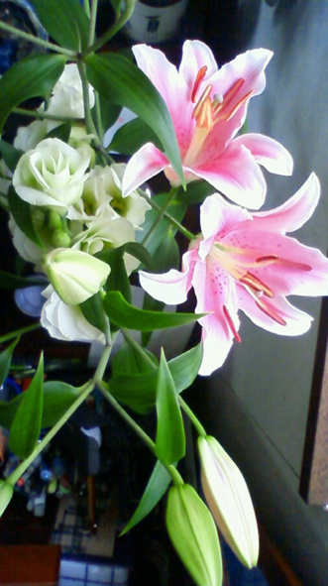
Vision for the Future
VICH welcome collaboration with non-VICH countries, and VICH sincerely wish to improve the health for both human and animals by supplying the VICH standards and knowledge for the world.

Slide 21
Thank you for your Attention!

